Slide 1
Status report of the DIRAC experiment (PS 212)
L.Nemenov
SPS Committee, April 3, 2012.

Slide 2








DIRAC collaboration
CERN
Geneva, Switzerland
Tokyo Metropolitan University
Tokyo, Japan
Czech Technical University
Prague, Czech Republic
IFIN-HH
Bucharest, Romania
Institute of Physics ASCR
Prague, Czech Republic
JINR
Dubna, Russia
Nuclear Physics Institute ASCR
Rez, Czech Republic
SINP of Moscow State University
Moscow, Russia
INFN-Laboratori Nazionali di Frascati
Frascati, Italy
IHEP
Protvino, Russia
University of Messina
Messina, Italy
Santiago de Compostela University
Santiago de Compostela, Spain
KEK
Tsukuba, Japan
Bern University
Bern, Switzerland
Kyoto University
Kyoto, Japan
Zurich University
Zurich, Switzerland
Kyoto Sangyou University
Kyoto, Japan

Slide 3
Content
Long-lived π⁺π⁻ atoms : data taking in 2011 for their observation and data processing schedule in 2012.
Status of the run 2012 preparation for the long-lived π⁺π⁻ atom observation.
3. Status and schedule of data (2008-10) analysis of K⁺π⁻, K⁻π⁺ and π⁺π⁻ atoms in 2012.
Multiple-scattering measurement during 2011 run
and data processing schedule.
5. Published results of π⁺π⁻ atom lifetime measurement.

Slide 4
DIRAC setup
Upgraded DIRAC setup
MDC - microdrift gas chambers, SFD - scintillating fiber detector, IH – ionization hodoscope. DC - drift chambers , VH – vertical hodoscopes, HH – horizontal hodoscopes, Ch – nitrogen Cherenkov , PSh - preshower detectors , Mu - muon detectors
Modifided parts

Slide 5
Extrapolation to the target
Notes:
5

Slide 6
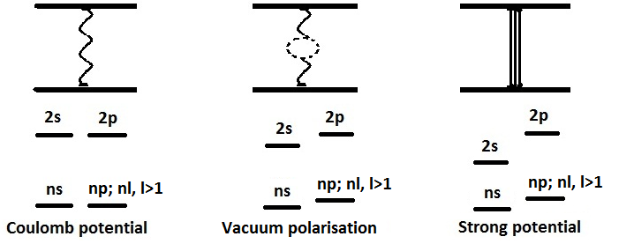



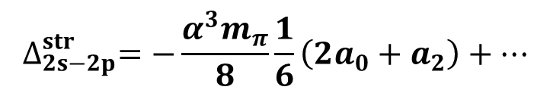


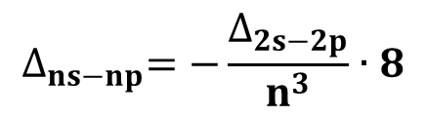
ENERGY SPLITTING MEASUREMENT
A_{2π} Energy Levels
J. Schweizer [PL B (2004)]
For Coulomb potential
E depends on n only.
$$∆_{2s−2p}^{str}=−0.47 eV$$
$$∆_{2s−2p}^{vac+str}=−0.58 eV$$
$$∆_{2s−2p}^{str}=−\frac{α^{3}m_{π}}{8}\frac{1}{6}\left(2a_{0}+a_{2}\right)+…$$
$$∆_{ns−np}^{}=−\frac{∆_{2s−2p}}{n^{3}}∙8$$
CONCLUSION: one parameter (2a₀+a₂) allows to calculate all Δ_{ns-np} values.

Slide 7
Long-lived π⁺π⁻ atoms
The observation of ππ atom long-lived states opens the future possibility to measure the energy difference between ns and np states ΔE(ns-np) and the value of ππ scattering lengths |2a₀+a₂|.
If a resonance method can be applied for the ΔE(ns-np) measurement, then the precision of ππ scattering length measurement can be improved by one order of magnitude relative to the precision of other methods.
7

Slide 8

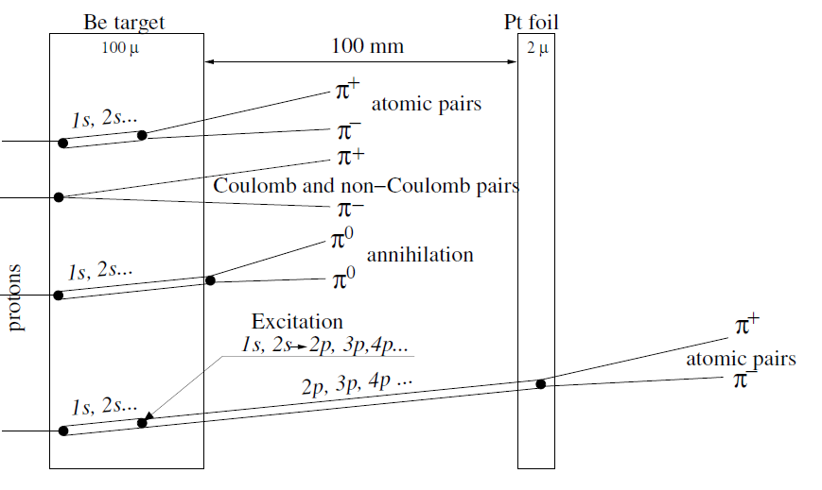

Slide 9
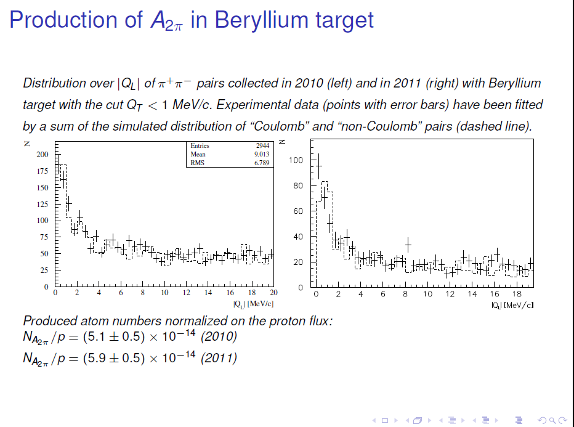

Slide 10
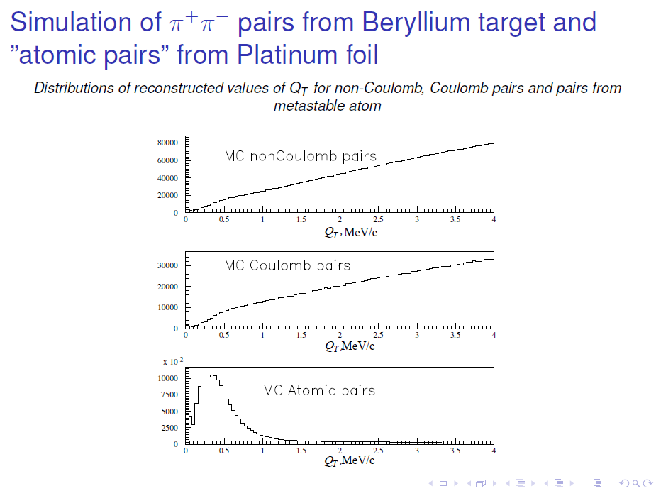

Slide 11
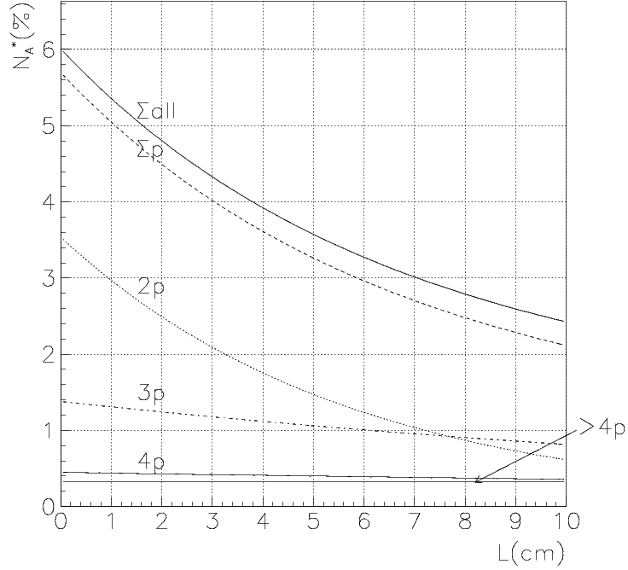
“Long-lived A_{2π}” yield and quantum numbers
L. Afanasev; O. Gorchakov (DIPGEN)
Atomic pairs from “long-lived A_{2π}” breakup in 2μm Pt.

Slide 12
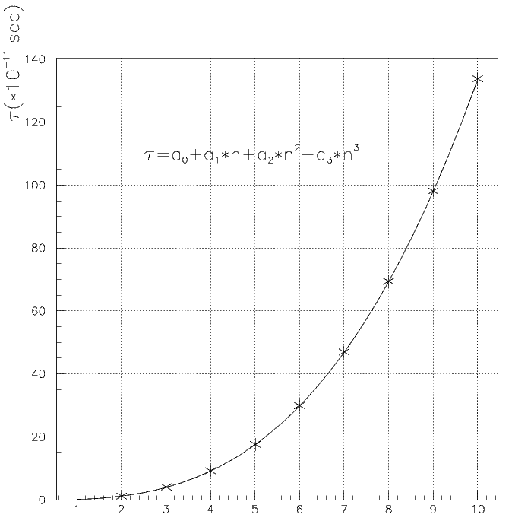
A_{2π} lifetime, τ, in np states
M. Pentia
n_{H} | τ_{H} •10⁸ s | τ_{2π} •10¹¹ s | Decay length A_{2π} in L.S. cm for γ=16.1
2p | 0.16 | 1.17 | 5.7
3p | 0.54 | 3.94 | 19
4p | 1.24 | 9.05 | 44
5p | 2.40 | 17.5 | 84.5
6p | 4.1 | 29.9 | 144
7p |  | 46.8* | 226
8p |  | 69.3* | 335
* - extrapolated values
CERN, Geneva - Monday 26, September, 2011

Slide 13
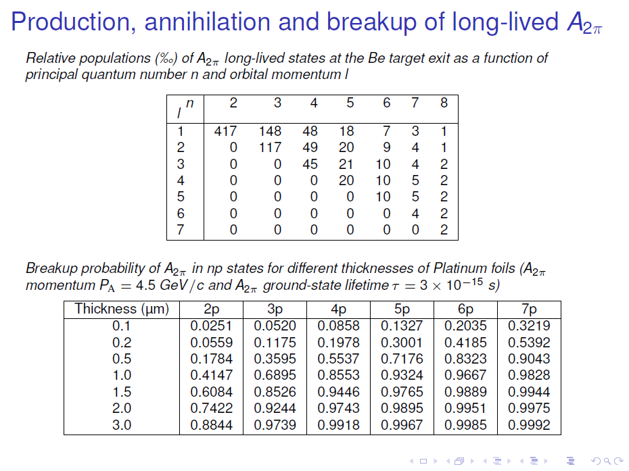

Slide 14
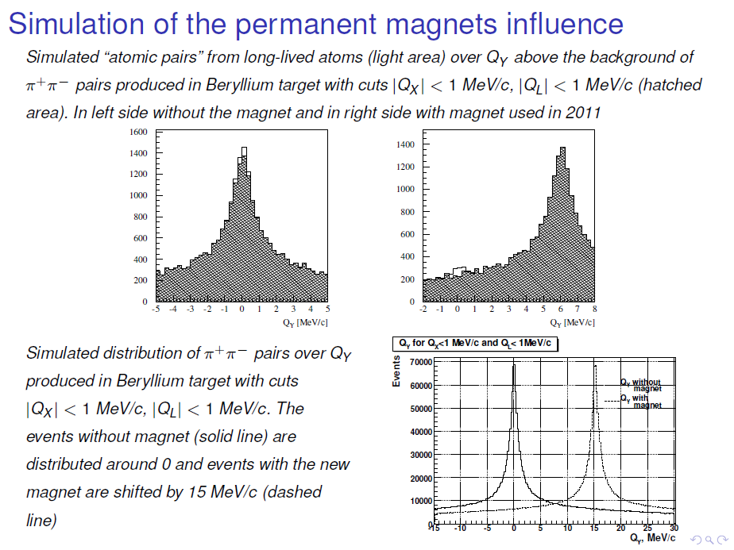

Slide 15
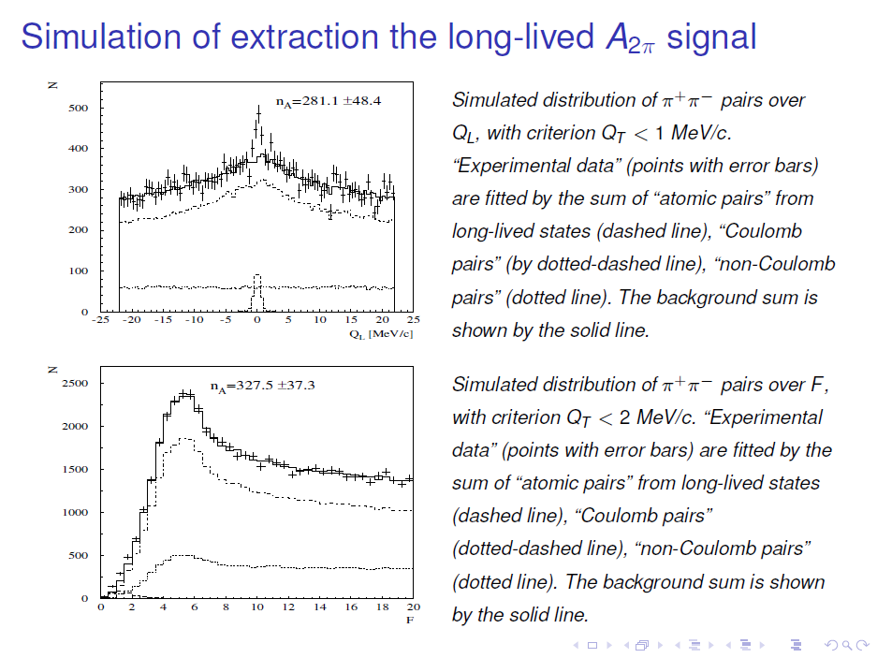

Slide 16
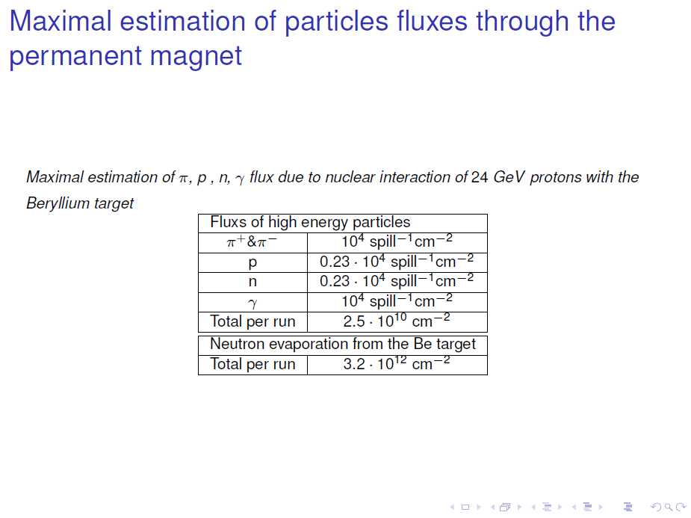

Slide 17
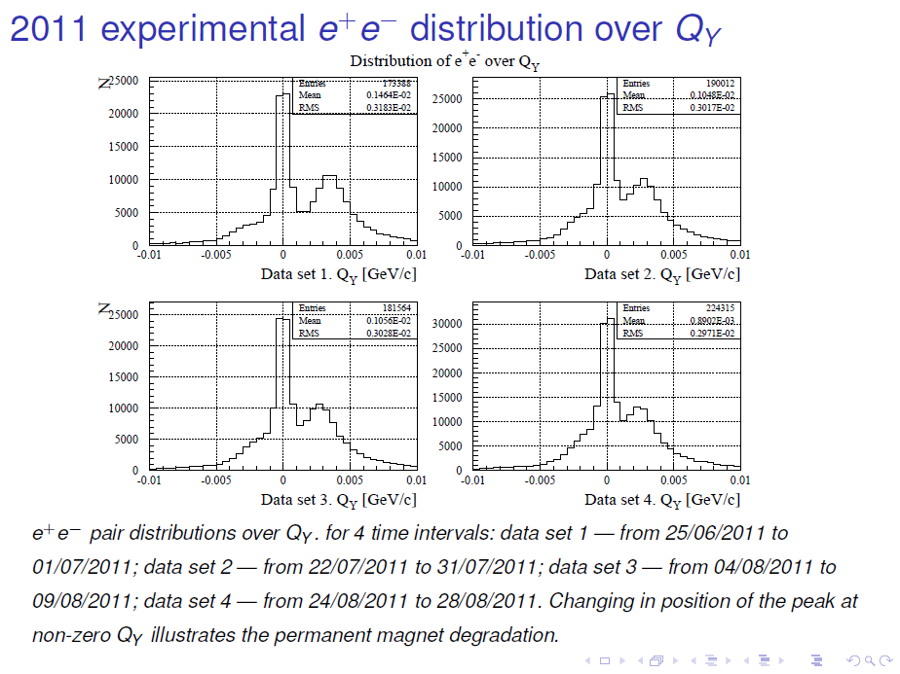

Slide 18
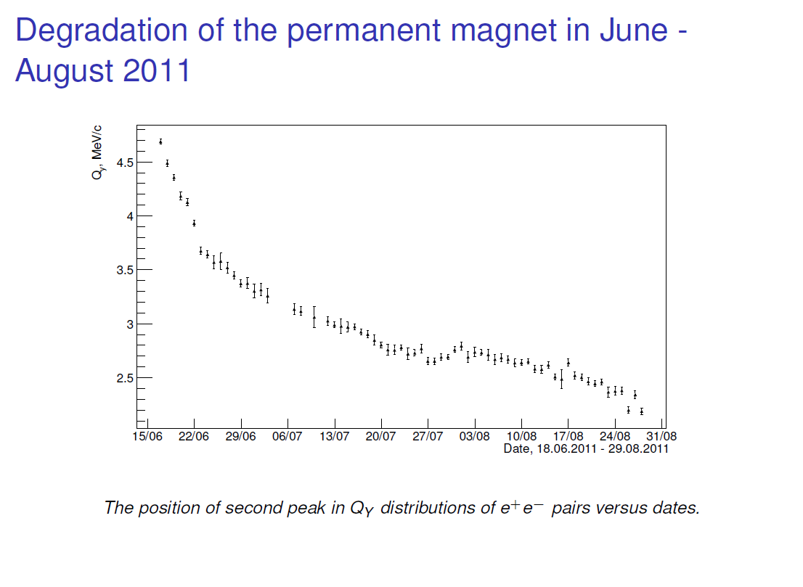

Slide 19
Plan of 2011 run data processing
End of data preselection : June 2012
Ntuple preparation completion : August 2012
Atomic pair signal from “long-lived atom” ionization without magnetic field is expected on the level of about 3.5 sigma.

Slide 20
Magnet for 2012 run
2 new magnets:
Sm₂Co₁₇, high resistivity against radiation,
BL = 0.02 Tm, expected signal > 9 sigma.
New retracting device allows to replace magnet fast.
Magnet will be ready in the middle of April.
Retracting device will be ready at the end April.

Slide 21
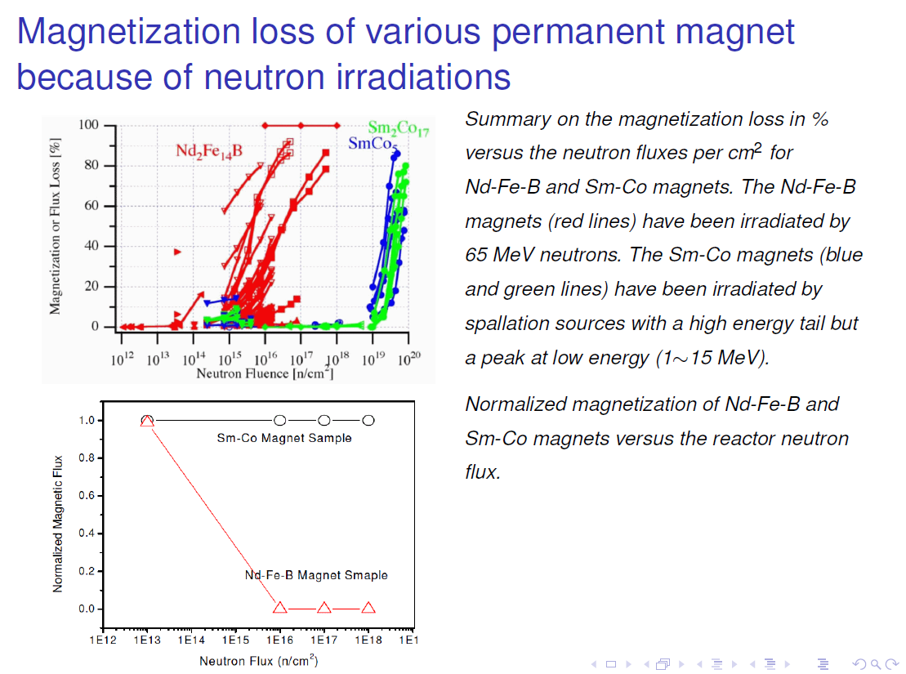

Slide 22
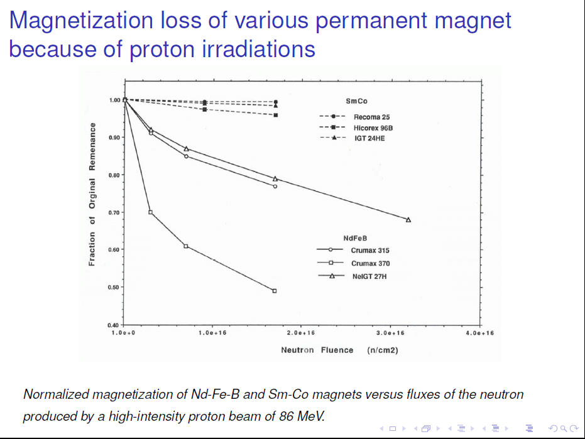

Slide 23
Permanent dipole magnet for DIRAC
Permanent magnet material: Sm2Co17
Alexey Vorozhtsov
CERN
TE-MSC-MNC

Slide 24
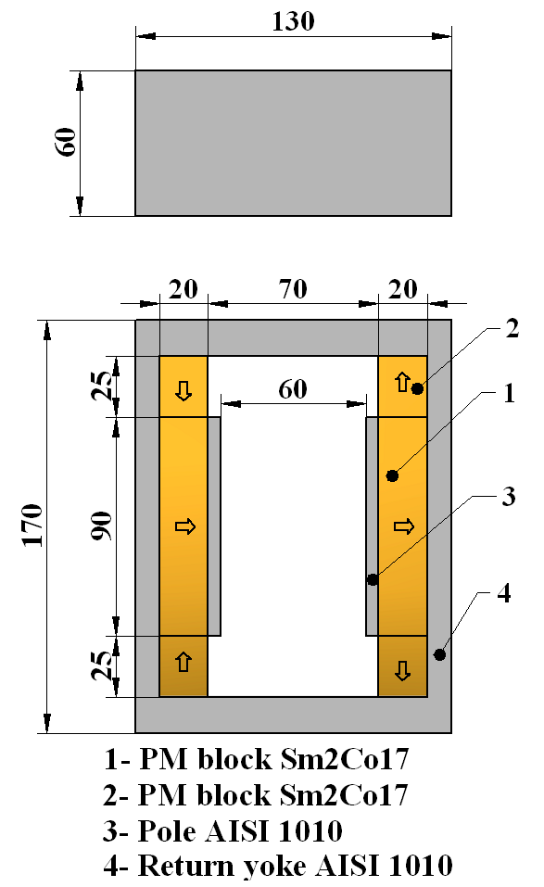
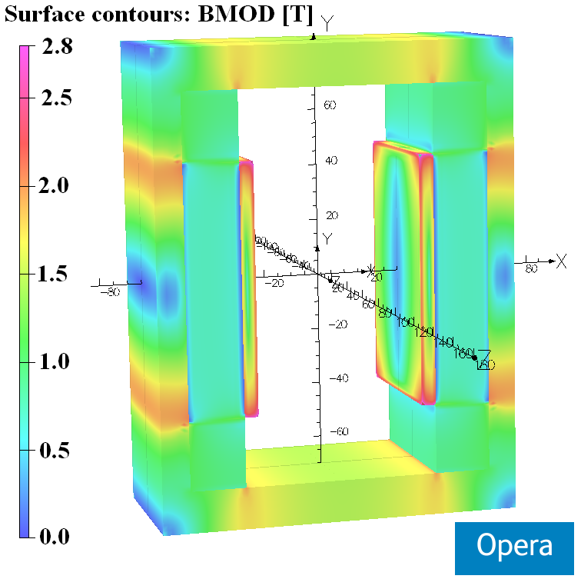
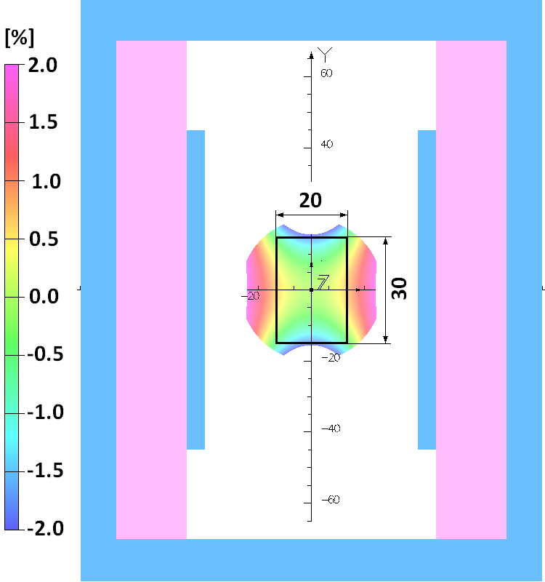
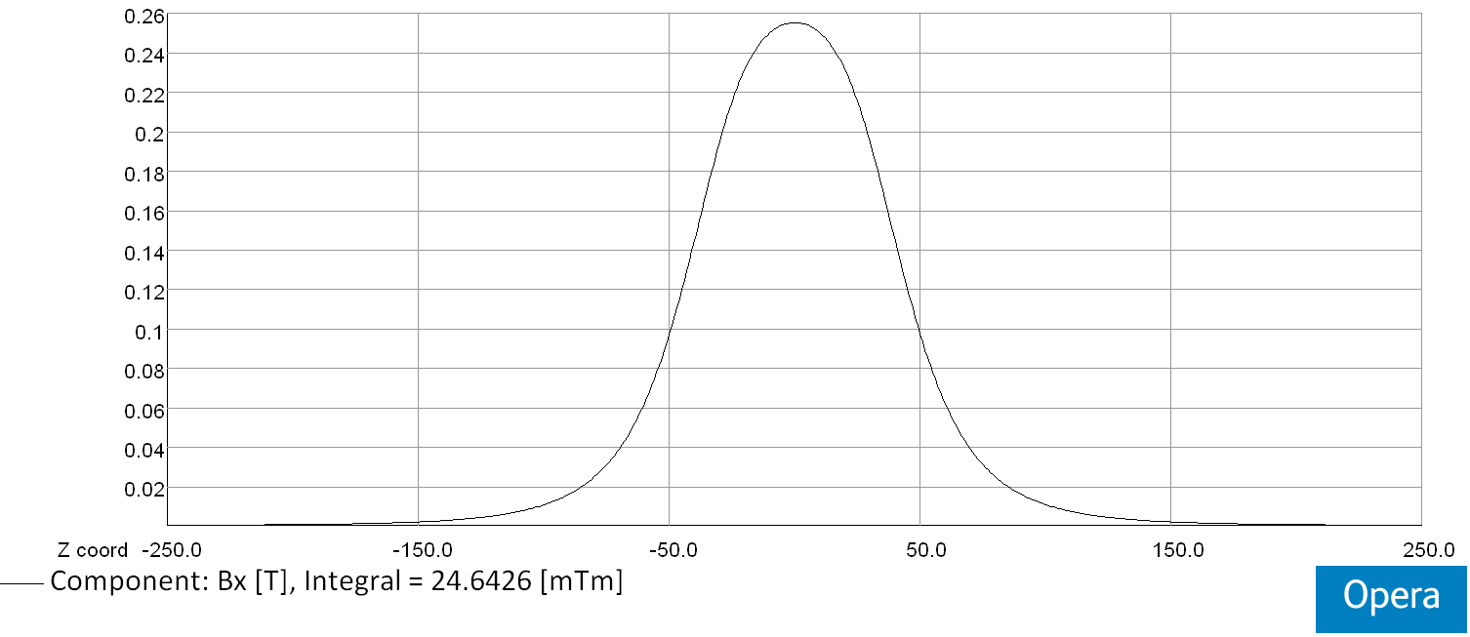
Magnet design
Layout of the dipole magnet
(arrows indicate the direction of magnetization)
Integrated horizontal field homogeneity
inside the GFR X×Y = 20 mm × 30 mm:
∆∫Bxdz/ ∫Bx(0,0,z)dz [%]
Opera 3D model
with surface field distribution
Horizontal field distribution along z-axis at X=Y=0 mm
∫Bx(0,0,z)dz= 24.6×10⁻³ [T×m]

Slide 25
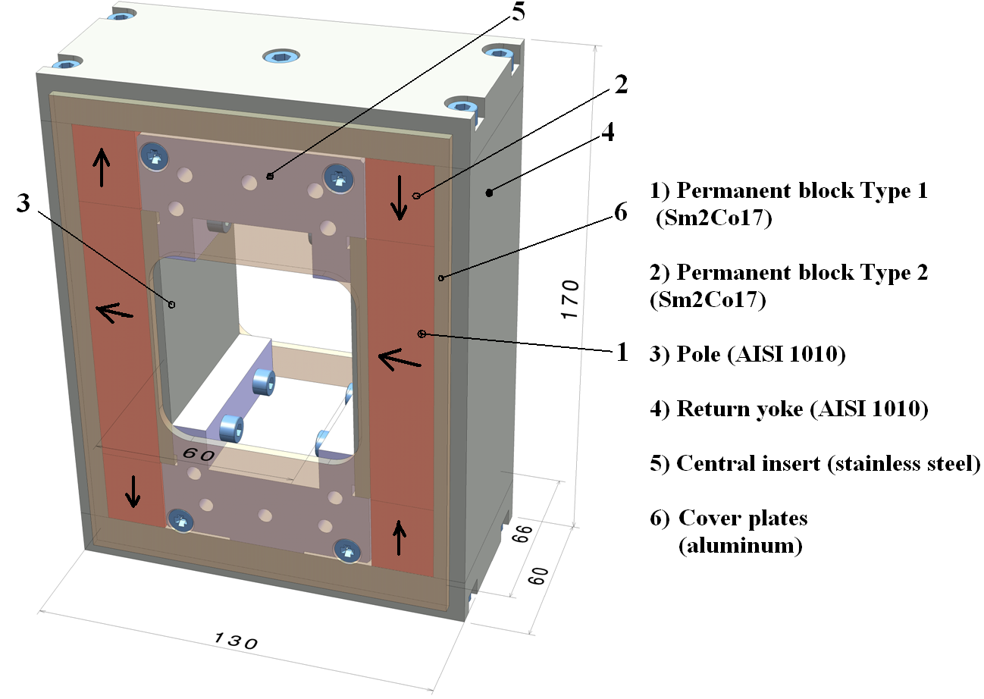
Mechanical structure

Slide 26
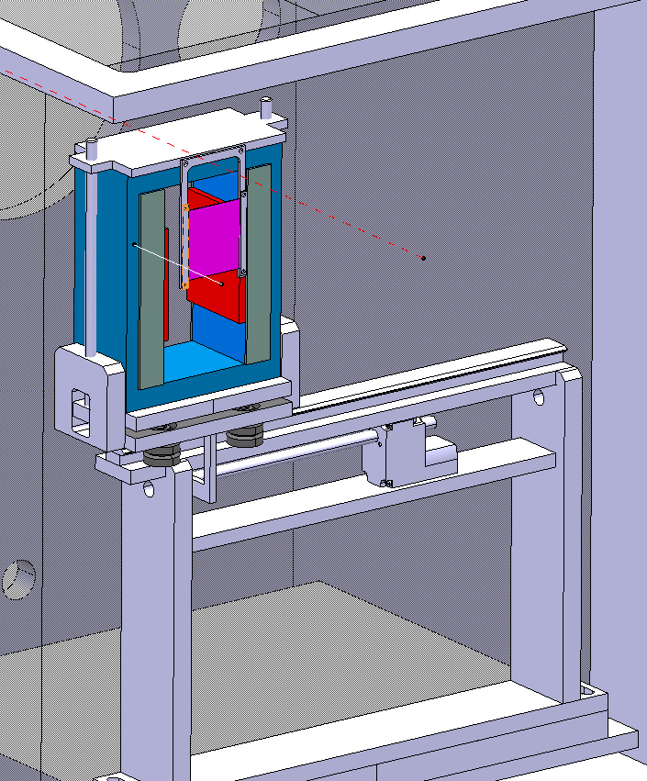
Permanent magnet with retractable device
BLUE … magnet yoke
GREY … magnet poles
RED … magnet shimming
PURPLE … Pt foil

Slide 27
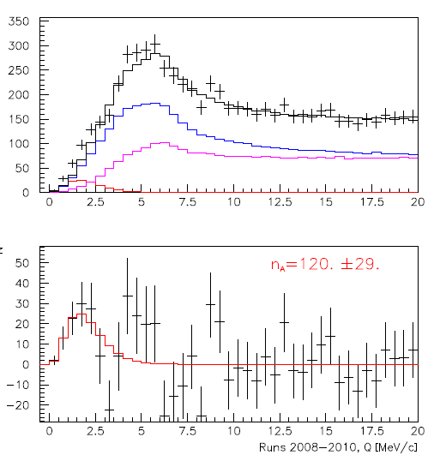
I Status of π⁺K‒ -atoms
A. Benelli, V. Yazkov
Coulomb pairs
Run 2008-2010, statistics with low and medium background (⅔ of all statistics). Point-like production of all particles. The e⁺e‒ background was not subtracted.
non-Coulomb pairs
Atomic pairs
Q
Q – relative momentum in the πK c.m.s.

Slide 28
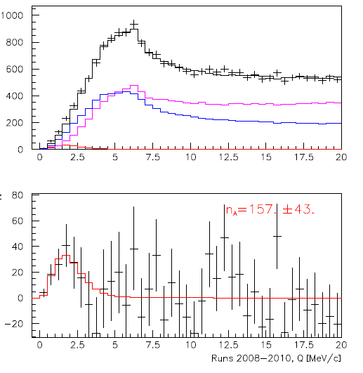
II Status of π⁻K⁺ -atoms
A. Benelli, V. Yazkov
Coulomb pairs
Run 2008-2010, statistics with low and medium background (⅔ of all statistics). Point-like production of all particles. The e⁺e‒ background was not subtracted.
non-Coulomb pairs
Atomic pairs
Q – relative momentum in the πK c.m.s.

Slide 29
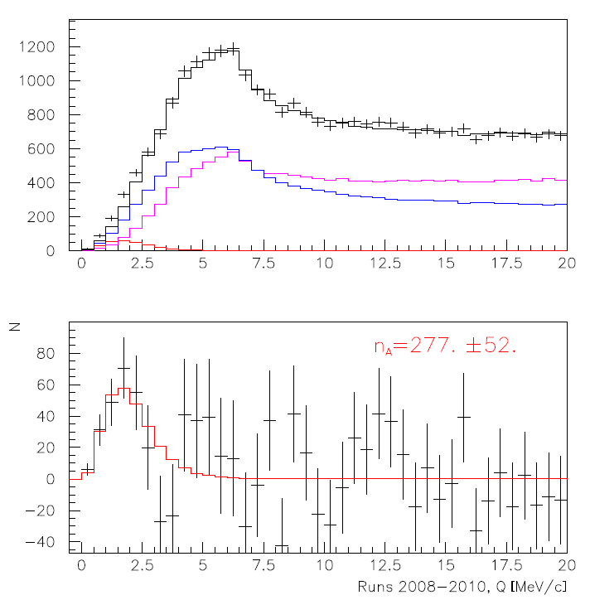
III. The status of π⁻K⁺ and π⁺K‒atoms
A. Benelli, V. Yazkov
Run 2008-2010, statistics with low and medium background (⅔ of all statistics). Point-like production of all particles. The e⁺e‒ background was not subtracted.
Coulomb pairs
non-Coulomb pairs
Atomic pairs
Q – relative momentum in the πK c.m.s.

Slide 30
IV Status π⁺π‒ -atoms
A. Benelli, V. Yazkov
Coulomb pairs
Coulomb pairs
non-Coulomb pairs
non-Coulomb pairs
Atomic pairs
Atomic pairs
Run 2008-2010, statistics with low and medium background (⅔ of all statistics). Point-like production of all particles. The e⁺e‒ background was not subtracted.

Slide 31
Amplitude distributions for one slab of preshower detector for pions (upper) and electrons (lower). Red line presents criterion for electrons.

Slide 32
Amplitude distributions for one slab of right arm of preshower
(X-projection) versus amplitude in left arm (Y-projection). Red line presents criterion for e+e- pairs.

Slide 33
Transverse momentum distributions for e+e- (upper) and pi+pi- (lower).
All events are in black, events after amplitude criterion are in red
and events after subtraction of weighted electron-like pairs are in
magenta.

Slide 34
Coordinated difference at X-plane of ScFi detector distributions for e+e-
(upper) and pi+pi- (lower). All events are in black, events after
amplitude criterion are in red and events after subtraction of weighted
electron-like pairs are in magenta.

Slide 35
π⁺π⁻ data
Statistics for measurement of |a₀-a₂| scattering length difference and expected precision
Year | n_{A} | δ_{stat} (%) | Δ_{syst} (%) | δ_{syst} (%) MS | δ_{tot} (%)
2001-2003 | 21000 | 3.1 | 3.0 | 2.5 | 4.3
2008-2010 * | 24000 | 3.0 | 3.0 | 2.5 | 4.3
2001-2003 2008-2010 | 45000 | 2.1 | 3.0 (2.1) | 2.5 (1.25) | 3.7 (3.0)
* There is 40% of data with a higher background whose implication is under investigation.
35

Slide 36
Plan of data analysis of πK and ππ atoms in 2012
Run 2008 data analysis without and with e+e- background subtraction:
May 2012
2. Runs 2008, 2009 and 2010 data analysis (all data) without and with e+e- background subtraction:
June 2012.
3. Run 2008, 2009 and 2010 data analysis, taking into account non-pointlike π- and K- mesons production: October 2012.
36

Slide 37
Published results on π π atom: lifetime & scattering length
DIRAC data | τ_{1s} (10⁻¹⁵s) value stat syst theo* tot | |a₀ – a₂| value stat syst theo* tot | Reference
2001 |  |  | PL B 619 (2005) 50
2001-03 |  |  | PL B 704 (2011) 24
* theoretical uncertainty included in systematic error
NA48 | K-decay | a₀ – a₂ value stat syst theo tot | Reference
2009 | K_{3π} |  | EPJ C64 (2009) 589
2010 | K_{e4} & K_{3π} |  | EPJ C70 (2010) 635
Notes:
37

Slide 38
DIRAC prospect at CERN SPS
Yield of dimeson atoms per one proton-Ni interaction, detectable by DIRAC upgrade setup at Θ_{L}=5.7º
 | 24 GeV |  |  | 450 GeV
E_{p} | A_{2π} | A_{K}+_{π}− | A_{π}+_{K}− | A_{2π} | A_{K}+_{π}− | A_{π}+_{K}−
W_{A} | 1.1·10⁻⁹ | 0.52·10⁻¹⁰ | 0.29·10⁻¹⁰ | 0.13·10⁻⁷ | 0.10·10⁻⁸ | 0.71·10⁻⁹
W_{A}^{N} | 1. | 1. | 1. | 12. | 19. | 24.
W_{A} /W_{π} | 3.4·10⁻⁸ | 16.·10⁻¹⁰ | 9.·10⁻¹⁰ | 1.3·10⁻⁷ | 1.·10⁻⁸ | 7.1·10⁻⁹
W_{A}^{N} /W_{π}^{N} | 1. | 1. | 1. | 3.8 | 6.2 | 8.
 |  |  |  | A multiplier due to different spill duration ~4
Total gain | 1. | 1. | 1. | 15. | 25. | 32.

Slide 39
Thank you for your attention

Slide 40
Values for energy shifts and lifetimes of π⁺π⁻ atom
J. Schacher
[J. Schweizer, PL B587 (2004) 33]
*)

Slide 41
Observation of long-lived π⁺π⁻ atoms
…opens future possibility to measure the energy splitting ΔE(ns-np).
A_{2π} decay dominated by the annihilation process:
A_{2π} lifetime depends on the ππ scattering length difference |a₀ – a₂|
Energy shift contributions
Strong interaction contribution
41

Slide 42
Simulation of long-lived A_{2π} observation
Q and F for Be
Q_{y}
Q<1MeV/c
F<2
Q_{L}
Q_{x}

Slide 43
Main parameters
Magnet Type | Permanent Magnet Dipole
Quantity | 1+1(spare)
Magnet Height × Width × Length | 170 mm × 130 mm × 66 mm
Magnet mass | 8.6 kg
Full horizontal aperture | 60 mm
Good Field Region(GFR) Horizontal × Vertical | 20 mm × 30 mm
Magnetic field characteristics
Nominal integrated horizontal field ∫B_{x(0,0,Z)}dz | 24.6 ×10⁻³ T×m
Horizontal field in magnet center B_{x(0,0,0)} | 0.255 T
Magnetic length ∫B_{x(0,0,Z)}dz / B_{x(0,0,0)} | 96.5 mm
Integrated field homogeneity inside GFR ∆∫B_{x}dz / ∫B_{x(0,0,Z)}dz | < ±2%
Components
Permanent magnet blocks | Sm2Co17, “Recoma 30S” or equivalent
Pole and Return Yoke | Low carbon steel: AISI 1010
Central inserts | Stainless steel: 316L+N
Cover plates | Aluminum: EN-AW-6082

Slide 44
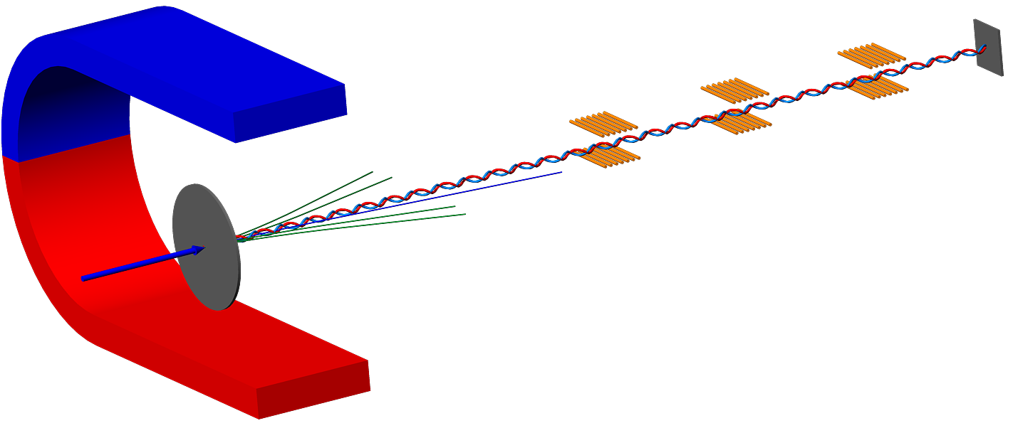
Resonant method
Resonators
π⁺
π⁰
π⁰
π⁰
π⁻
A*_{2π} A*_{πμ} A*_{πK}
π⁰
π⁰
π⁰
Pt foil
Proton beam
p
Charged secondary
γ_{res1}
γ_{res2}
γ_{res3}
γ_{res4}

Slide 45
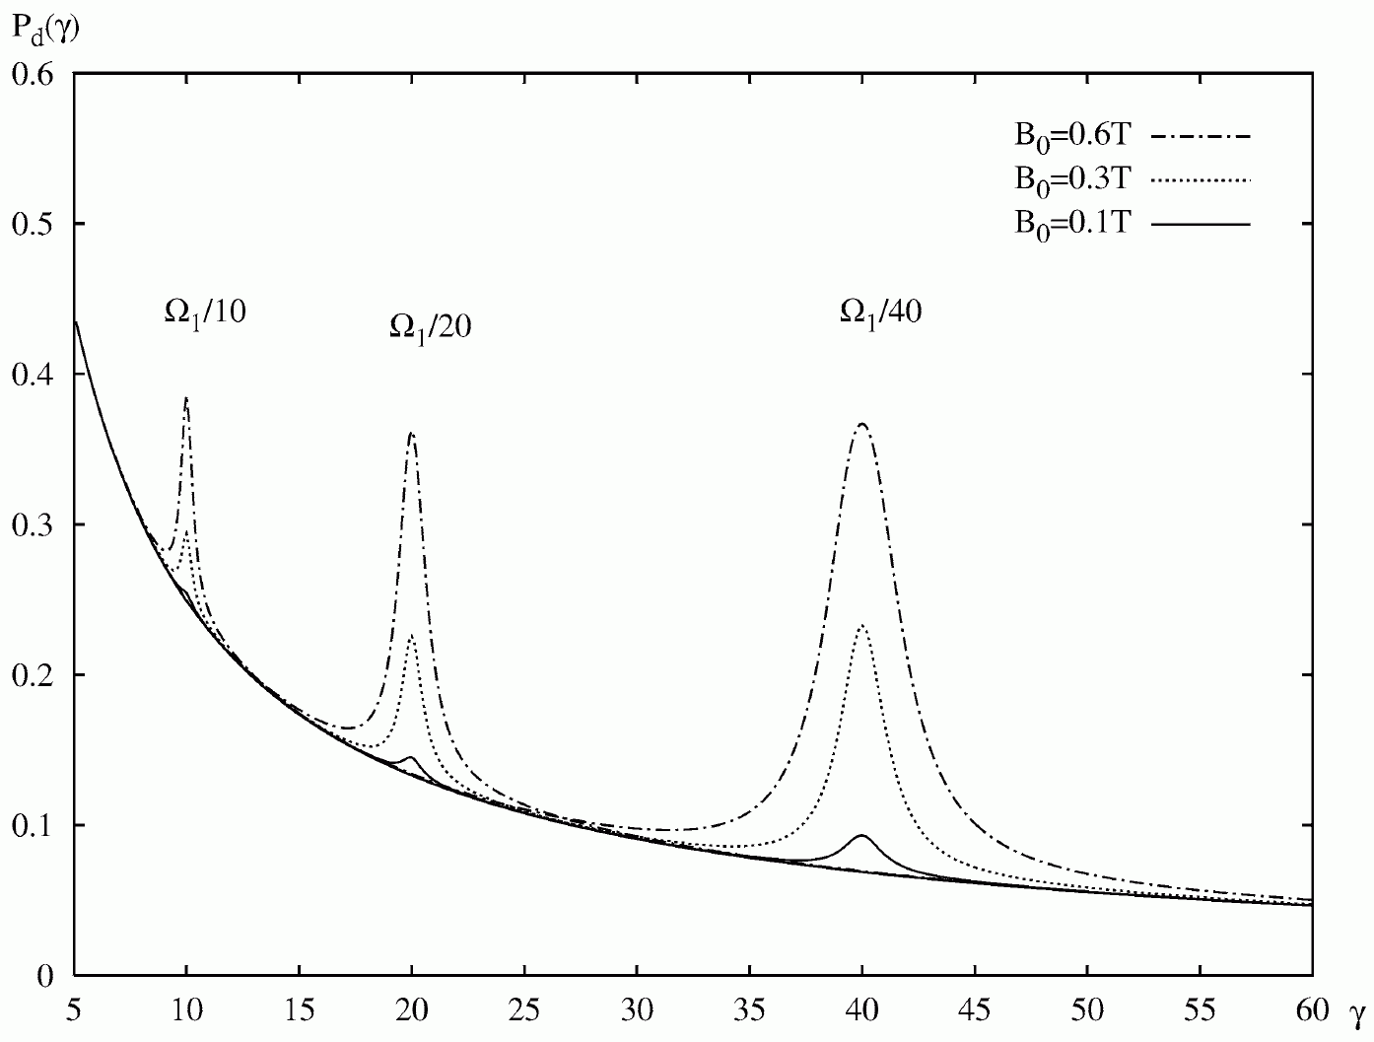
Resonant enhancement
45

Slide 46
Coulomb pairs and atoms
Strong interaction
π⁺
Κ⁺
π⁺
Κ⁺
π⁺
μ⁺
p
nucleus
π⁻
π⁻
Κ⁻
Κ⁻
μ⁻
π⁻
For small Q there are Coulomb pairs :
pp, pK, K⁺K⁻, πµ C-pairs
pp, pK, K⁺K⁻, πµ atoms
The production yield strongly increases for smaller Q

Slide 47
Method of A_{2π} observation and measurement
Target Ni 98 μm
π⁺
p
A_{2π}
(n_{A})
Atomic pairs
24 GeV/c
(N_{A})
π⁻
Interaction point
π⁺
Coulomb correlated
pairs
p
(N_{C})
π⁻
24 GeV/c
Δ,ρ,ω,…
π⁺
π⁺
p
Non-Coulomb pairs
24 GeV/c
π⁻
η, η’,…
π⁺
Interaction point
π⁰
p
π⁺
24 GeV/c
Accidental pairs
p
π⁻

Slide 48
A_{2π} level scheme and 2s – 2p energy splitting
E_{n} (keV)
J. Schacher
-0.21
n=3
-0.47
n=2
ε_{2s}
Γ_{2s}
ΔE_{2s-2p}
Stark mixing
-1.86
n=1
ε_{1s}
Γ_{1s}

Slide 49

Lamb shift measurement with external magnetic field
See: L. Nemenov, V. Ovsiannikov, Physics Letters B 514 (2001) 247.
Impact on atomic beam by
external magnetic field B_{lab} and Lorentz factor γ
…. relative distance between
π⁺ and π⁻ in A_{2π} system
π⁻
…. laboratory magnetic field
π⁺
…electric field in A_{2π} system

Slide 50
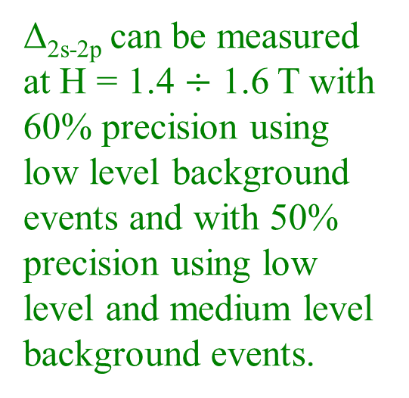
H=0.0 T ξ=1 N_{A}=330 ± 40
H=0.1 T ξ=1 N_{A}=330 (1-0.7%)
V. Brekhovskikh
ξ | 0.4 |  | 1 |  | 1.6
H=0.4 T | 328 |  | 317 |  | 302
 |  | 11 |  | 15 |  | 13
H=0.6 T | 325 |  | 304 |  | 279
 |  | 21 |  | 25 |  | 23
H=0.8 T | 322 |  | 290 |  | 258
 |  | 32 |  | 32 |  | 32
H=1.0 T | 317 |  | 276 |  | 241
 |  | 41 |  | 35 |  | 38
H=1.2 T | 312 |  | 263 |  | 227
 |  | 49 |  | 36 |  | 46
H=1.4 T | 307 |  | 251 |  | 215
 |  | 56 |  | 36 |  | 46
H=1.6 T | 302 |  | 241 |  | 206
 |  | 61 |  | 35 |  | 48
Δ_{2s-2p} can be measured at H = 1.4 $÷$ 1.6 T with 60% precision using low level background events and with 50% precision using low level and medium level background events.

Slide 51
Magnetic Field - 1.0 T
V. Brekhovskikh
Magnetic Field 1.0 T ξ = 40% 317.273
 | 2p | 3p | 4p | 5p | 6p | 7p | 8p | ∑
n,% | 0.42 | 0.27 | 0.15 | 0.079 | 0.046 | 0.025 | 0.012 | 1.002
τ∙10⁻¹¹,s | 1.17 | 3.94 | 9.05 | 17.5 | 29.9 | 46.8 | 69.3 | 177.66
L,cm | 5.64 | 19.02 | 43.68 | 84.47 | 144.32 | 225.89 | 334.49 | 857.50
ξ_{n} | 0.0075 | 0.0254 | 0.0603 | 0.1177 | 0.2034 | 0.3231 | 0.4822 | 1.2197
τ_{eff}∙10⁻¹¹,s | 1.162 | 3.656 | 6.302 | 6.571 | 5.011 | 3.461 | 2.397 | 28.561
L_{eff},cm | 5.609 | 17.647 | 30.418 | 31.715 | 24.188 | 16.703 | 11.572 | 137.85
N_{a} | 0.0714 | 0.1595 | 0.1193 | 0.0701 | 0.0429 | 0.0239 | 0.0116 | 0.499
N_{a}^{eff} | 0.0710 | 0.1557 | 0.1124 | 0.0624 | 0.0349 | 0.0171 | 0.0070 | 0.4605
Magnetic Field 1.0 T ξ = 100% 276.147
 | 2p | 3p | 4p | 5p | 6p | 7p | 8p | ∑
n,% | 0.42 | 0.27 | 0.15 | 0.079 | 0.046 | 0.025 | 0.012 | 1.002
τ∙10⁻¹¹,s | 1.17 | 3.94 | 9.05 | 17.5 | 29.9 | 46.8 | 69.3 | 177.66
L,cm | 5.64 | 19.02 | 43.68 | 84.47 | 144.32 | 225.89 | 334.49 | 857.50
ξ_{n} | 0.0188 | 0.0636 | 0.1507 | 0.2943 | 0.5086 | 0.8076 | 1.2056 | 3.0492
τ_{eff}∙10⁻¹¹,s | 1.122 | 2.653 | 2.429 | 1.535 | 0.933 | 0.590 | 0.395 | 9.659
L_{eff},cm | 5.416 | 12.806 | 11.726 | 7.412 | 4.504 | 2.849 | 1.907 | 46.622
N_{a} | 0.0714 | 0.1595 | 0.1193 | 0.0701 | 0.0429 | 0.0239 | 0.0116 | 0.499
N_{a}^{eff} | 0.0683 | 0.1369 | 0.0821 | 0.0335 | 0.0118 | 0.0030 | 0.0005 | 0.3362
Magnetic Field 1.0 T ξ = 160% 240.908
 | 2p | 3p | 4p | 5p | 6p | 7p | 8p | ∑
n,% | 0.42 | 0.27 | 0.15 | 0.079 | 0.046 | 0.025 | 0.012 | 1.002
τ∙10⁻¹¹,s | 1.17 | 3.94 | 9.05 | 17.5 | 29.9 | 46.8 | 69.3 | 177.66
L,cm | 5.64 | 19.02 | 43.68 | 84.47 | 144.32 | 225.89 | 334.49 | 857.50
ξ_{n} | 0.0301 | 0.1017 | 0.2411 | 0.4709 | 0.8137 | 1.2922 | 1.9289 | 4.8788
τ_{eff}∙10⁻¹¹,s | 1.055 | 1.757 | 1.135 | 0.634 | 0.372 | 0.233 | 0.155 | 5.339
L_{eff},cm | 5.092 | 8.483 | 5.476 | 3.059 | 1.793 | 1.122 | 0.747 | 25.774
N_{a} | 0.0714 | 0.1595 | 0.1193 | 0.0701 | 0.0429 | 0.0239 | 0.0116 | 0.499
N_{a}^{eff} | 0.0637 | 0.1079 | 0.0458 | 0.0106 | 0.0016 | 0.0001 | 3.87∙10⁻⁶ | 0.2296
CERN, Geneva - Monday 26, September, 2011

Slide 52
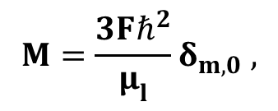
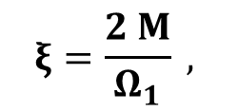
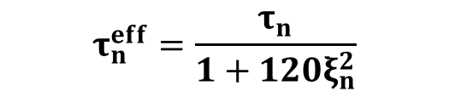

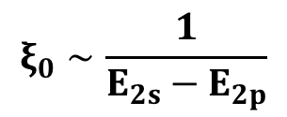
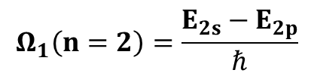
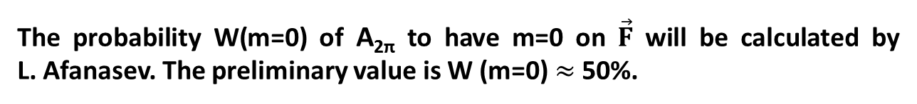

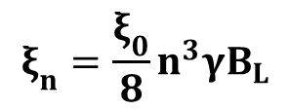
The lifetime of A_{2π} in electric field
L. Nemenov, V. Ovsiannikov (P. L. 2oo1)
mmmmmmmmmmm
F – strength of electric field in A_{2π} c.m.s.
$${F=βγB}_{L},$$
B_{L} in lab. syst.
→ m must be 0
$$Ω_{1}\left(n=2\right)=\frac{E_{2s}−E_{2p}}{ℏ}$$
$$ξ_{0}∼\frac{1}{E_{2s}−E_{2p}}$$
$$ξ_{n}=\frac{ξ_{0}}{8}n^{3}γB_{L}$$
$$ξ\left(2s−2p\right)=ξ_{0}γB_{L}$$
CONCLUSION: the lifetimes for long-lived states can be calculated using only one parameter → E_{2s}-E_{2p}.
The probability W(m=0) of A_{2π} to have m=0 on $\vec{F}$ will be calculated by L. Afanasev. The preliminary value is W (m=0)$≈$ 50%.

Slide 53
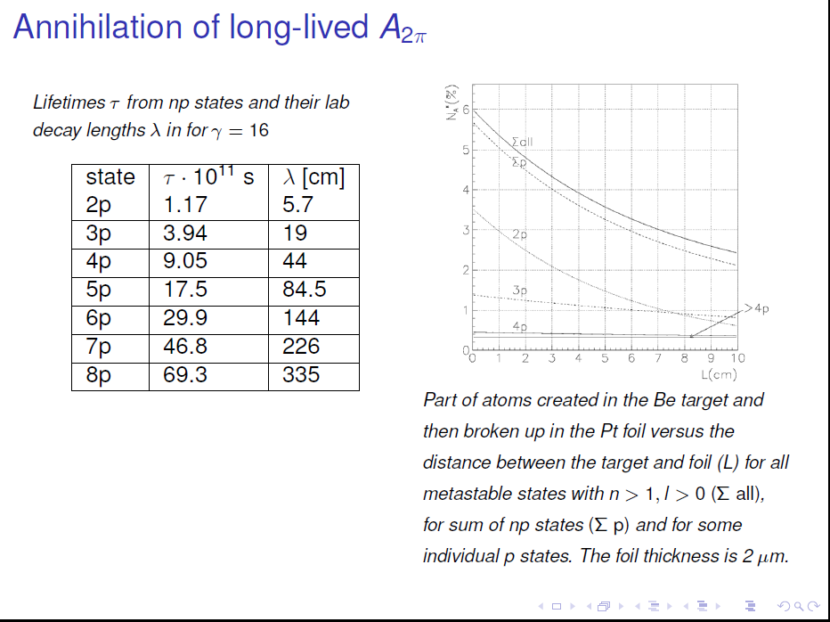

Slide 54
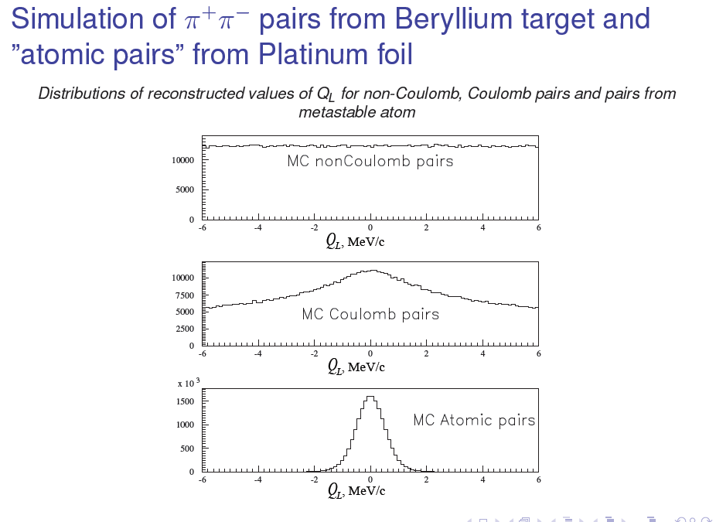

Slide 55
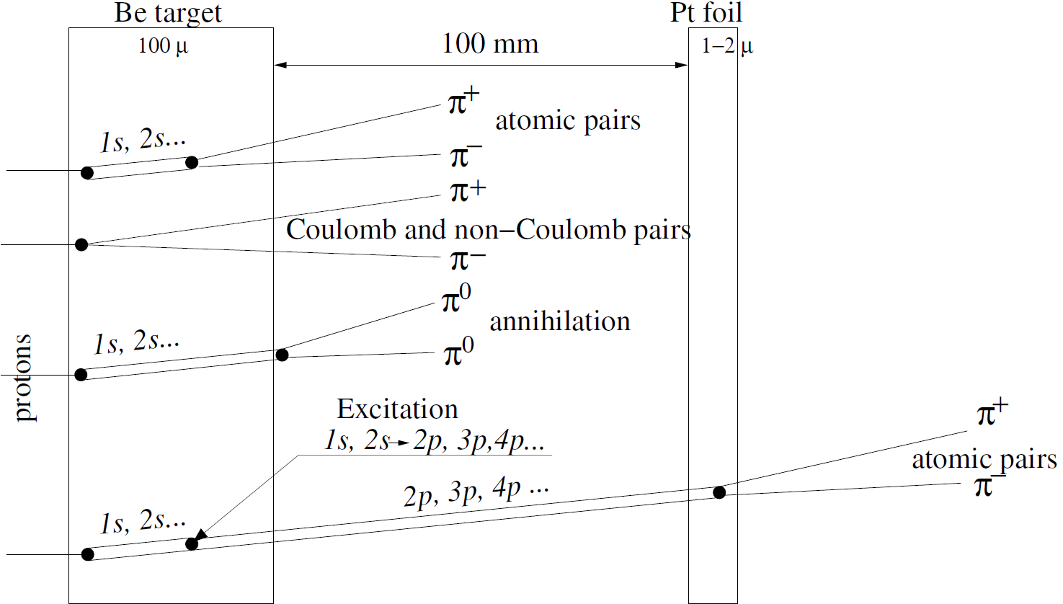
Observation method
The A_{2π} decay in the p-state is forbidden by angular momentum conservation. So the lifetime of the A_{2π} atom in the 2p state (τ_{2p}=1.17 ·10⁻¹¹ s) is determined by the 2p–1s radiative transition with a subsequent annihilation in 1s state (τ_{1s}=3 ·10⁻¹⁵ s): π⁺ + π⁻ → π⁰ + π⁰
The lifetime of the np-states is about 10³ larger than the ns-states, so it is possible to measure the energy difference of these levels by exerting an electric field (Stark effect) on the atom and tracking the field dependence of the decay probability.
The influence of an magnetic field on the A_{2π} atom lifetime opens the possibility to measure the splitting between 2s and 2p levels.
For p_{A} = 4.5 GeV/c (γ = 16.1)
τ_{1s} = 2.9 × 10 ⁻¹⁵ s , λ_{1s} = 1.4 × 10 ⁻³ cm
τ_{2s} = 2.3 × 10 ⁻¹⁴ s , λ_{2s} = 1.1 × 10 ⁻² cm
τ_{2p} = 1.17 × 10 ⁻¹¹ s , λ_{2p} = 5.7 cm, λ_{3p} ≈ 19 cm,
λ_{4p} ≈ 43 cm
55
55

Slide 56
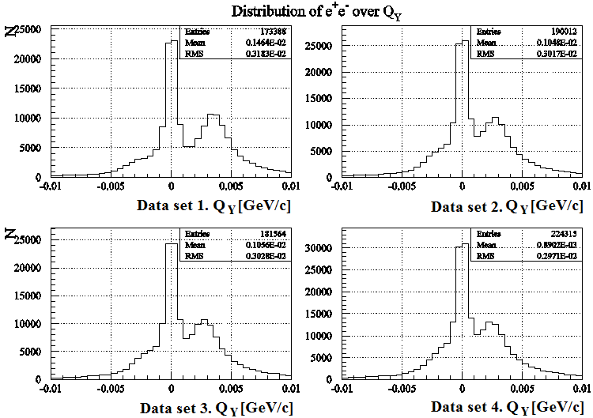
Shift of Q_{y} (June-August) e⁺e‒ data
F. Takeutchi, V. Yazkov
1
2
1
Pairs generated after magnet
2
Pairs generated on Be target before magnet

