Slide 1
Status report of the DIRAC experiment (PS 212)
L. Nemenov
SPS Committee, April 9, 2013

Slide 2








DIRAC collaboration
CERN
Geneva, Switzerland
Tokyo Metropolitan University
Tokyo, Japan
Czech Technical University
Prague, Czech Republic
IFIN-HH
Bucharest, Romania
Institute of Physics ASCR
Prague, Czech Republic
JINR
Dubna, Russia
Nuclear Physics Institute ASCR
Rez, Czech Republic
SINP of Moscow State University
Moscow, Russia
INFN-Laboratori Nazionali di Frascati
Frascati, Italy
IHEP
Protvino, Russia
University of Messina
Messina, Italy
Santiago de Compostela University
Santiago de Compostela, Spain
KEK
Tsukuba, Japan
Bern University
Bern, Switzerland
Kyoto University
Kyoto, Japan
Zurich University
Zurich, Switzerland
Kyoto Sangyou University
Kyoto, Japan

Slide 3
Contents
1. Long-lived π⁺π⁻ atoms: status of data obtained in 2011 and 2012.
2. Multiple scattering measurements.
3. The new ionization hodoscope.
4. DIRAC dismantling.
5. Status and schedule of π⁺π⁻ atom analysis (runs 2008-2010).
6. Status and schedule of Κ⁺π⁻, Κ⁻π⁺ atom analysis (runs 2008-2010).
7. Atoms consisting of Κ⁺Κ⁻.
8. Generation of Κ⁺π⁻, Κ⁻π⁺ and π⁺ π⁻ atoms in p-nuclear interaction at proton beam momentum 24 GeV/c and 450 GeV/c.

Slide 4
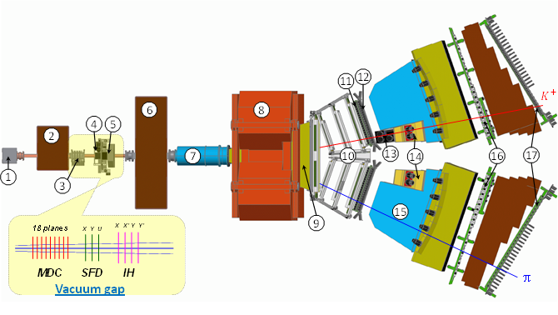
Experimental setup
1 Target station with Ni foil; 2 First shielding; 3 Micro Drift Chambers; 4 Scintillating Fiber Detector; 5 Ionization Hodoscope; 6 Second Shielding; 7 Vacuum Tube; 8 Spectrometer Magnet; 9 Vacuum Chamber; 10 Drift Chambers; 11 Vertical Hodoscope; 12 Horizontal Hodoscope; 13 Aerogel Čerenkov; 14 Heavy Gas Čerenkov; 15 Nitrogen Čerenkov; 16 Preshower; 17 Muon Detector

Slide 5
Long-lived π⁺π⁻ atoms
The observation of ππ atom long-lived states opens the future possibility to measure the energy difference between ns and np states ΔE(ns-np) and the value of ππ scattering lengths |2a₀+a₂|.
If a resonance method can be applied for the ΔE(ns-np) measurement, then the precision of ππ scattering length measurement can be improved by one order of magnitude relative to the precision of other methods.

Slide 6
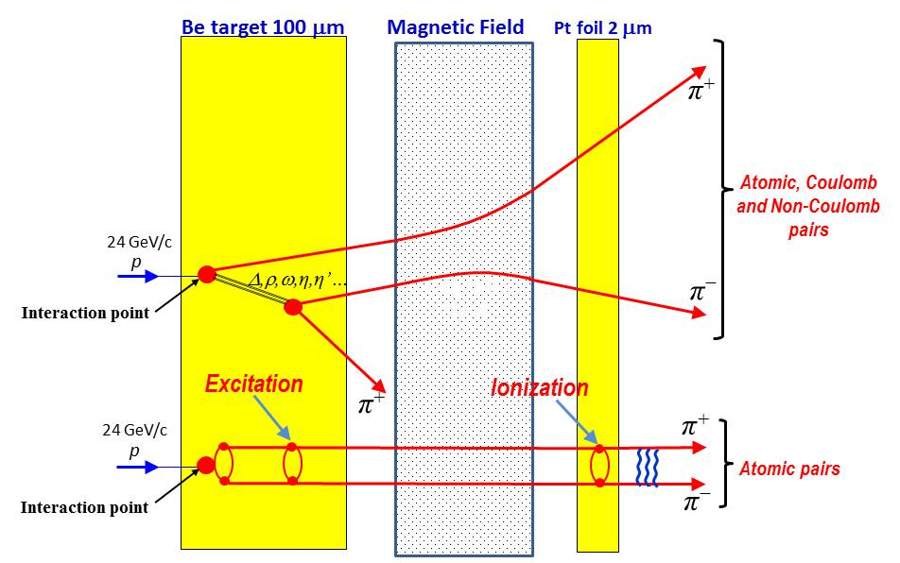
Method for observing long-lived A_{2π} with breakup Pt foil
Q_{Y}
l(2p) = 5.7 cm, l(3p) = 19 cm, l(4p) = 44 cm, l(5p) = 87 cm

Slide 7
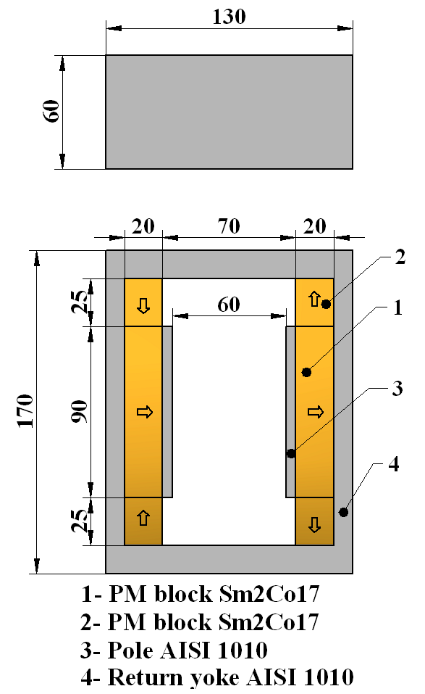
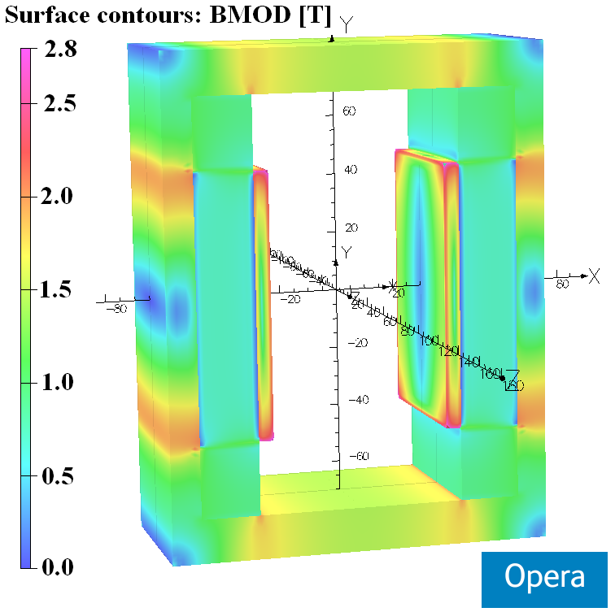
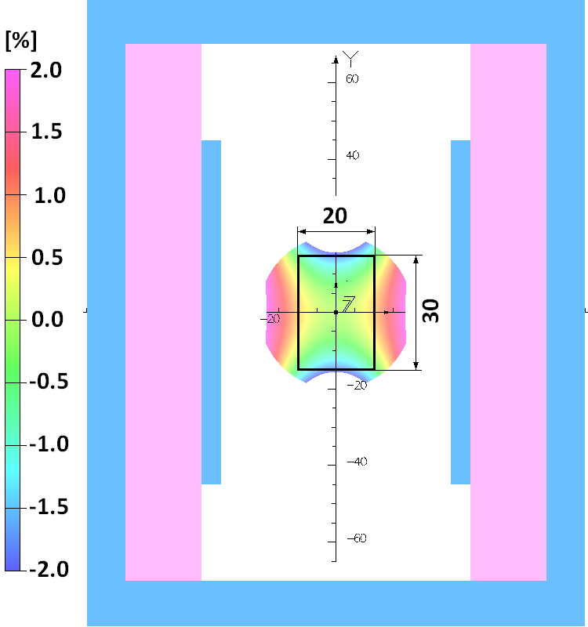
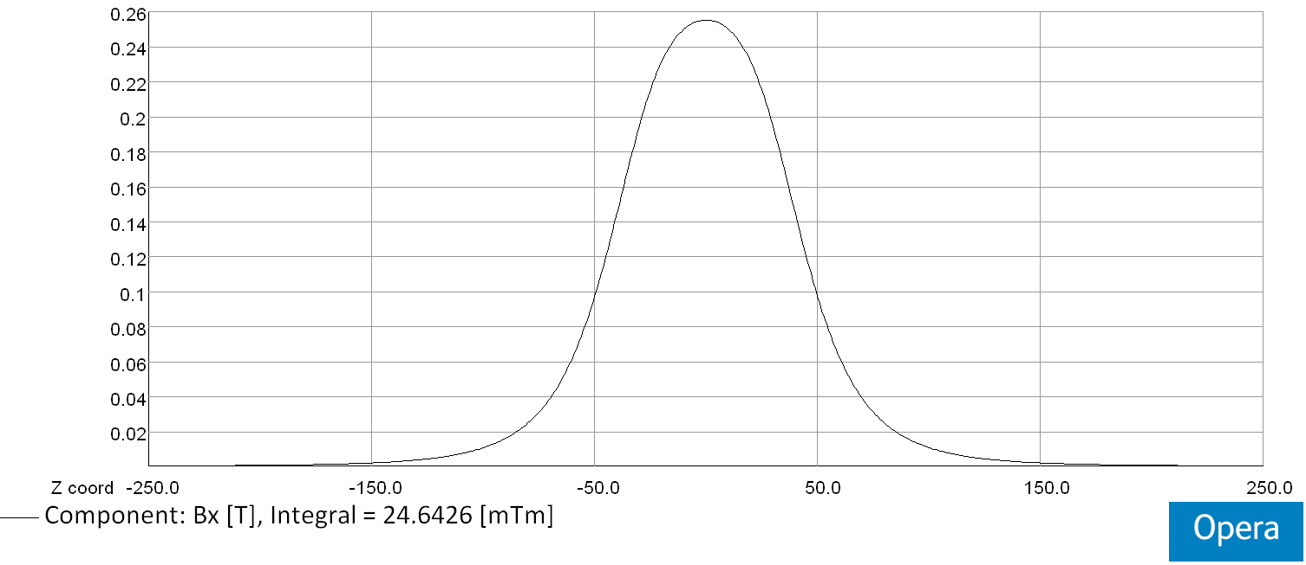
Magnet was designed & constructed in CERN (TE/MCS/MNC)
Layout of the dipole magnet (arrows indicate the direction of magnetization)
Integrated horizontal field homogeneity inside the GFR X х Y = 20 mm х 30 mm:
∆∫Bxdz/ ∫Bx(0,0,z)dz [%]
Opera 3D model with surface field distribution
Horizontal field distribution along z-axis at X=Y=0 mm
∫Bx(0,0,z)dz = 24.6x10⁻³ [Txm]

Slide 8
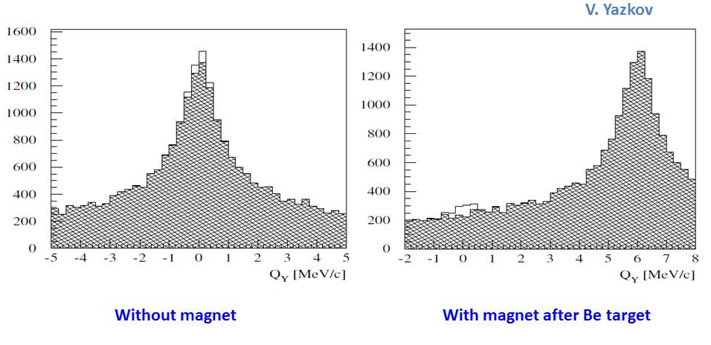
Simulation of long-lived A_{2π} observation
Simulated distribution of π⁺π⁻ pairs over Q_{Y} with criteria:
|Q_{X}| < 1 MeV/c, |Q_{L}| < 1 MeV/c. Atomic pairs from long-lived atoms (light area) above background (hatched area) produced in Beryllium target.

Slide 9
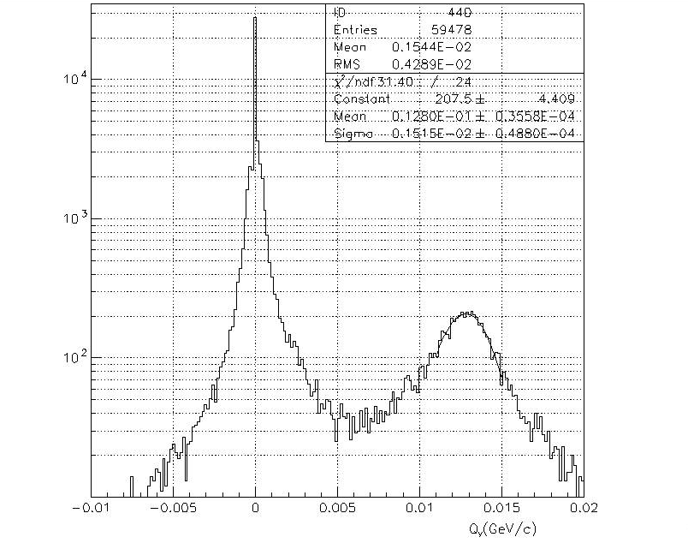
Q_{Y} distribution for e⁺e⁻ pair

Slide 10
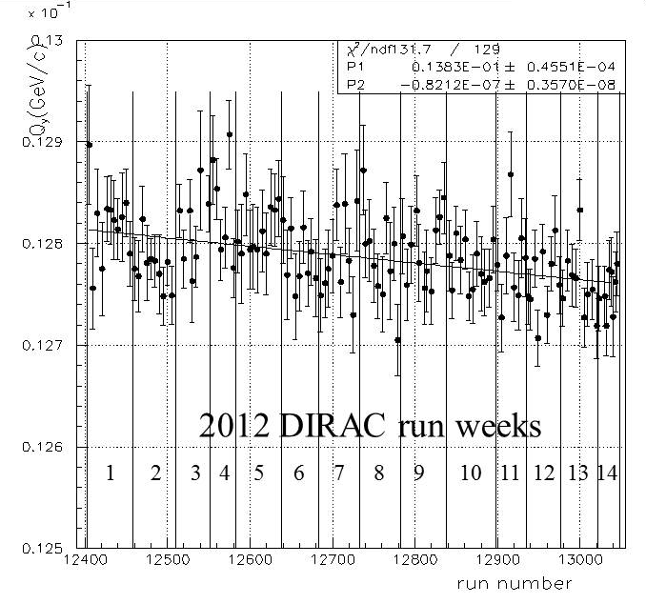
Magnetic field stability measured by Q_{Y} of the e⁺e⁻ pair
Sm₂Co₁₇

Slide 11
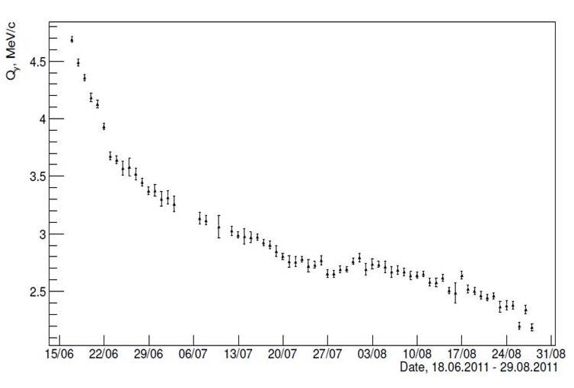
Degradation of the old magnet in June-August 2011
Nd-Fe-B
The position of the second peak in Q_{Y} distributions of e⁺e⁻ pairs versus dates.

Slide 12
Schedule of 2011 and 2012 runs data process and analysis
Run 2011 ntuples are ready.
Run 2012 ntuples will be ready in June 2013.
Preliminary results on the search for long-lived ππ atoms are planned for January 2014.
The expected atomic pair signal should be better than 6σ.

Slide 13
π⁺π⁻ data
Statistics for the measurement of |a₀-a₂| scattering length difference and expected precision
Year | n_{A} | δ_{stat}(%) | Δ_{syst}(%) | δ_{syst}(%)MS | δ_{tot}(%)
2001-2003 | 21000 | 3.1 | 3.0 | 2.5 | 4.3
2008-2010* | 23000 | 3.1 | 3.0 | 2.5 | 4.3
2001-2003 2008-2010 | 44000 | 2.2 | 3.0 2.1 | 2.5 1.25 | 3.7 3.0
* There is 30% of the data with a higher background whose implication will be investigated.

Slide 14
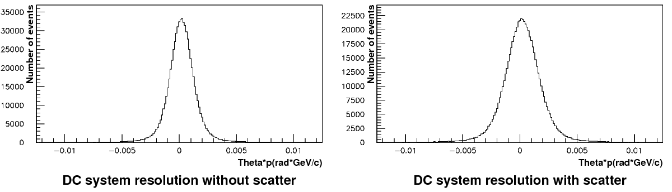
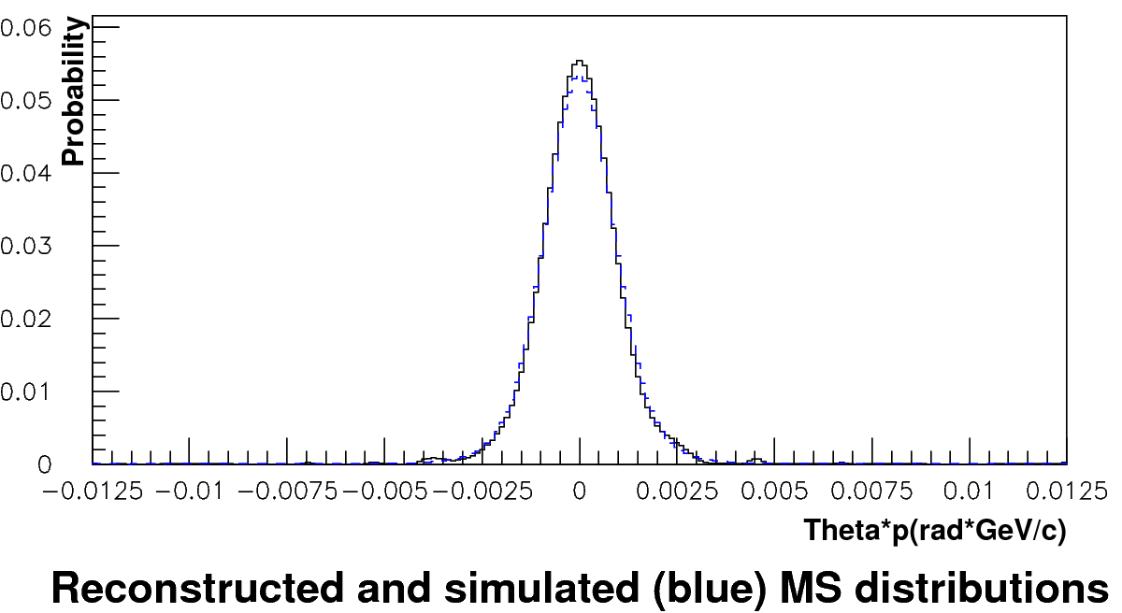
Analysis of multiple scattering in Ni (100 μm)
Run 2011. Analysis of multiple scattering in Ni (100 µm). Only events with one track in each projection were analyzed. δθ/θ ~ 0.7 %. After including in the analysis of all available events the statistics will be doubled and the expected value will be less than 0.5 %.

Slide 15
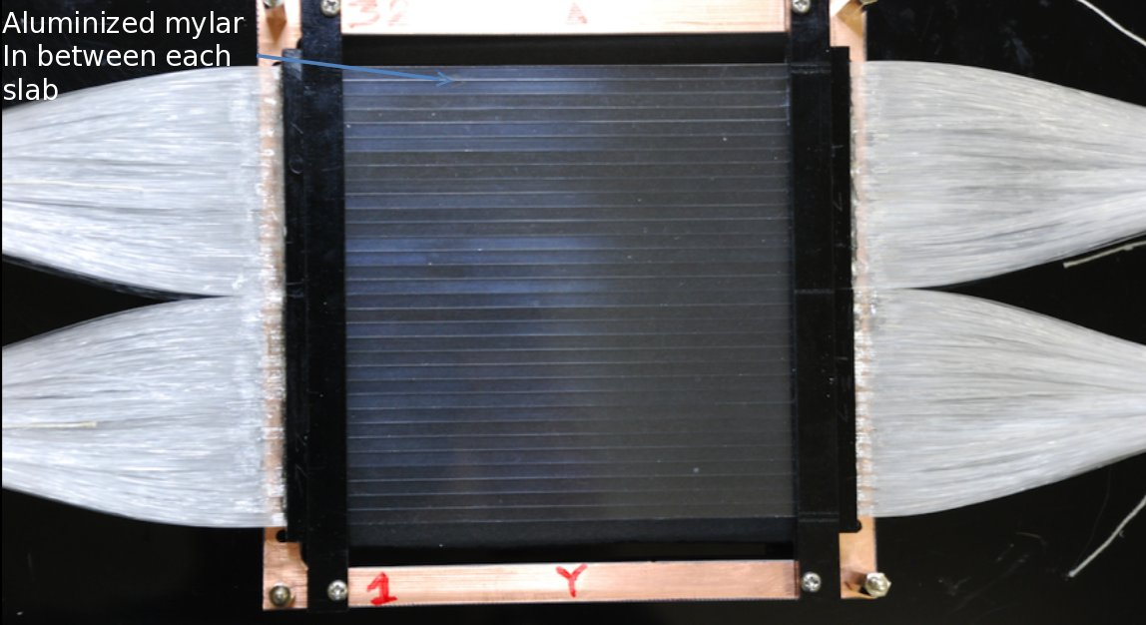
New dE/dx counter
Scintillator plane for new IH

Slide 16
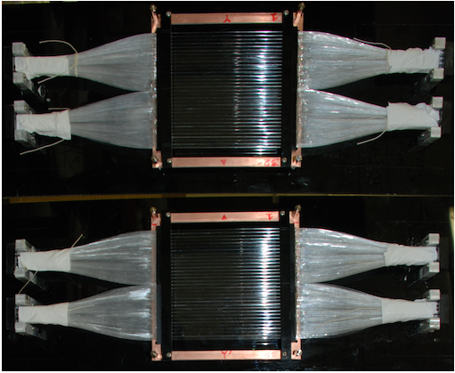
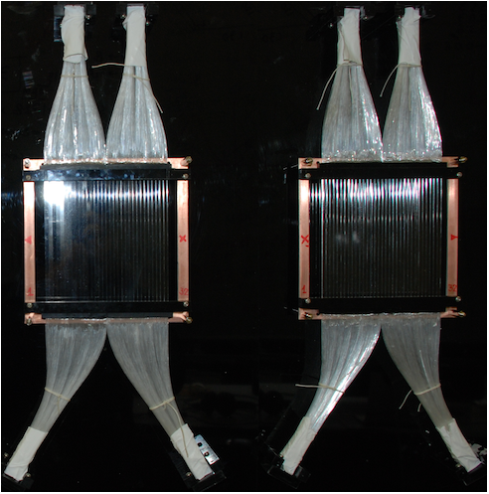
New dE/dx counter
Counter needed to separate the single minimum-ionizing particles (MIPs) and DIRAC pairs (2 MIPs with very small distances).
Required to
Give constant pulse-height independently of the hit position (Landau tail effect can be removed using multiple laters) with a good resolution,
Works as a front-end detector accepting about 3 x 10⁷ particles/s on a 10 x 10 cm² plane,
Have a good timing resolution.
Solution: Use of
32 scintillator slabs with width: 3.5 mm and thickness: 2 mm, read-out from 2 ends,
Read-out with flexible 28 clear fibres attached to each end of a slab,
PMT with a ultra bialkali photocathode (Hamamatsu H6568Mod III),
F1-TDC-ADC to record timing and pulse-height of each hit.
Number of
photoelectrons >20
σ_{t}≈200ps

Slide 17
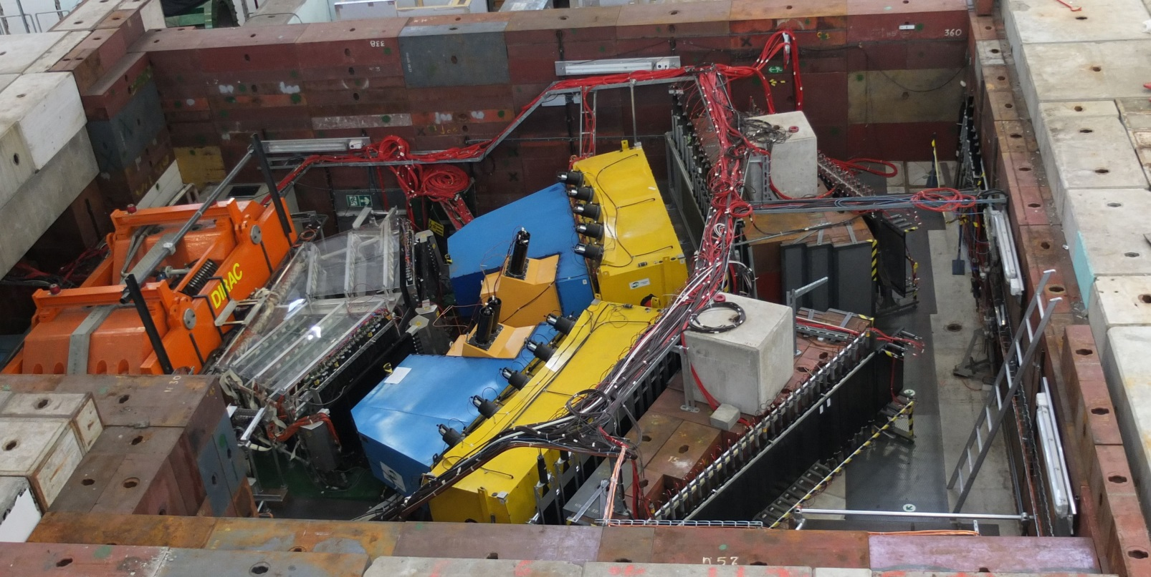
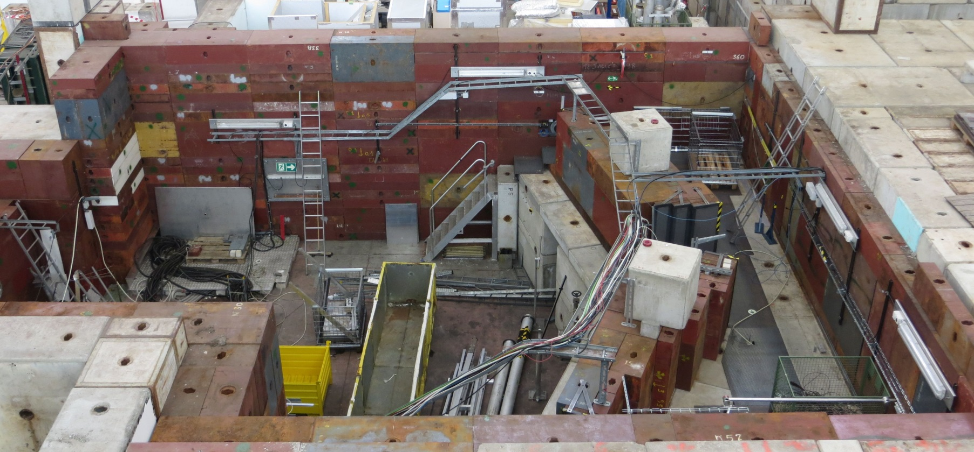
DIRAC dismantling
February 2013
Arpil 2013

Slide 18
Method of ππ and Κπ atom observation and investigation
Target Ni 98 μm
p
A_{Kπ}
K⁺ ( K ⁻)
(n_{a})
Atomic pairs
24 GeV/c
(N_{A})
π⁻ ( π⁺ )
Interaction point
Ni
K⁺ ( K ⁻)
Coulomb pairs
p
(N_{C})
π⁻ ( π⁺ )
24 GeV/c
Δ,ρ,ω,…
π
p
ɸ
K⁻ ( K ⁺)
K⁺ ( K ⁻)
24 GeV/c
Coulomb pairs
π⁻ ( π⁺ )
Interaction point
p
K⁺ ( K ⁻)
Non-Coulomb pairs
24 GeV/c
π⁻ ( π⁺ )
η, η’,…
Interaction point
π ⁺( π ⁻)
π⁰
p
K⁺ ( K ⁻)
24 GeV/c
Accidental pairs
p
π⁻ ( π⁺ )

Slide 19
Coulomb pairs and atoms
For charged pairs from short-lived sources and with small relative momentum Q there is a strong Coulomb attraction in the final state.
This interaction increases the production yield of the free pairs with Q decreasing and also creates atoms.
π⁺π⁻, Κ⁺π⁻, Κ⁻π⁺,
Κ⁺Κ⁻, π⁺μ⁻, π⁻μ⁺
(π⁺π⁻), (Κ⁺π⁻), (Κ⁻π⁺),
(Κ⁺Κ⁻), (π⁺μ⁻), (π⁻μ⁺)
Coulomb pairs
Atoms
There is a precise ratio between the number of produced Coulomb pairs (N_{C}) with small Q and the number of atoms (N_{A}) produced simultaneously with these Coulomb pairs:

Slide 20
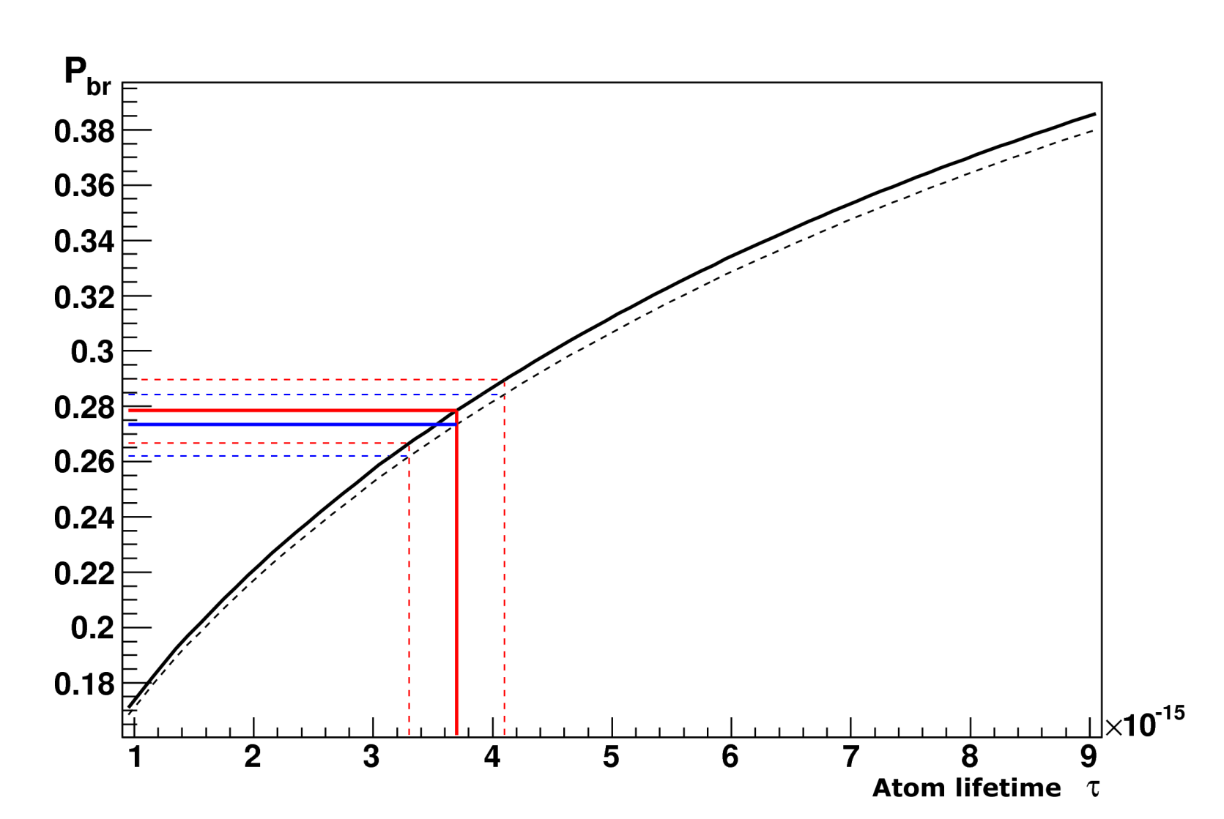
Break-up dependencies P_{br} from atoms lifetime for Κ⁺π⁻ atom (A_{Κπ}) and Κ⁻π⁺ atom (A_{πΚ})
P_{br} values corresponding to τ_{1S}^{th}
Atom | s, μm | P_{br} | P_{br}-σ | P_{br}+σ
A_{πΚ} | 98 | 0.274 | 0.263 | 0.285
A_{πΚ} | 108 | 0.278 | 0.267 | 0.290
A_{Κπ} | 98 | 0.269 | 0.258 | 0.280
A_{Κπ} | 108 | 0.273 | 0.262 | 0.284
Probability of breakup as a function of lifetime in the ground state for A_{πΚ} (solid line) and A_{Κπ} atoms (dashed line) in the Ni target of thickness 108 μm.
Average momentum of A_{Κπ} and A_{πΚ} are 6.4 GeV/c and 6.5 GeV/c, accordingly.

Slide 21
Mechanism of production of false pairs with small Q_{T}
Charged particle
π⁻ (K ⁻) / π⁺ (K⁺)
Layer 1
Layer 2
Layer 3
………
………..….…
………..….…
………..….…
………..….…
………..….…
………..….…
……..…….…
………..….…
……..…….…
Layer 7
Layer 8
no signal
signal
.
.
.
.
.
.
.
.
.
δ
δ
δ

Slide 22
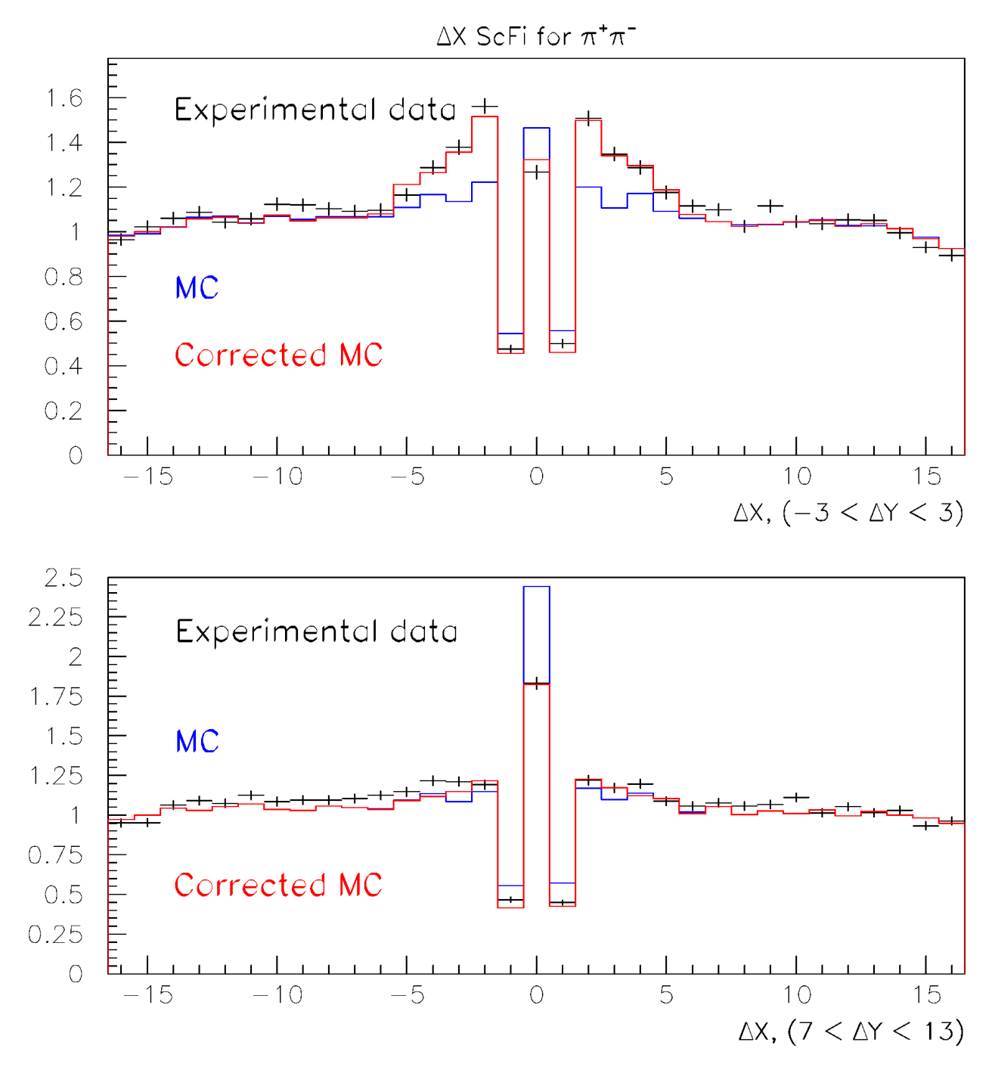
Distribution of π⁺π⁻ pairs without Coulomb peak (Q_{L}>10 MeV/c) over distance between tracks in X-plane of SFD

Slide 23
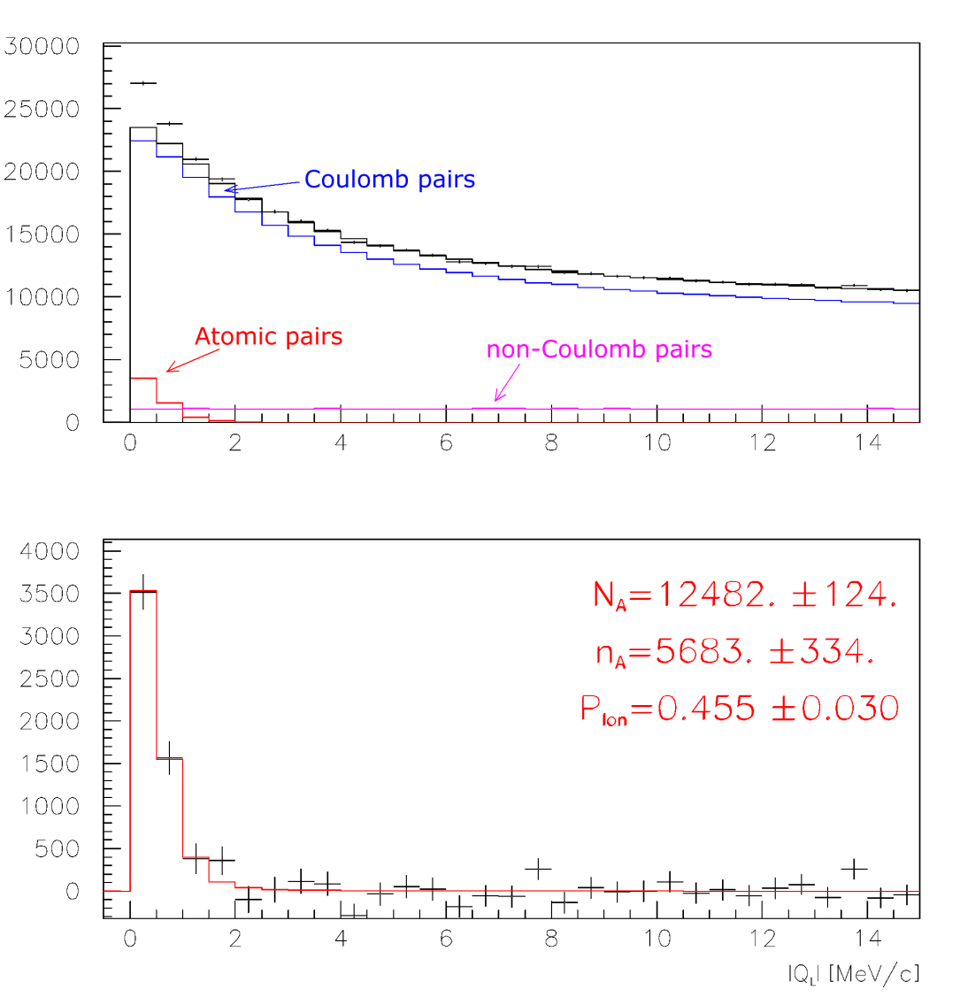
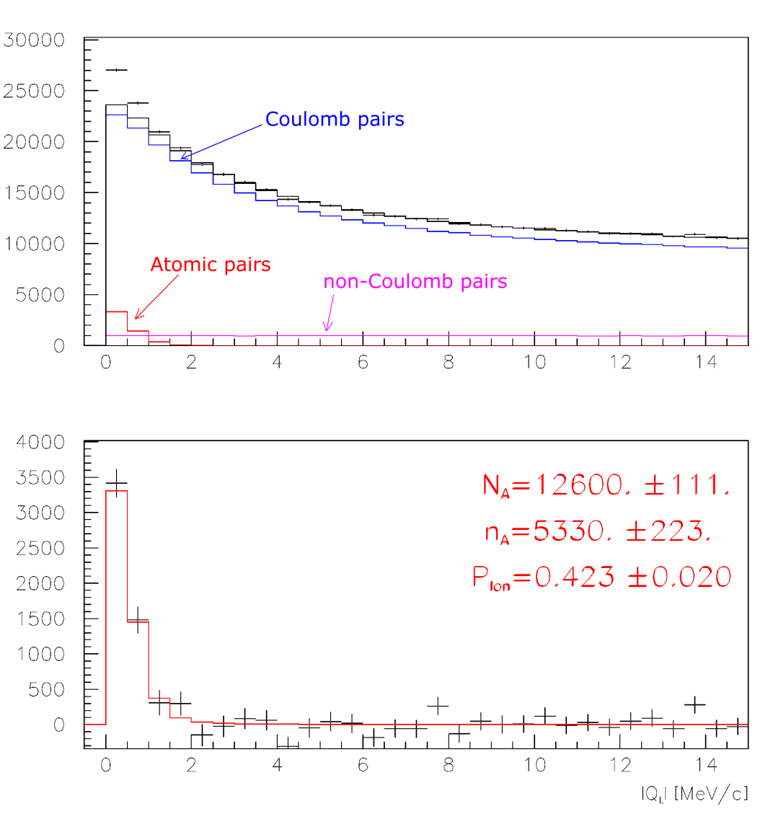
π⁺π⁻ atoms, run 2008
Run 2008, statistics with low and medium background (2/3 of all statistics). Point-like production of all particles.
Analysis on Q_{L}, Q_{T} < 4 MeV/c
Analysis on Q_{L}-Q_{T}, Q_{T} < 4 MeV/c

Slide 24
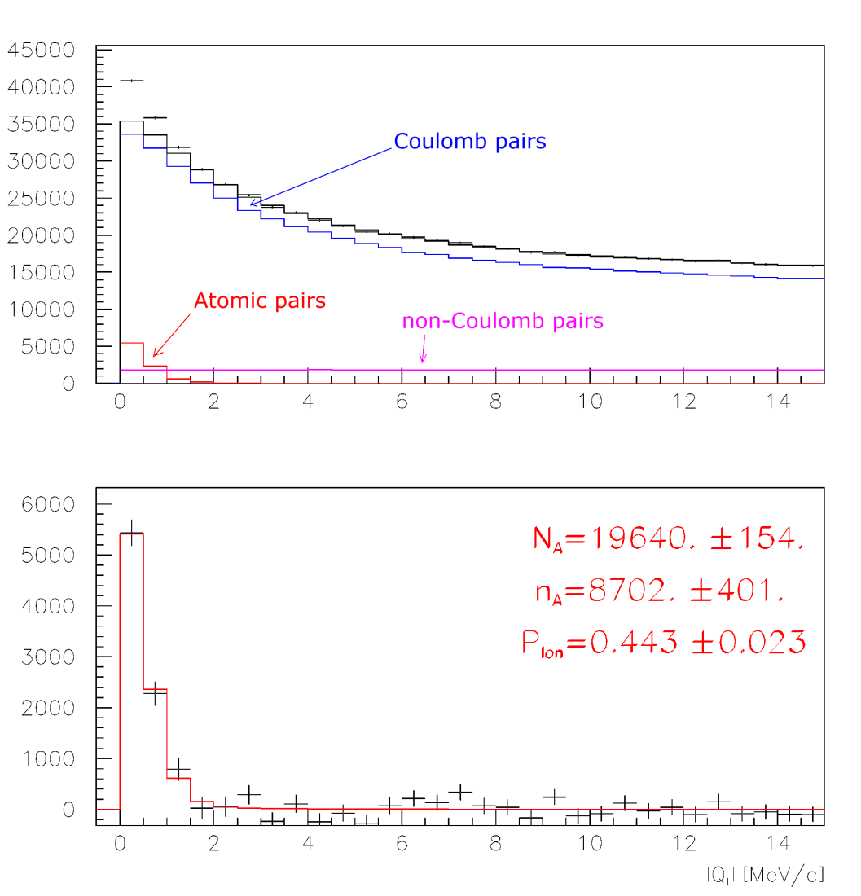
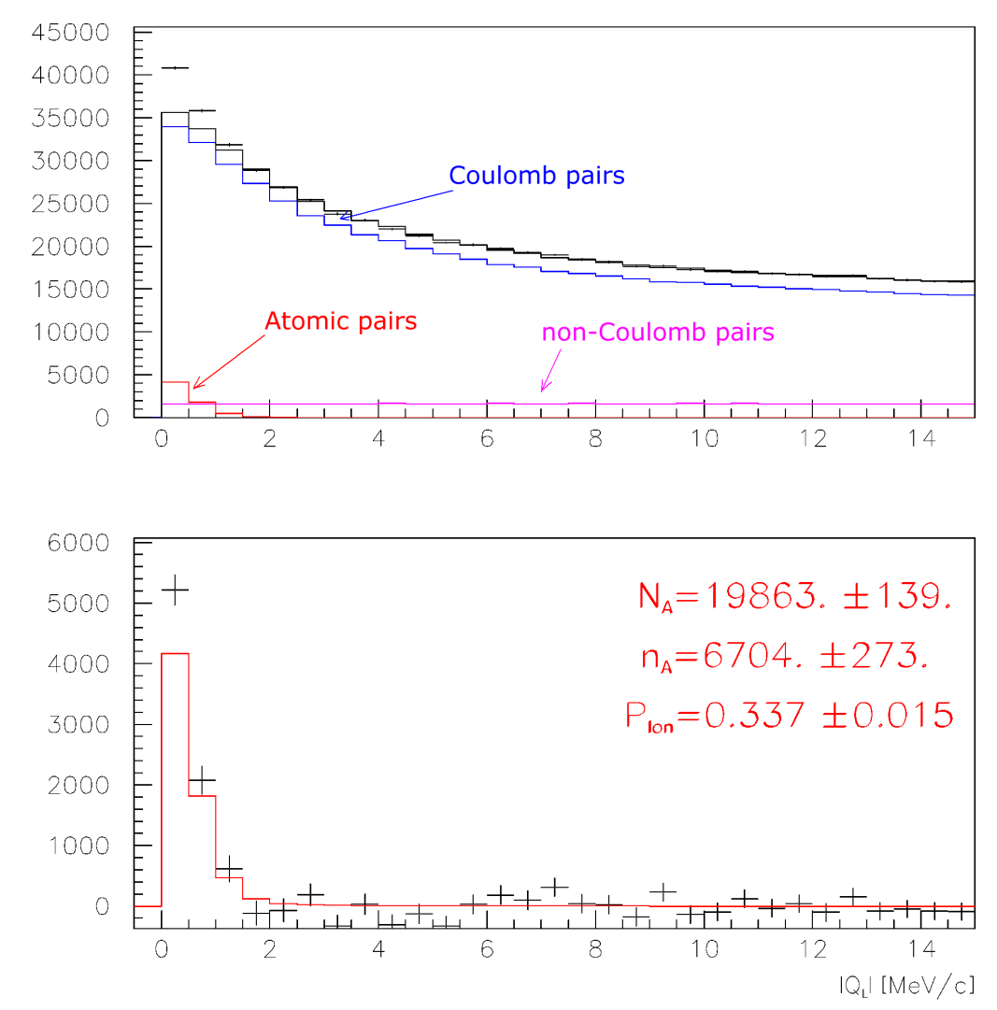
π⁺π⁻ atoms, run 2009
Run 2009, statistics with low and medium background (2/3 of all statistics). Point-like production of all particles.
Analysis on Q_{L}, Q_{T} < 4 MeV/c
Analysis on Q_{L}-Q_{T}, Q_{T} < 4 MeV/c

Slide 25
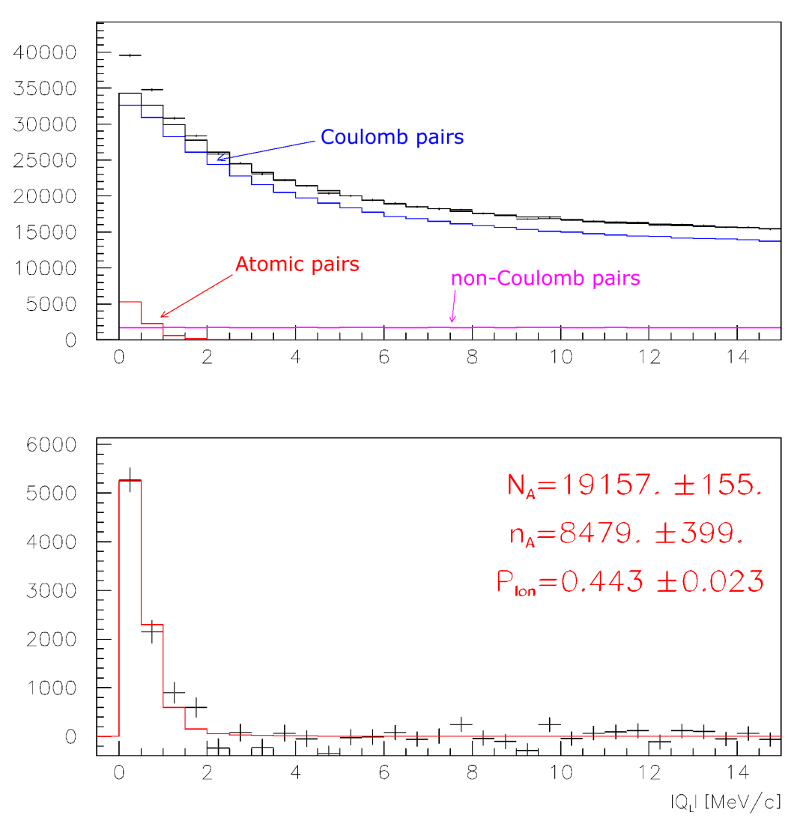
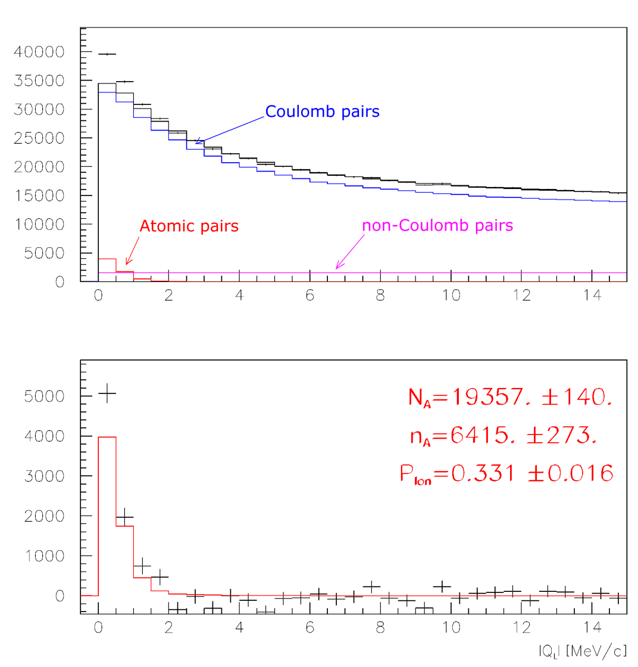
π⁺π⁻ atoms, run 2010
Run 2010, statistics with low and medium background (2/3 of all statistics). Point-like production of all particles.
Analysis on Q_{L}, Q_{T} < 4 MeV/c
Analysis on Q_{L}-Q_{T}, Q_{T} < 4 MeV/c

Slide 26
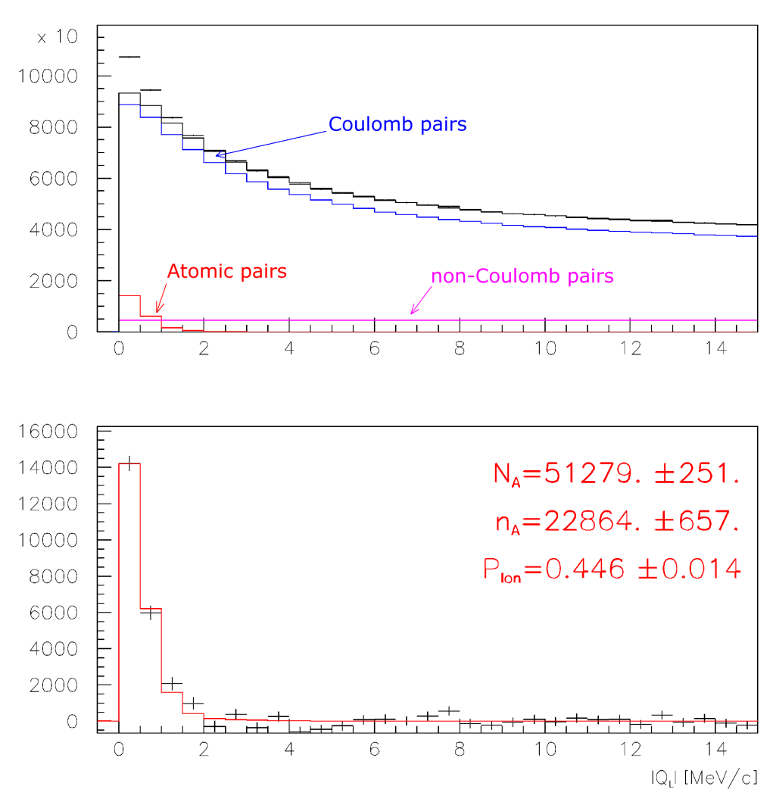
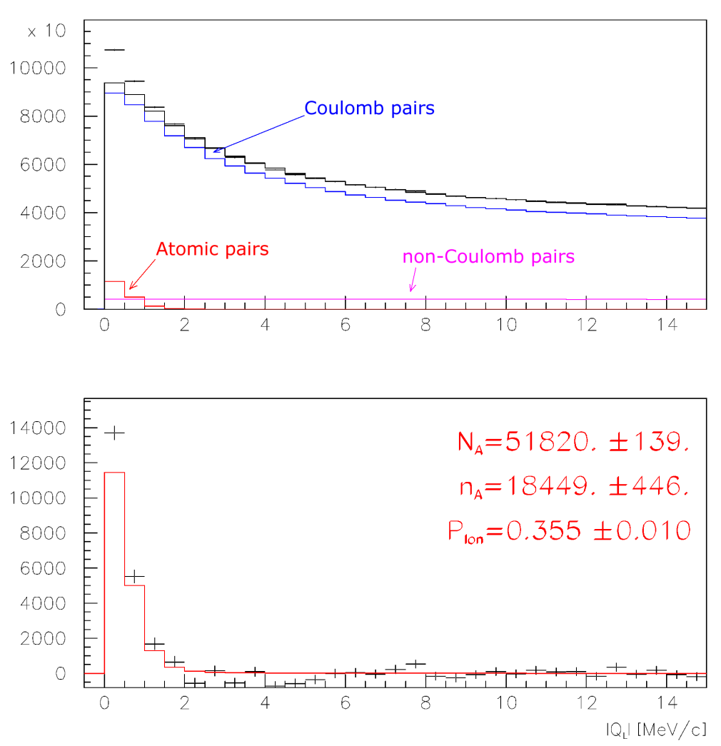
π⁺π⁻ atoms, run 2008-2010
Run 2008-2010, statistics with low and medium background (2/3 of all statistics). Point-like production of all particles.
Analysis on Q_{L}, Q_{T} < 4 MeV/c
Analysis on Q_{L}-Q_{T}, Q_{T} < 4 MeV/c
P_{br} (2001-2003) = 0.446±0.0093

Slide 27
π⁺π⁻ pair analysis
 | 2008 | 2009 | 2010
N_{A}(Q_{L}) | 12480±120 | 19640±150 | 19160±160
N_{A}(Q_{L}-Q_{T}) | 12600±110 | 19860±140 | 19360±140
n_{A}(Q_{L}) | 5680±330 | 8700±400 | 8480±400
n_{A}(Q_{L}-Q_{T}) | 5330±220 | 6700±270 | 6420±270
P_{br}(Q_{L}) | 0.455±0.030 | 0.443±0.023 | 0.443±0.023
P_{br}(Q_{L}-Q_{T}) | 0.423±0.020 | 0.337±0.015 | 0.331±0.016
P_{br}(2001-2003)=0.446±0.0093

Slide 28
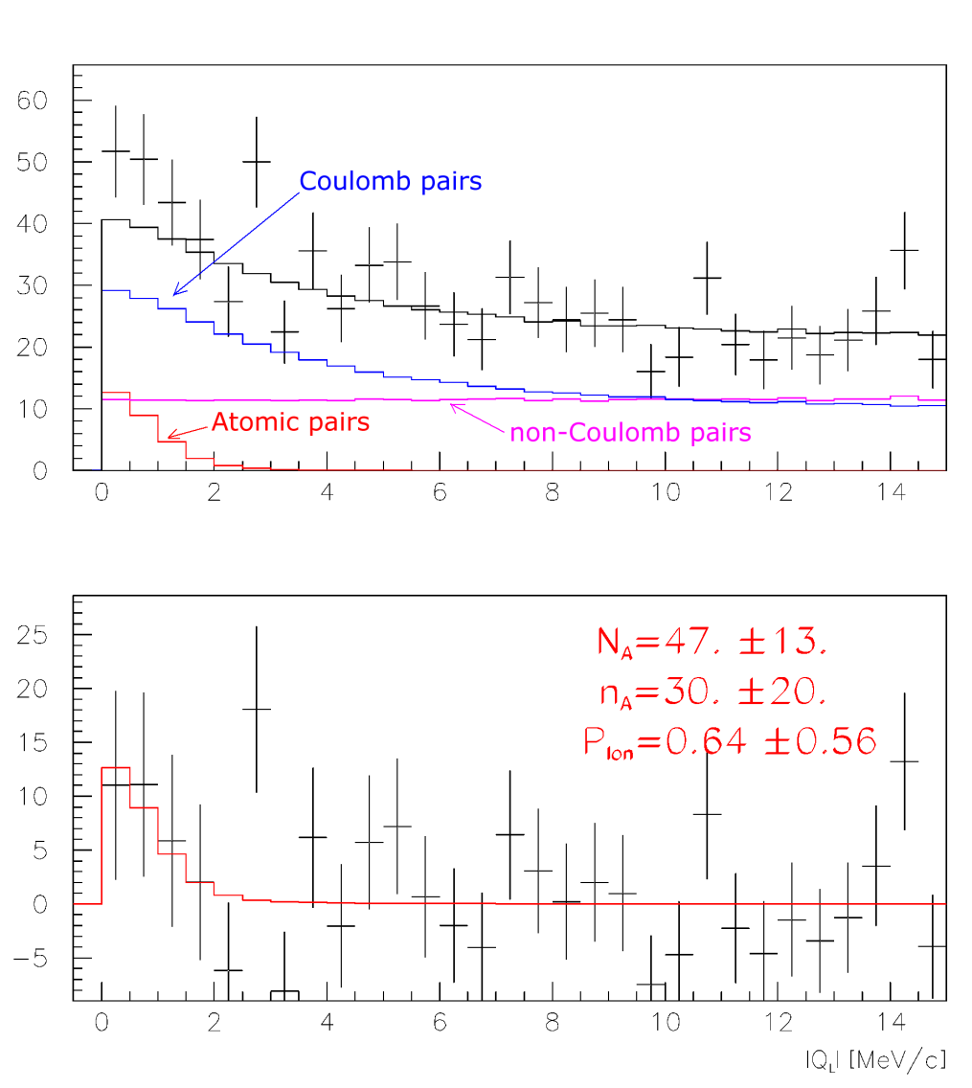
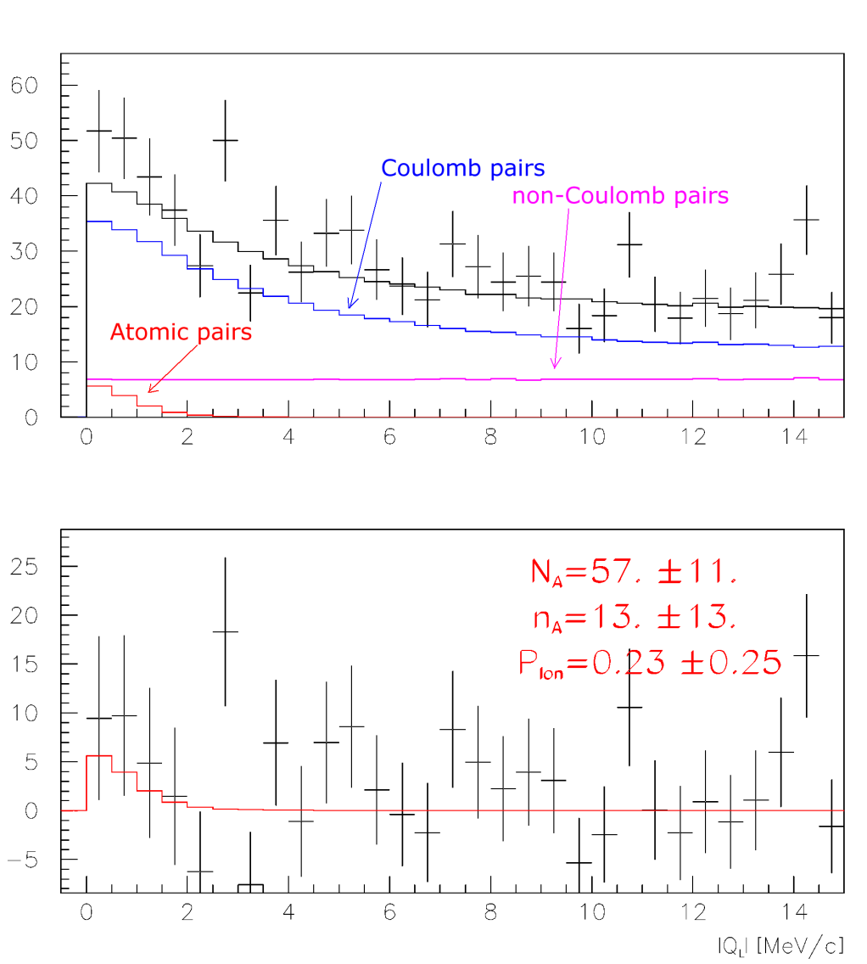
π⁺Κ⁻ atoms, run 2008
Run 2008, statistics with low and medium background (2/3 of all statistics). Point-like production of all particles.
Analysis on Q_{L}, Q_{T} < 4 MeV/c
Analysis on Q_{L}-Q_{T}, Q_{T} < 4 MeV/c

Slide 29
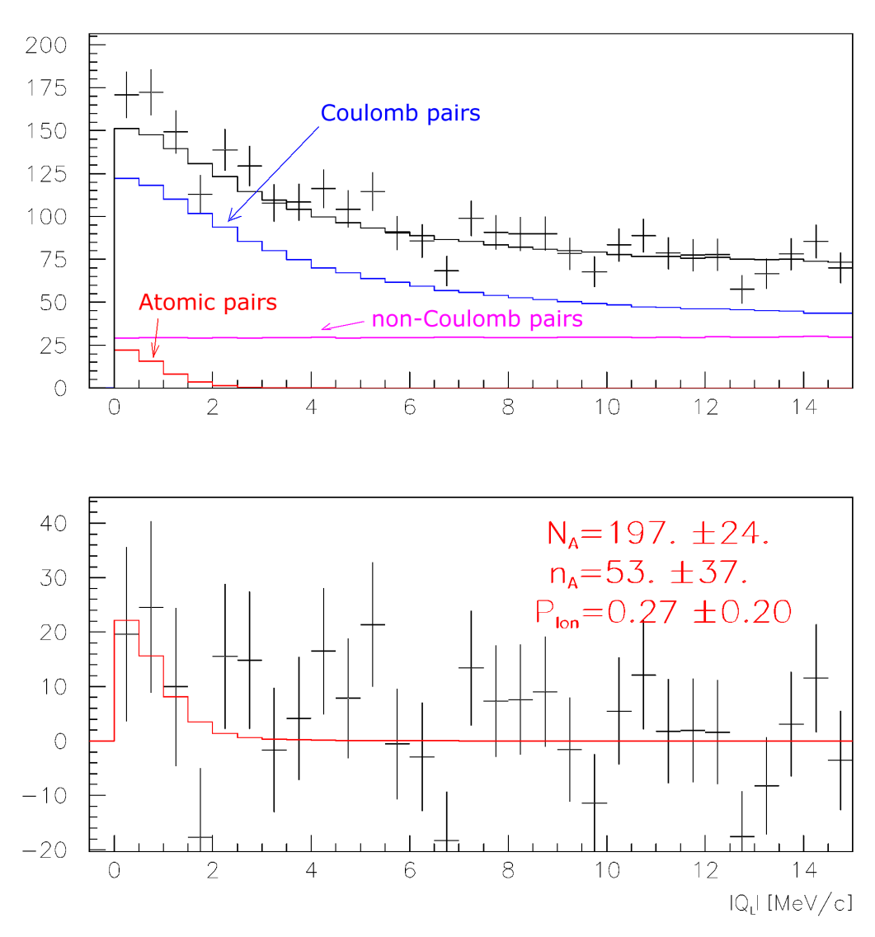
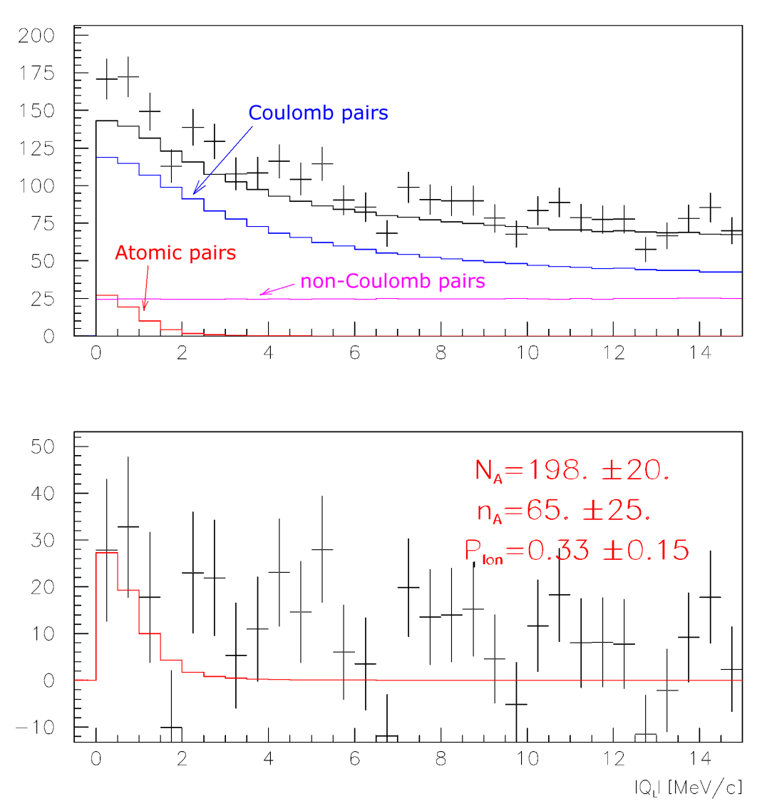
π⁺Κ⁻ atoms, run 2008-2010
Run 2008-2010, statistics with low and medium background (2/3 of all statistics). Point-like production of all particles.
Analysis on Q_{L}, Q_{T} < 4 MeV/c
Analysis on Q_{L}-Q_{T}, Q_{T} < 4 MeV/c

Slide 30
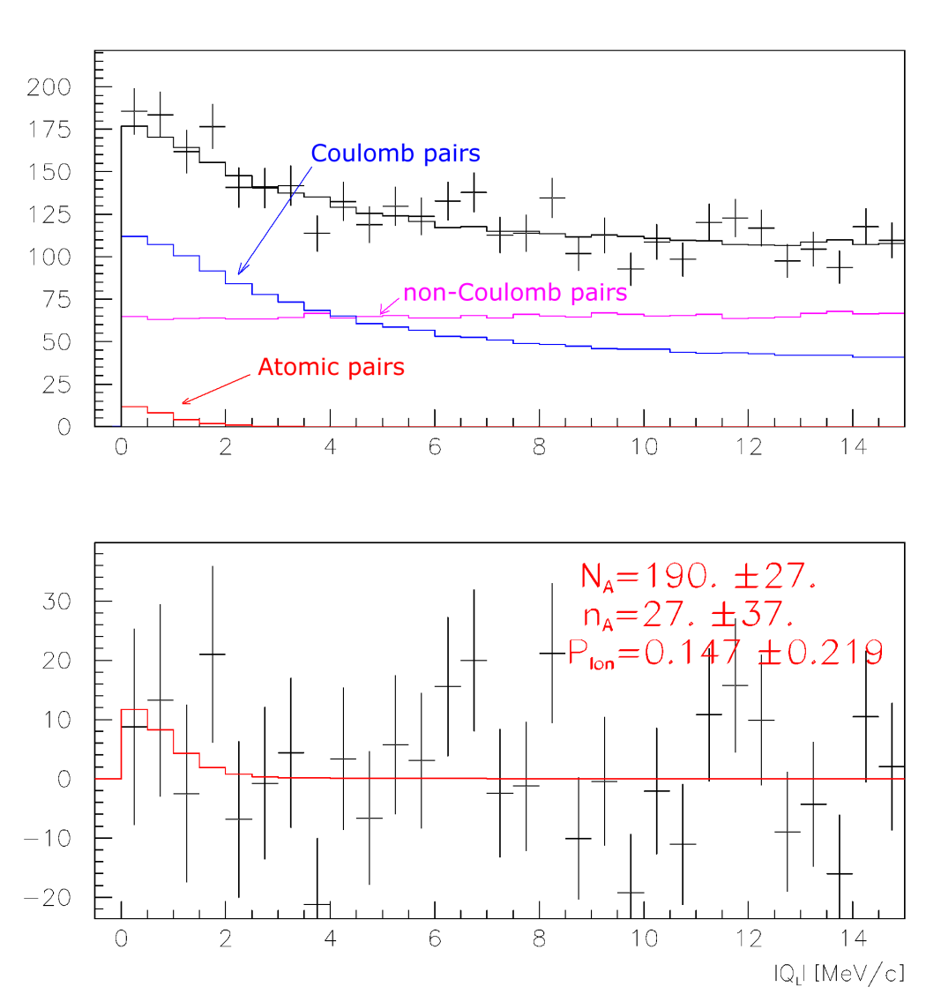
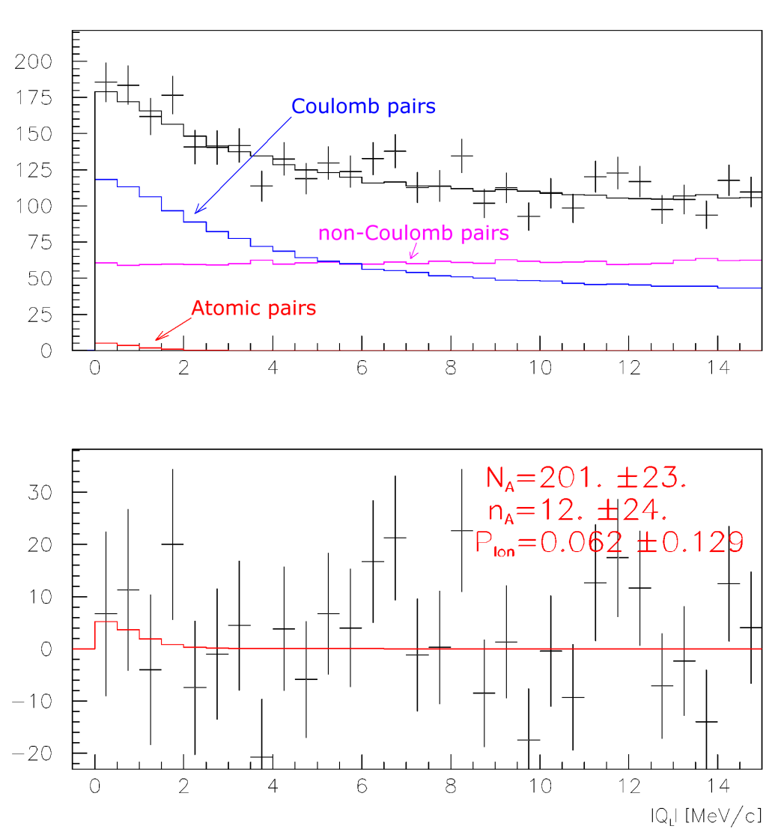
Κ⁺π⁻ atoms, run 2010
Run 2010, statistics with low and medium background (2/3 of all statistics). Point-like production of all particles.
Analysis on Q_{L}, Q_{T} < 4 MeV/c
Analysis on Q_{L}-Q_{T}, Q_{T} < 4 MeV/c

Slide 31
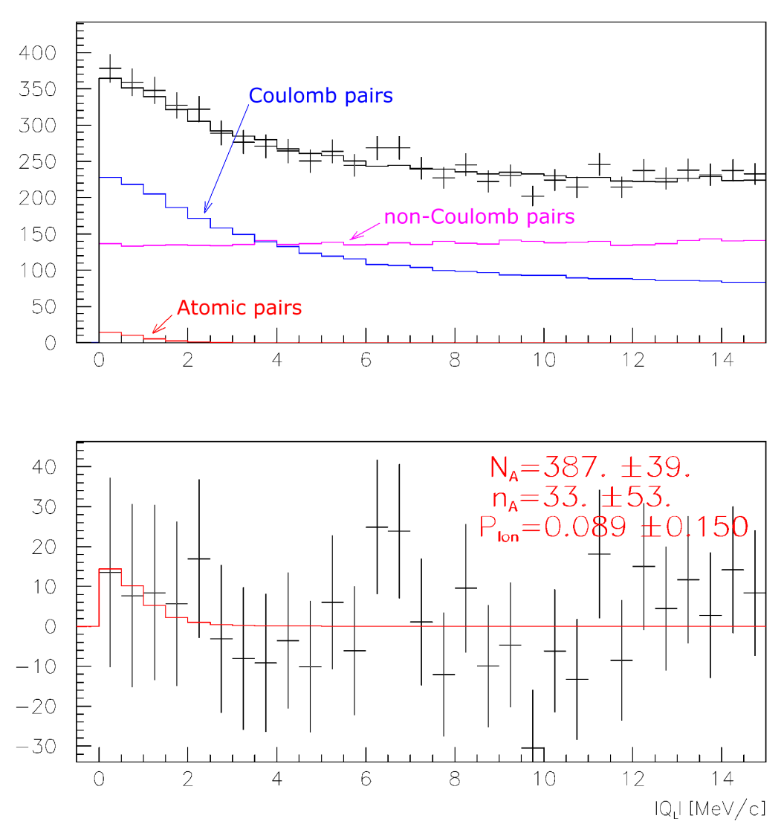
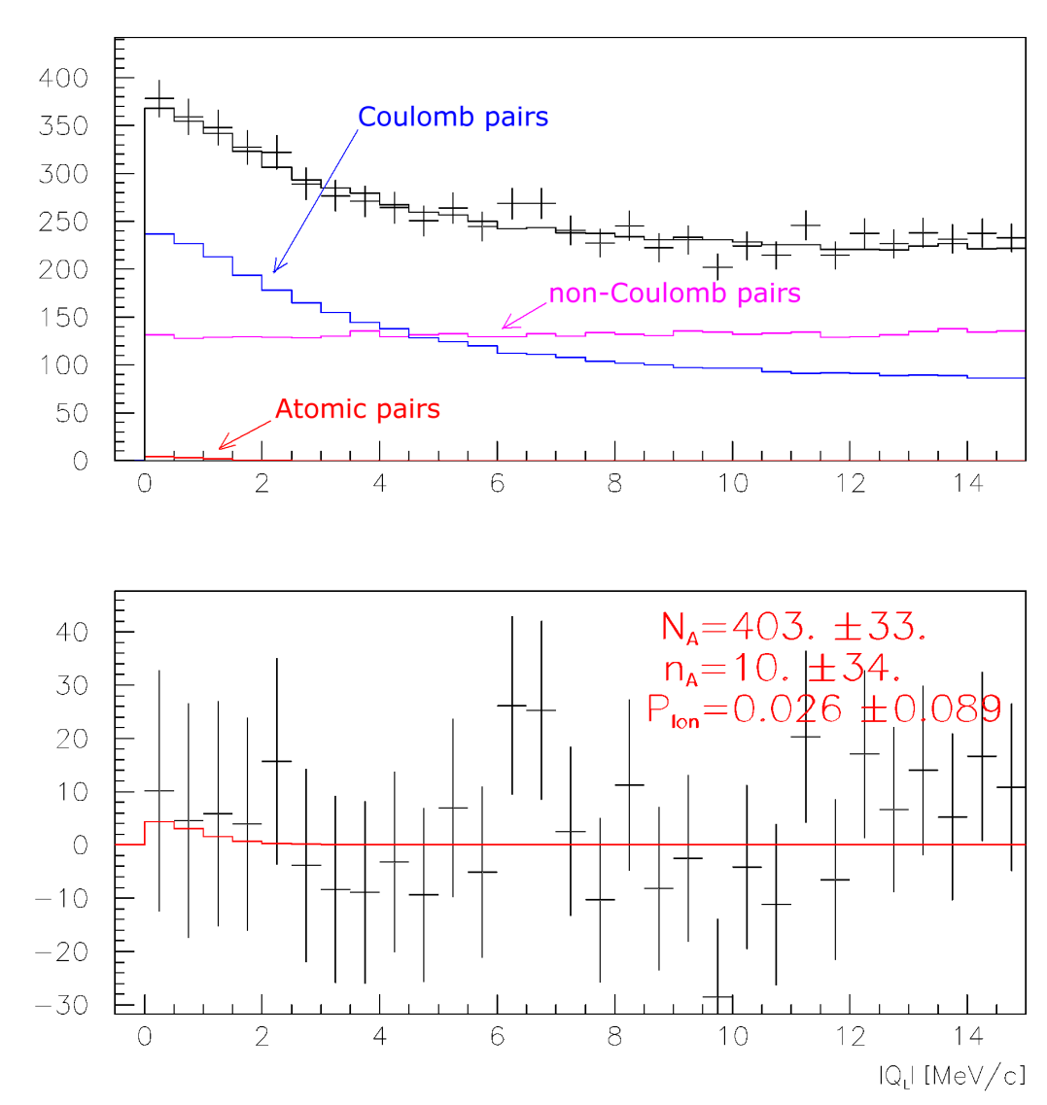
Κ⁺π⁻ atoms, run 2009-2010
Run 2009-2010, statistics with low and medium background (2/3 of all statistics). Point-like production of all particles.
Analysis on Q_{L}, Q_{T} < 4 MeV/c
Analysis on Q_{L}-Q_{T}, Q_{T} < 4 MeV/c

Slide 32
π⁺Κ⁻ and Κ⁺π⁻ pair analysis
 | π⁺Κ⁻ pairs 2008-2010 | Κ⁺π⁻ pairs 2009-2010
N_{A}(Q_{L}) | 200±24 | 390±40
N_{A}(Q_{L}-Q_{T}) | 200±20 | 400±33
n_{A}(Q_{L}) | 53±37 | 33±53
n_{A}(Q_{L}-Q_{T}) | 65±25 | 10±34
P_{br}(Q_{L}) | 0.27±0.20 | 0.089±0.150
P_{br}(Q_{L}-Q_{T}) | 0.33±0.15 | 0.026±0.089
n_{A}(Q_{L}) (sum) = 86±65
P_{br}^{theor} = 0.278 ±

Slide 33
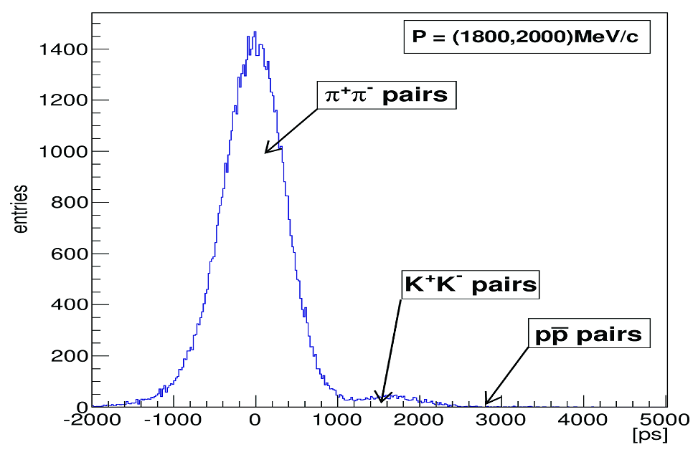
2010 data: distribution of pairs on (t₊+t₋)/2
for P=(1800, 2000) MeV/c
(t₊+t₋)/2

Slide 34
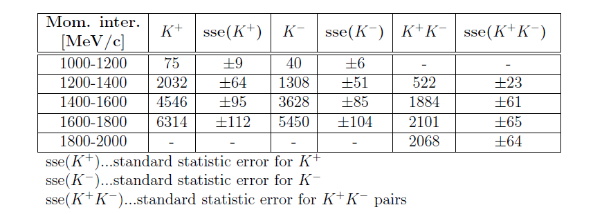
2010 data: results for kaons and K⁺K⁻ pairs in low momenta
Total number of K⁺K⁻ pairs in low momenta is 6575.

Slide 35
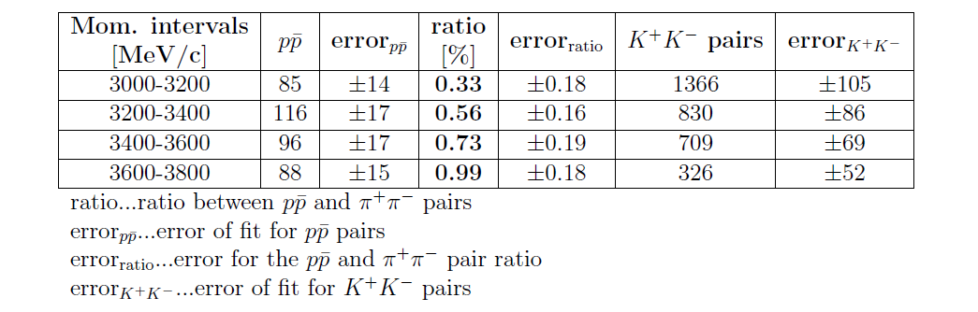
2010 data: results for K⁺K⁻ and pp pairs in high momenta
Total number of K⁺K⁻ pairs in high momenta is 3231.
The sum of low and high energy kaon pairs is 9806.

Slide 36
Coulomb pairs and atoms
For charged pairs from short-lived sources and with small relative momentum Q there is a strong Coulomb attraction in the final state.
This interaction increases the production yield of the free pairs with Q decreasing and also creates atoms.
π⁺π⁻, Κ⁺π⁻, Κ⁻π⁺,
Κ⁺Κ⁻, π⁺μ⁻, π⁻μ⁺
(π⁺π⁻), (Κ⁺π⁻), (Κ⁻π⁺),
(Κ⁺Κ⁻), (π⁺μ⁻), (π⁻μ⁺)
Coulomb pairs
Atoms
There is a precise ratio between the number of produced Coulomb pairs (N_{C}) with small Q and the number of atoms (N_{A}) produced simultaneously with these Coulomb pairs:

Slide 37
Κ⁺Κ⁻ atom and its lifetime
Properties of the K⁺K⁻ atom (kaonium or A_{2K}):
a_{B} = [αm_{K}/2]⁻¹ = 109.6 fm … Bohr radius
|E_{1s}| = α²m_{K}/4 = 6.57 keV … binding energy
τ(A_{2K}) ≈ [Γ(A_{2K})]⁻¹ = … lifetime
The lifetime for the kaonium decay into 2 pions is strongly reduced by the presence of strong interaction (OBE, scalar meson f₀ and a₀).
τ (A_{2K}→ ππ,πη) | K⁺K⁻ interaction
1.2×10⁻¹⁶ s | Coulomb-bound
3.2×10⁻¹⁸ s | + one-boson exchange (OBE)
1.1×10⁻¹⁸ s | + f₀’ (I=0) + πη-channel (I=1)
K⁺K⁻ interaction
complexity
Ref.:
S. Wycech, A.M. Green, Nucl. Phys. A562 (1993), 446;
S. Krewald, R. Lemmer, F.P. Sasson, Phys. Rev. D69 (2004), 016003.

Slide 38
A_{2π} and A_{πΚ} production

Slide 39
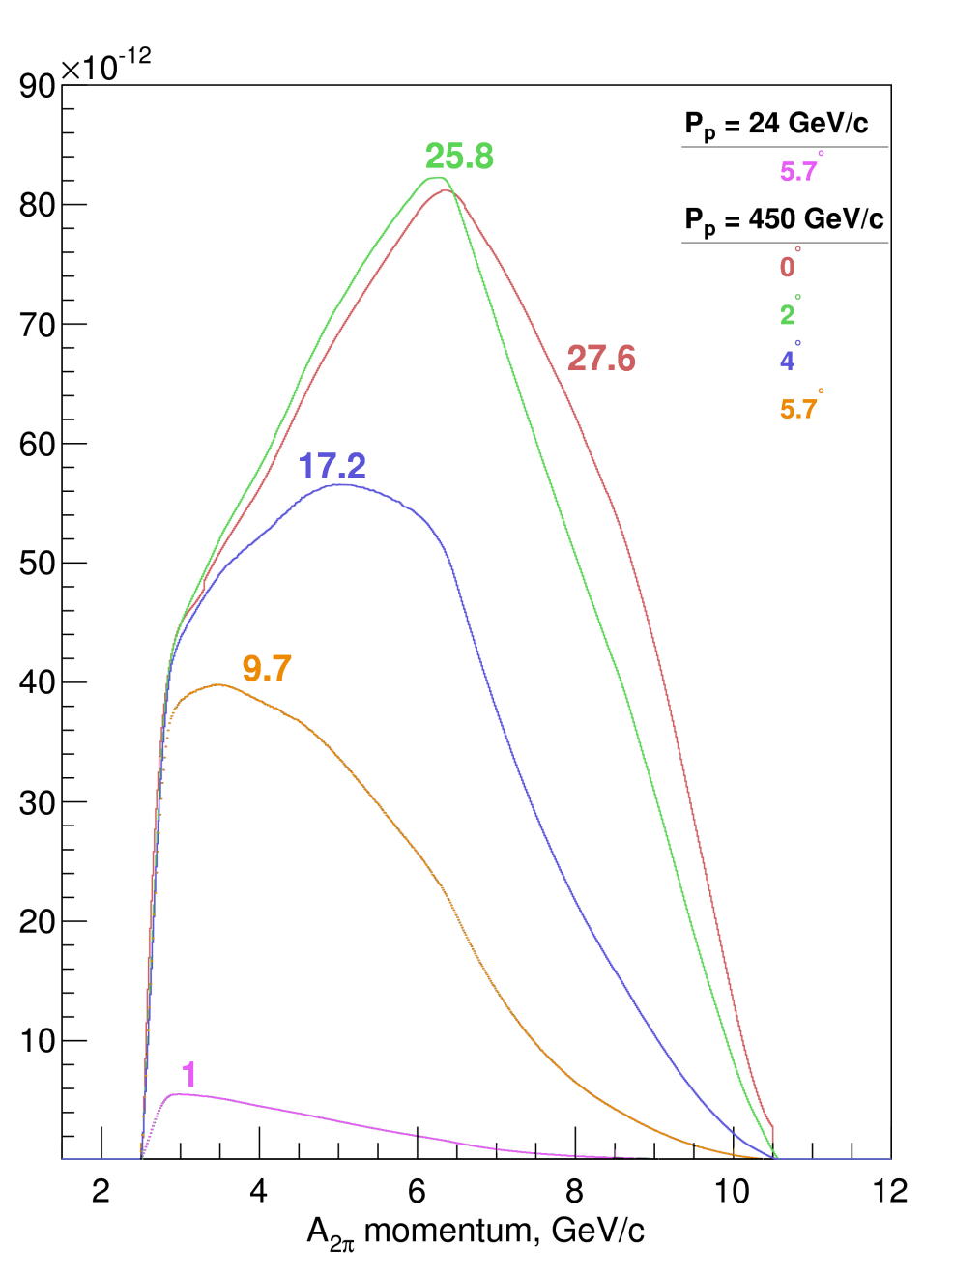
Yield of A_{2π} per one p-Ni interaction
Yield of A_{2π} dependence as a function of the atoms angle production and momentum in L. S. Bin = 15 MeV/c.

Slide 40
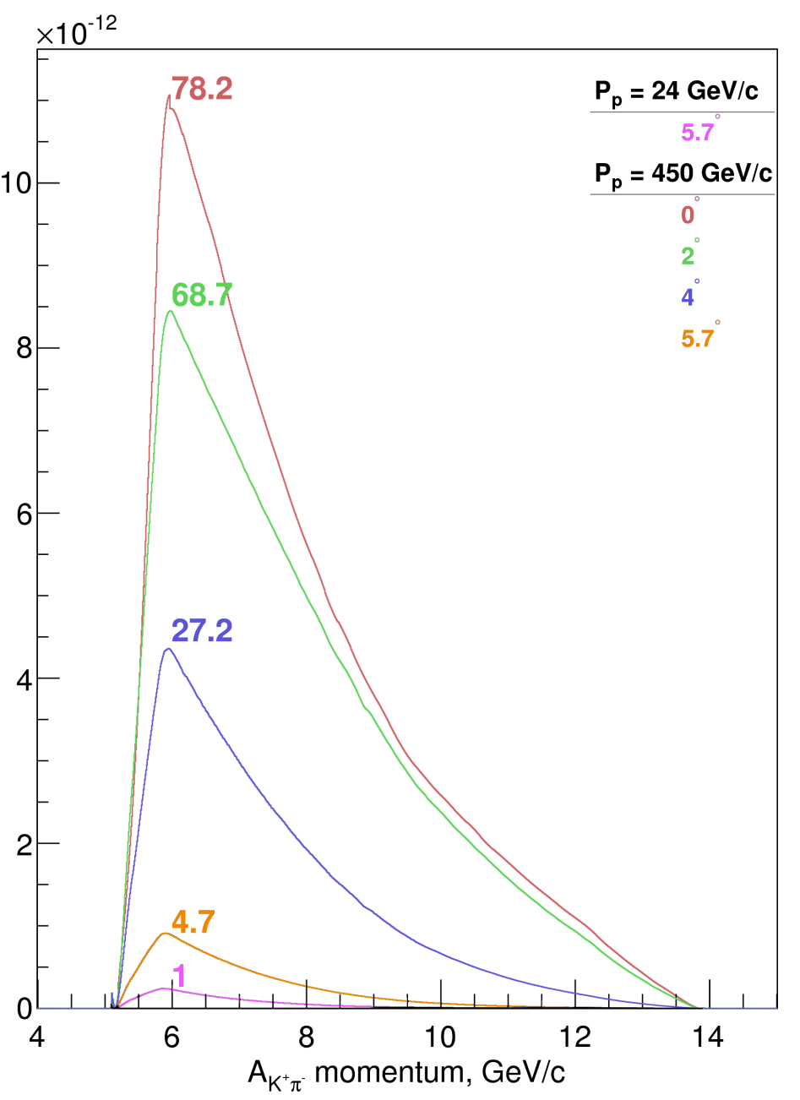
Yield of A_{Kπ} per one p-Ni interaction
Yield of A_{Kπ} dependence as a function of the atoms angle production and momentum in L. S. Bin = 9.6 MeV/c.

Slide 41
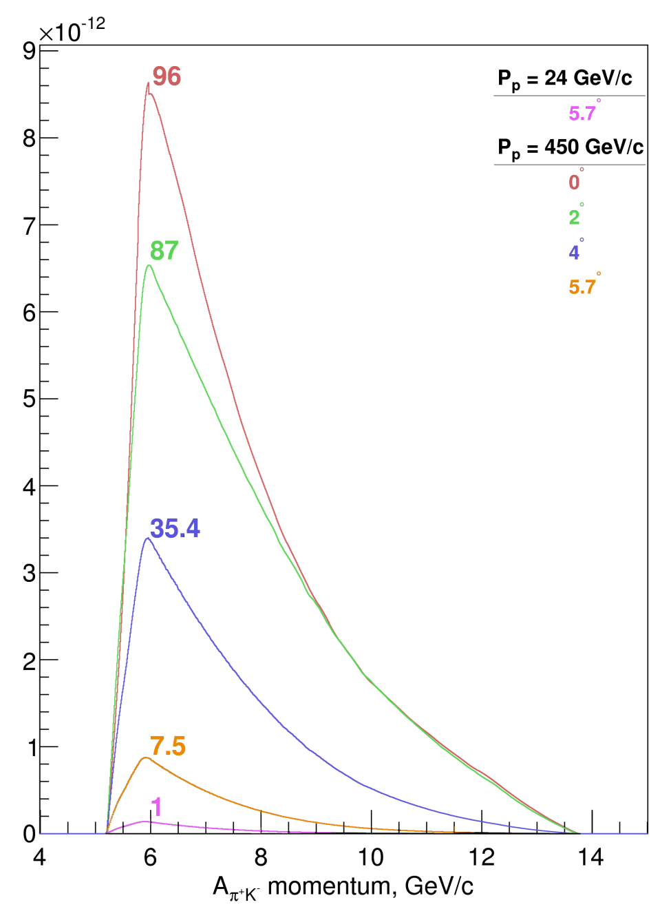
Yield of A_{πΚ} per one p-Ni interaction
Yield of A_{πΚ} dependence as a function of the atoms angle production and momentum in L. S. Bin = 9.6 MeV/c.

Slide 42
Thank you
for your attention!

Slide 43
Experimental conditions (run 2008-2010)
Primary proton beam | 24 GeV/c
Beam intensity | (10.5÷12)·10¹⁰ proton/spill
Single count of one IH plane | (5÷6)·10⁶ particle/spill
Spill duration | 450 ms
Ni target
Purity | 99.98%
Target thickness (year) | 98±1 μm (2008) | 108 ±1 μm (2009-2010)
Radiation thickness | 6.7·10⁻³ X₀ | 7.4·10⁻³ X₀
Probability of inelastic proton interaction | 6.4·10⁻⁴ | 7.1·10⁻⁴

Slide 44
Experimental conditions
Secondary particles channel (relative to the proton beam) | 5.7°
Angular divergence in vertical and horizontal planes | ±1°
Solid angle | 1.2•10⁻³ sr
Dipole magnet | B_{max} = 1.65 T, BL = 2.2 Tm
Time resolution [ps]
 | VH | IH |  |  |  | SFD
plane | 1 | 1 | 2 | 3 | 4 | X | Y | W
2008 | 112 | 713 | 728 | 718 | 798 | 379 | 508 | 518
2010 | 113 | 907 | 987 | 997 | 1037 | 382 | 517 | 527

Slide 45
Experimental conditions
SFD
Coordinate precision | σ_{X} = 60 μm | σ_{Y} = 60 μm | σ_{W} = 120 μm
Time precision | σ^{t}_{X} = 380 ps | σ^{t}_{Y} = 512 ps | σ^{t}_{W} = 522 ps
DC
Coordinate precision | σ = 85 μm
VH
Time precision | σ = 100 ps
Spectrometer
Relative resolution on the particle momentum in L.S. |  |  | 3•10⁻³
Precision on Q-projections | σ_{QX} = σ_{QY} = 0.5 MeV/c | σ_{QL} = 0.5 MeV/c (ππ) σ_{QL} = 0.9 MeV/c (πΚ)
Trigger efficiency 98 % | for pairs with Q_{L} < 28 MeV/c Q_{X} < 6 MeV/c Q_{Y} < 4 MeV/c

Slide 46
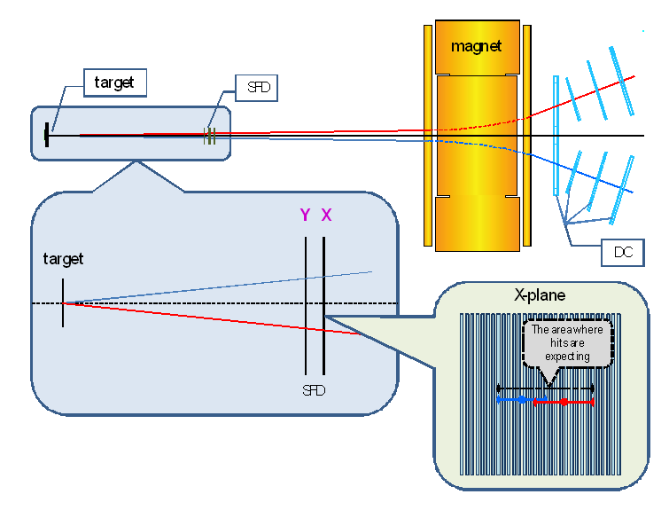
Extrapolation to the target

Slide 47
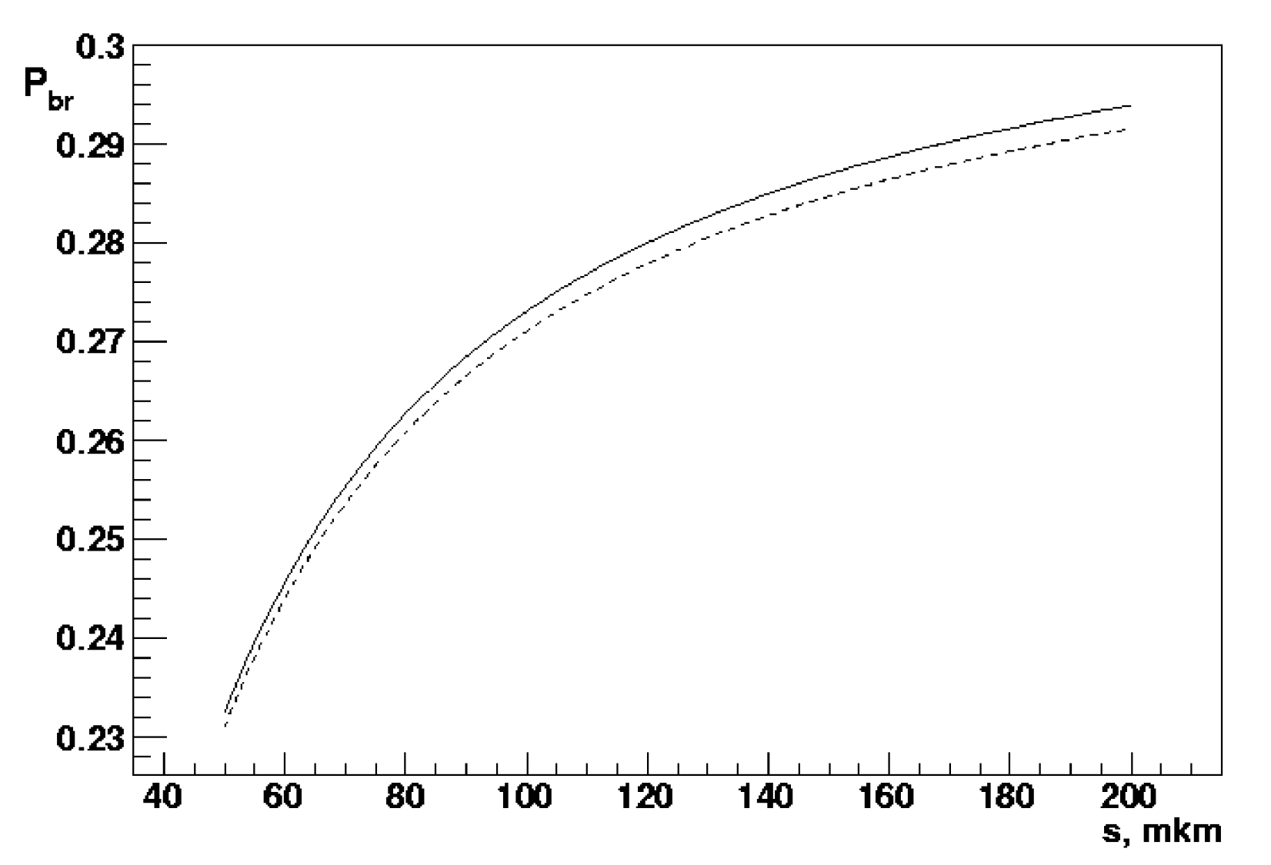
Break-up dependencies P_{br} from the target thickness for Κ⁺π⁻ atom (A_{Κπ}) and Κ⁻π⁺ atom (A_{πΚ})
Probability of break-up as a function of Ni target thickness for A_{πΚ} (solid line) and A_{Κπ} atoms (dashed line), τ_{1S} = 3.7•10⁻¹⁵ s.
Average momentum of A_{Κπ} and A_{πΚ} are 6.4 GeV/c and 6.5 GeV/c, accordingly.

Slide 48
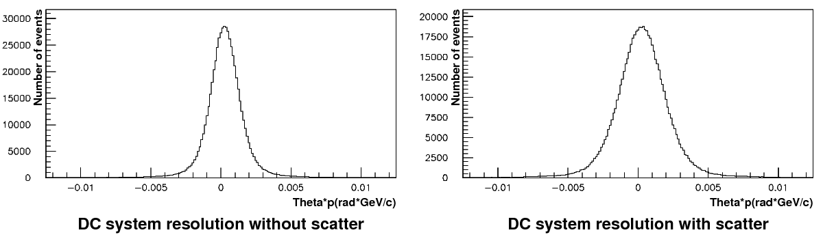
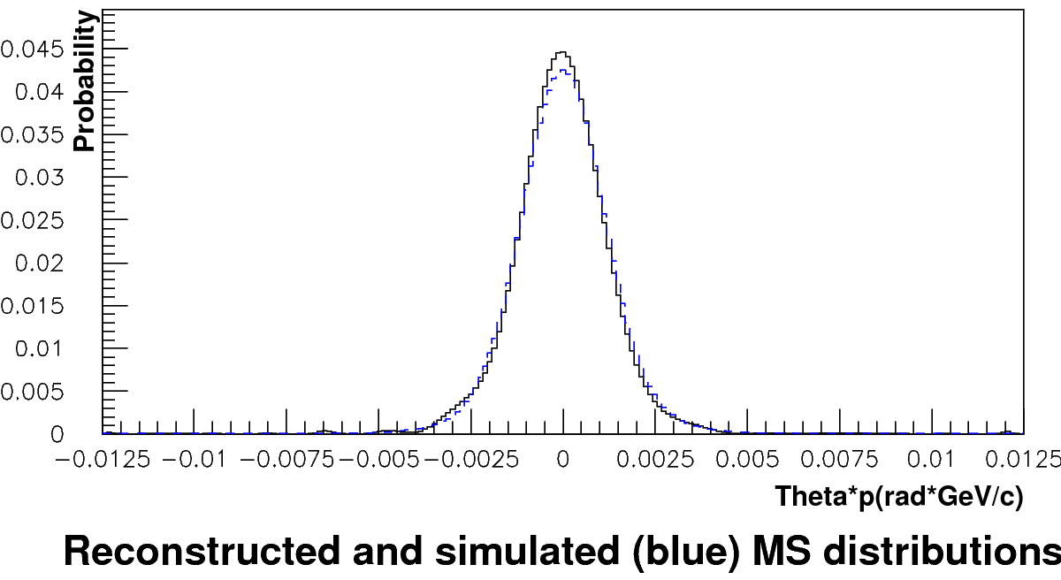
Analysis of multiple scattering in Ni (150 μm)
Run 2011. Analysis of multiple scattering in Ni (150 µm). Only events with one track in each projection were analyzed. δθ/θ ~ 0.7 %. After including in the analysis of all available events the statistics will be doubled and the expected value will be less than 0.5 %.

Slide 49
Light-yield – pulse-height spectrum
Test in the DIRAC spectrometer (with F1-TDC-ADC; pedestal is not visible)
ADC channels
Average number of photoelectrons is larger than 20.
Left-side peak is due to the crosstalk at PMT photocathode (almost 1 PE) and between slabs (a few PE).

Slide 50
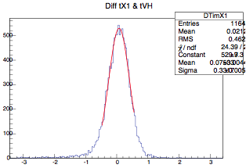
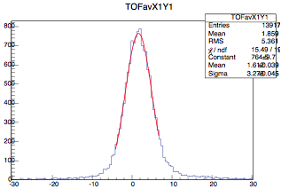
Time resolution and efficiency
Time resolution
with respect to VH
between couples of planes
average
300 ps
RMS
average
272 ps
RMS
Efficiency
using spectrometer prediction
0.970
using only e⁺e– trigger events
0.993 (better prediction precision)
between mutual planes
0.988
using only e⁺e– trigger events
0.994 (better prediction precision)
Efficiency in a high-intensity flux is yet to know.
Notes:
This slide shows all four scintillator planes.
50

Slide 51
Q_{L} distribution Κ⁺π⁻ pairs

Slide 52
Q_{L} distribution π⁺ Κ⁻ pairs

Slide 53
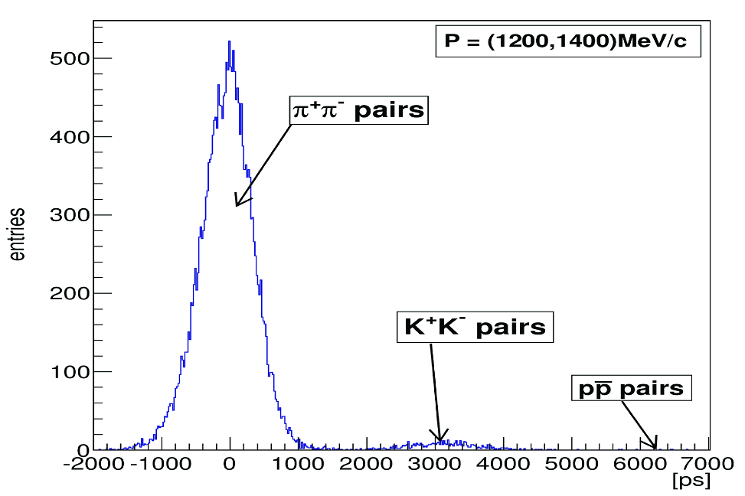
2010 data: distribution of pairs on (t₊+t₋)/2
for P=(1200, 1400) MeV/c
(t₊+t₋)/2

Slide 54
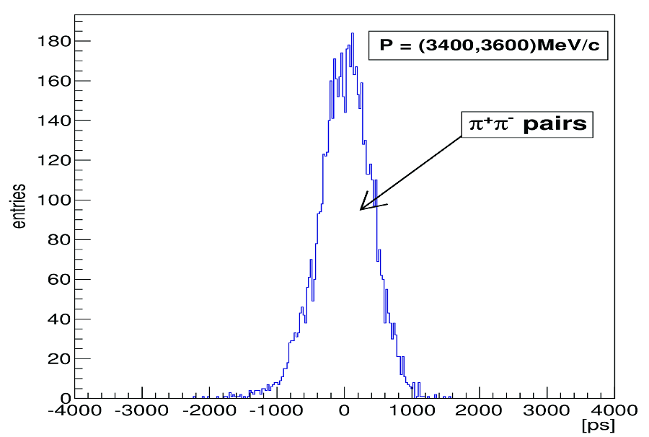
2010 data: distribution of π⁺π⁻ pairs detected by CHF on (t₊+t₋)/2 for P=(3400, 3600) MeV/c
(t₊+t₋)/2

Slide 55
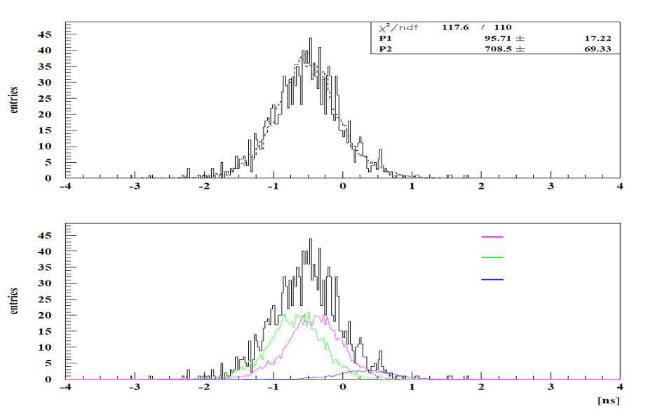
2010 data: distribution of π⁺π⁻, pp and K⁺K⁻ pairs on (t₊+t₋)/2 for P=(3400, 3600) MeV/c
No signal in CHF.
π⁺π⁻ pairs
Κ⁺Κ⁻ pairs
pp
(t₊+t₋)/2

Slide 56
Κ⁺Κ⁻ atom and its lifetime
Interests in KK physics?
General:
non-understood KK interplay with the scalar mesons [I^{G}(J^{PC})]
f₀[0⁺(0⁺⁺)] and a₀[1⁻(0⁺⁺)]
DIRAC experiment:
study of low-energy K⁺K⁻ scattering → estimate number of produced atoms A_{2K}
Kaonium decay width or lifetime “expected”:
Decay width Γ(A_{2K}) = [τ(A_{2K})]⁻¹ = α³m_{K}² Im(a_{KK}) … A_{2K} structure dependent:
Strong effects enter through the complex scattering length a_{KK} .
DIRAC experiment:
search for “atomic pairs” K⁺K⁻ from A_{2K} ionization
→ upper limit on τ(A_{2K}) → info about scattering length a_{KK} !

Slide 57

Κ⁺Κ⁻ atoms ionization probability
28 μm Pt
x 10⁻²
3.9
3.5
3.1
2.7
2.3
1.9
1.5
Ionization Probability
0 1 2 3 4
Life time τ in 10^{–18} s
Κ⁺Κ⁻ atoms Lorentz factor is γ = 18
Notes:
57

Slide 58

Lamb shift measurement with external magnetic field
L. Nemenov, V. Ovsiannikov, Physics Letters B 514 (2001) 247
Impact on atomic beam by external magnetic field B_{lab} & Lorentz factor γ
→
r_{A}
→
E
…. relative distance between
π⁺ and π⁻ in A_{2π} system
→
B_{lab}
→
r_{A}
→
B_{lab}
…. laboratory magnetic field
Α_{2π}, β = v/c
→
E
…electric field in A_{2π} system
→
p_{A}
→
| E | = βγ B_{lab}≈ γ B_{lab}

Slide 59

Resonant enhancement of the annihilation rate of A_{2π}
L. Nemenov, V. Ovsiannikov, E. Tchaplyguine, Nucl. Phys. (2002)

Slide 60

Resonant enhancement

Slide 61

Resonant method
Resonators
π⁺
π⁰
π⁰
π⁰
A*_{2π} A*_{πμ} A*_{πΚ}
π⁻
π⁰
π⁰
π⁰
Pt foil
Proton beam
Charged secondary
γ_{res1}
γ_{res2}
γ_{res3}
γ_{res4}

Slide 62
Published results on ππ atom: lifetime & scattering length
DIRAC data | τ_{1s} (10⁻¹⁵ s) value stat syst theo* tot | |a₀-a₂| value stat syst theo* tot | Reference
2001 |  |  | PL B 619 (2005) 50
2001-03 |  |  | PL B 704 (2011) 24
* theoretical uncertainty included in systematic error
NA48 | K-decay | a₀-a₂ value stat syst theo tot | Reference
2009 | K_{3π} |  | EPJ C64 (2009) 589
2010 | K_{e4} & K_{3π} |  | EPJ C70 (2010) 635
Notes:
62

Slide 63
A_{2π} lifetime, τ, in np states
n_{H} | τ_{H}•10⁸ s | τ_{2π}•10¹¹ s | Decay length A_{2π} in L.S. cm for γ=16.1
2p | 0.16 | 1.17 | 5.7
3p | 0.54 | 3.94 | 19
4p | 1.24 | 9.05 | 44
5p | 2.40 | 17.5 | 84.5
6p | 4.1 | 29.9 | 144
7p |  | 46.8* | 226
8p |  | 69.3* | 335
* extrapolated values

