Slide 1
Status Report of the
DIRAC Experiment - PS 212
L. Nemenov
18 April 2016

Slide 2








DIRAC Collaboration
CERN
Geneva, Switzerland
Tokyo Metropolitan University
Tokyo, Japan
Czech Technical University
Prague, Czech Republic
IFIN-HH
Bucharest, Romania
Institute of Physics ASCR
Prague, Czech Republic
JINR
Dubna, Russia
Nuclear Physics Institute ASCR
Rez, Czech Republic
SINP of Moscow State University
Moscow, Russia
INFN-Laboratori Nazionali di Frascati
Frascati, Italy
IHEP
Protvino, Russia
University of Messina
Messina, Italy
Santiago de Compostela University
Santiago de Compostela, Spain
KEK
Tsukuba, Japan
Bern University
Bern, Switzerland
Kyoto University
Kyoto, Japan
Kyoto Sangyo University
Kyoto, Japan
Zurich University
Zurich, Switzerland

Slide 3
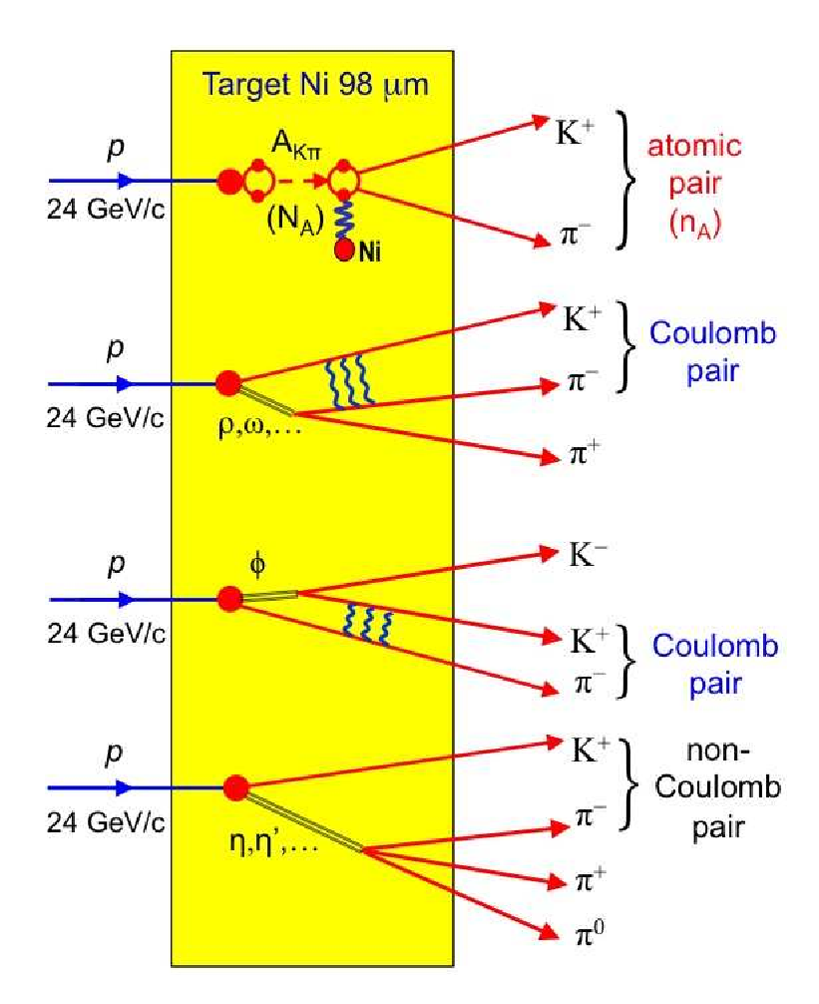
Inclusive πK production in 24 GeV/c p-Ni interaction
p + Ni → π⁻ K⁺ + X
Ionisation or breakup of the A_{Kπ} atoms leads to so-called atomic pairs
4/18/2016

Slide 4
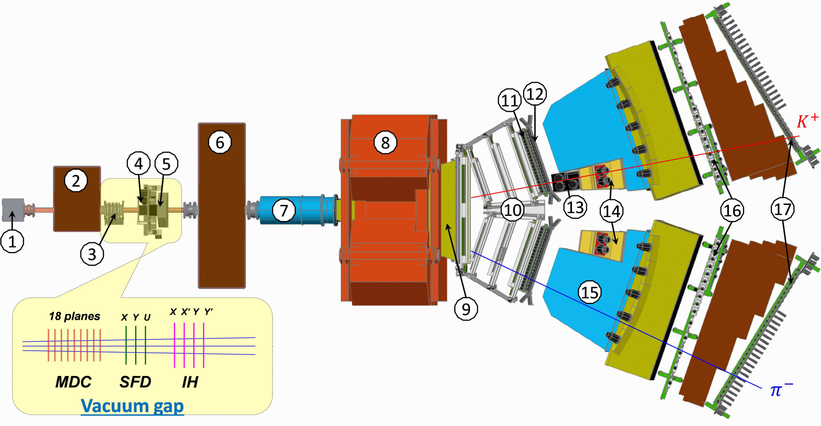
DIRAC upgraded Experimental setup
1 Target station ; 2 First shielding; 3 Micro Drift Chambers; 4 Scintillating Fiber Detector; 5 Ionization Hodoscope; 6 Second Shielding; 7 Vacuum Tube; 8 Spectrometer Magnet; 9 Vacuum Chamber; 10 Drift Chambers; 11 Vertical Hodoscope; 12 Horizontal Hodoscope; 13 Aerogel Čerenkov; 14 Heavy Gas Čerenkov; 15 Nitrogen Čerenkov; 16 Preshower; 17 Muon Detector
4/18/2016

Slide 5
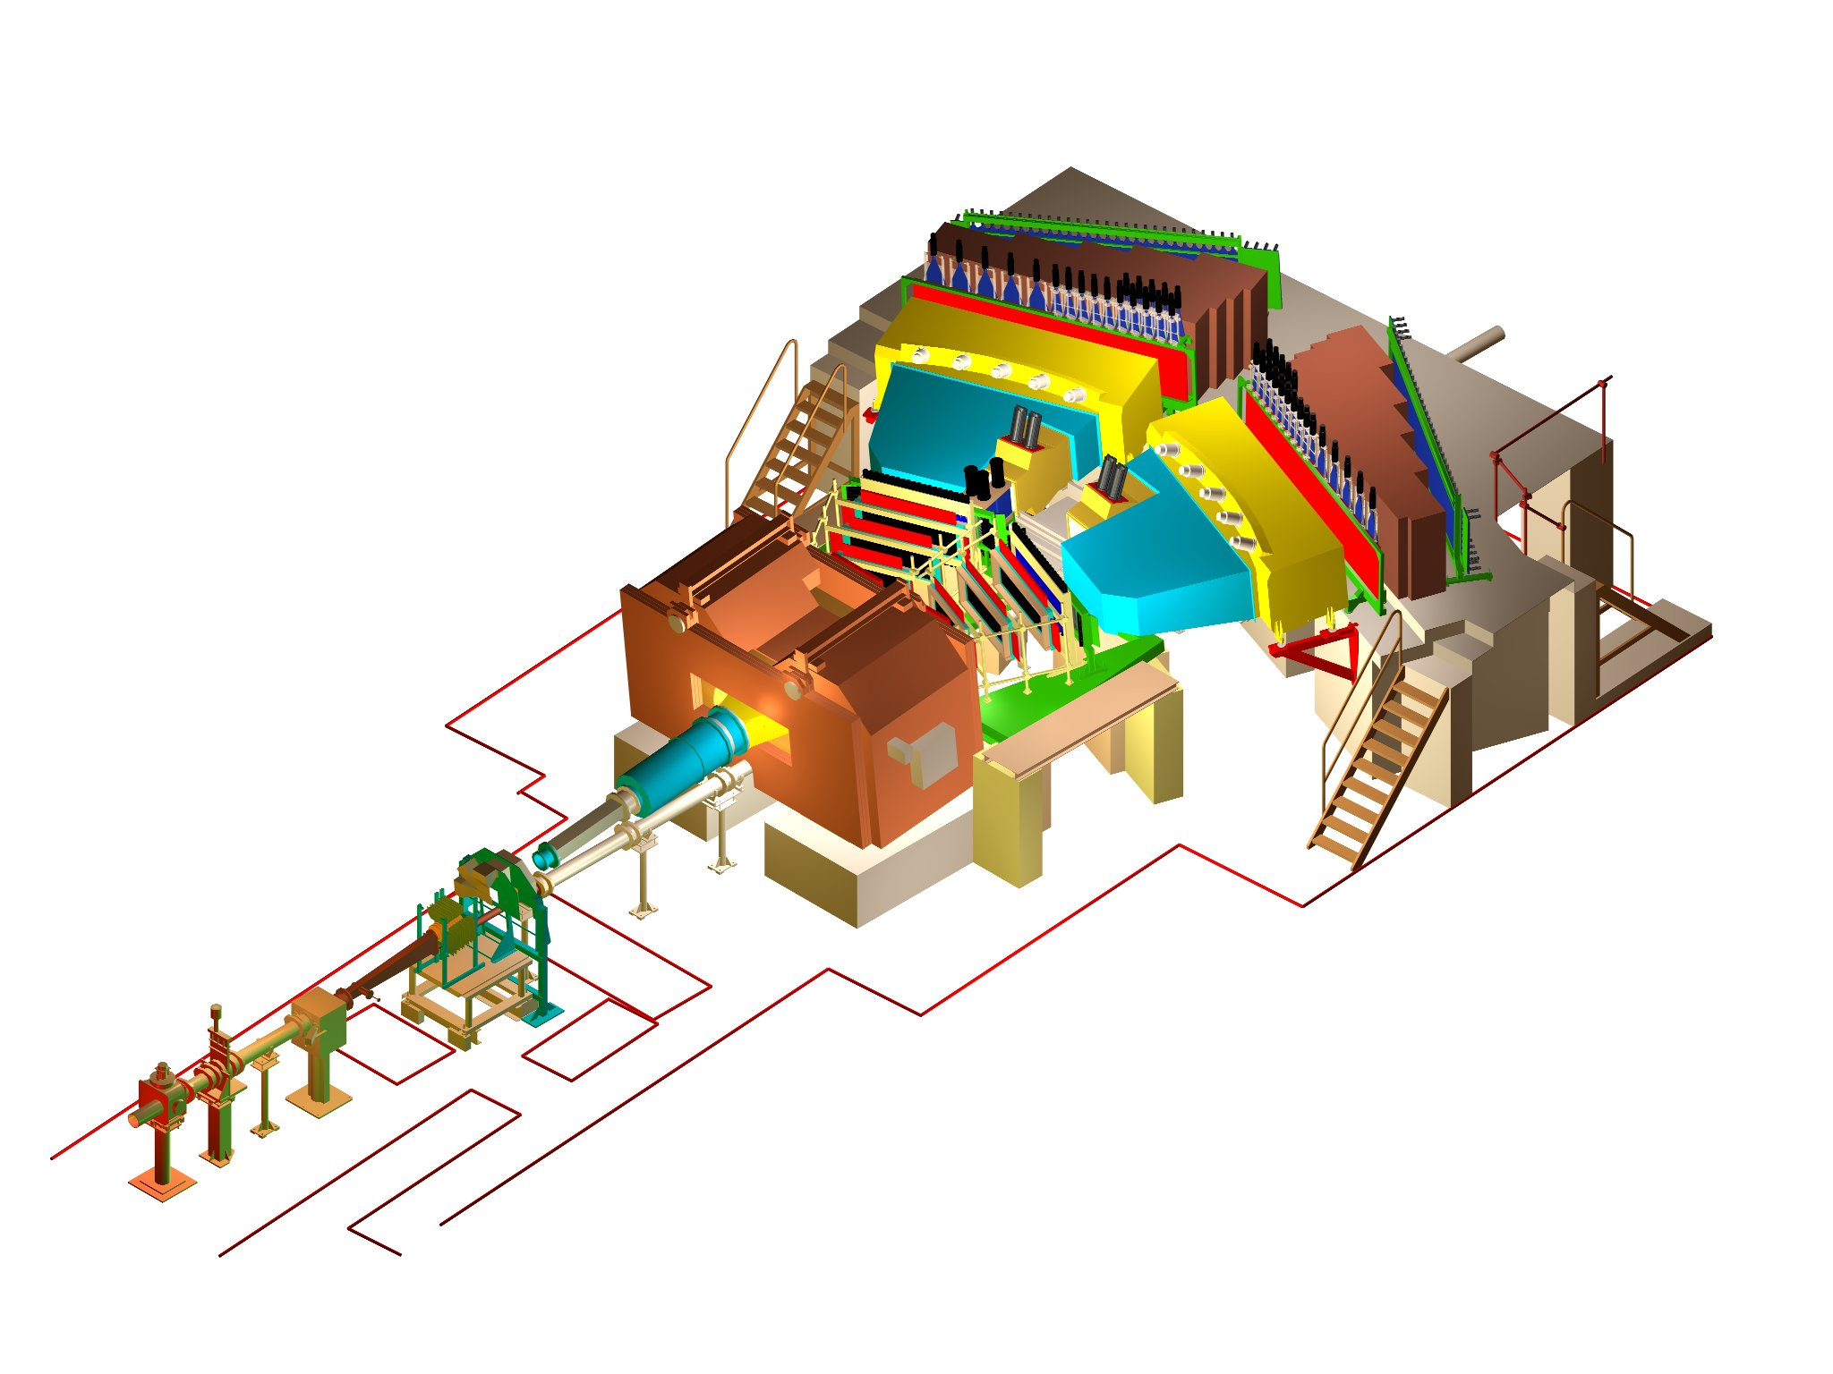
DIRAC upgraded Experimental setup
σ_{QX} = σ_{QY} = 0.5 MeV/c
σ_{QL} = 0.5 MeV/c (ππ)
σ_{QL} = 0.9 MeV/c (πΚ)
4/18/2016
Notes:
5

Slide 6
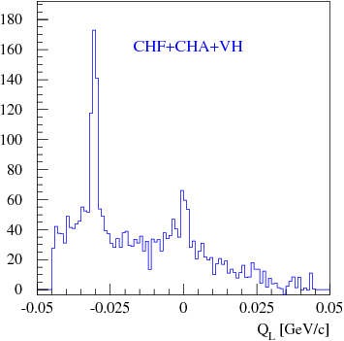
Q_{L} distributions of π⁻K⁺ pairs
Q_{L} distribution of π⁻K⁺ pairs after applying the selection criteria.
Events with positive Q_{L} are suppressed compared to those with negative Q_{L} due to lower acceptance and lower production cross section.
4/18/2016

Slide 7
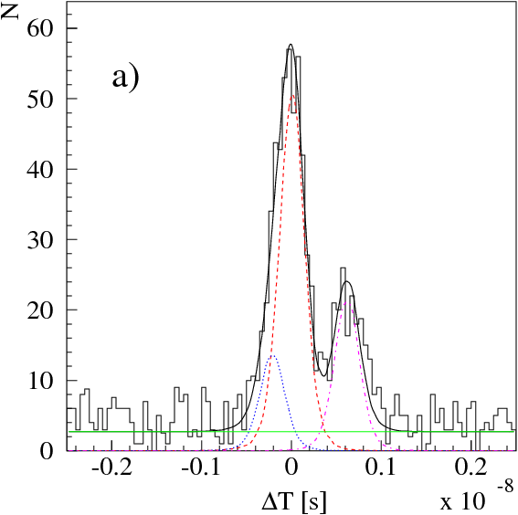
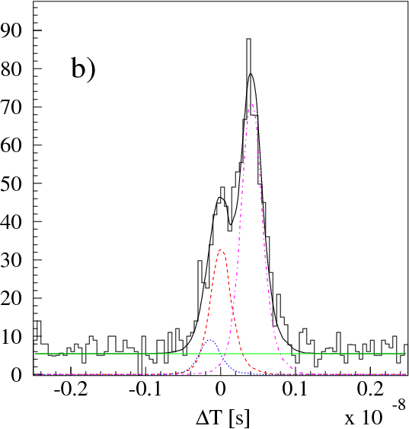
Time of flight difference for pair events data
Distributions over time-of-flight difference for events with positively charged particle momenta in the intervals: a) 4.4 - 4.5 GeV/c; b) 5.4 - 5.5 GeV/c.
Experimental data (histograms) are fitted by the sum of distributions: K⁺π⁻ (red, dashed), π⁺π⁻ (blue dotted), pπ⁻ (magenta dotted-dashed) and accidental pairs (green, constant). The sum of all the fractions is shown as black solid line.
4/18/2016

Slide 8
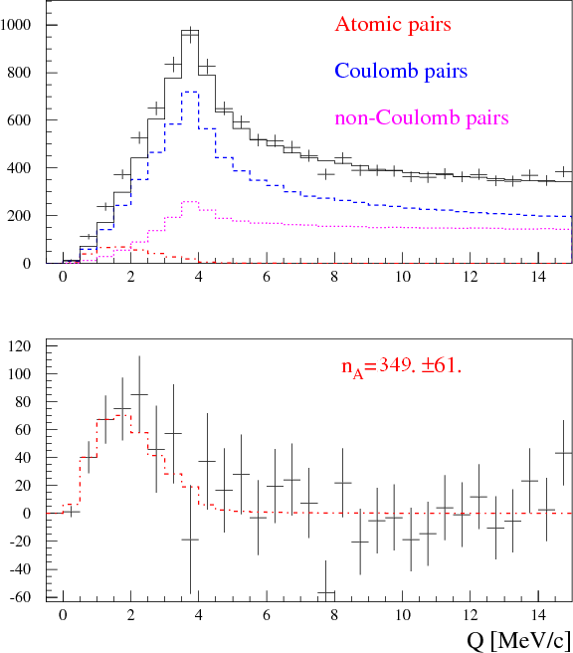
Experimental Q distributions of π–K⁺ and π⁺K– pairs
π⁻K⁺ and π⁺K⁻ pairs
Top: Q distribution of experimental π⁻K⁺ and π⁺K⁻ pairs fitted by the sum of simulated distributions of atomic, Coulomb and non-Coulomb pairs.
Atomic pairs are shown in red (dotted-dashed), free pairs (Coulomb in blue (dashed) and non-Coulomb in magenta (dotted)) in black (solid).
Bottom: Difference distribution between experimental and simulated free pair distributions compared with simulated atomic pairs.
The number of observed atomic pairs is denoted by n_{A}
4/18/2016

Slide 9
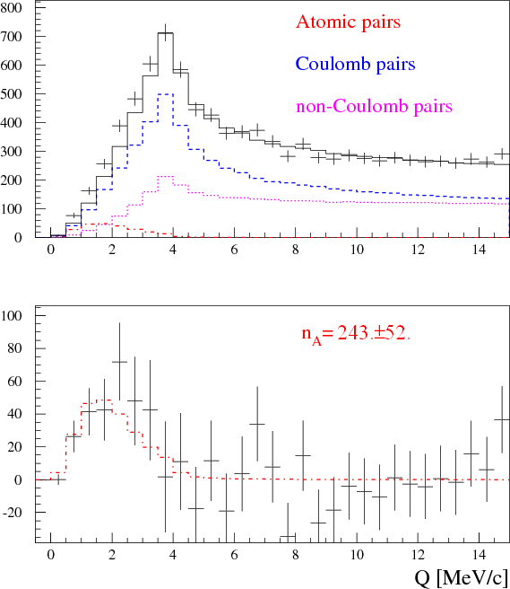
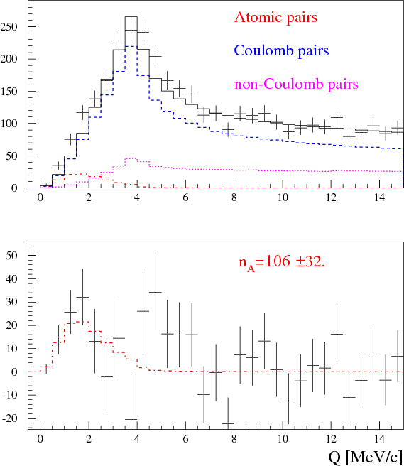
Experimental Q distributions of π–K⁺ and π⁺K– pairs
only π⁻K⁺ pairs
only π⁺K⁻ pairs
Top: Q distribution of experimental π⁻K⁺ and π⁺K⁻ pairs fitted by the sum of simulated distributions of atomic, Coulomb and non-Coulomb pairs.
Atomic pairs are shown in red (dotted-dashed), free pairs (Coulomb in blue (dashed) and non-Coulomb in magenta (dotted)) in black (solid).
Bottom: Difference distribution between experimental and simulated free pair distributions compared with simulated atomic pairs.
The number of observed atomic pairs is denoted by n_{A}
4/18/2016

Slide 10
Atomic pair numbers n_{A} of π⁻K⁺ and π⁺K⁻ pairs
Analysis | π⁻K⁺ | π⁺K⁻ | π⁻K⁺+ π⁺K⁻
Q | 243 ± 52 (4.7σ) | 106 ± 32 (3.3σ) | 349 ± 61 (5.7σ)
|Q_{L}| | 164 ± 79 (2.1σ) | 67 ± 47 (1.4σ) | 230 ± 92 (2.5σ)
|Q_{L}|,Q_{T} | 237 ± 50 (4.7σ) | 78 ± 32 (2.5σ) | 314 ± 59 (5.3σ)
Atomic pair numbers n_{A} by analysing the 1-dimensional Q and Q_{L} distributions and the 2-dimensional (|Q_{L}|, Q_{T}) distribution.
Only statistical errors are given.
The atomic pairs numbers taking in to account statistical and systematic errors are:
n_{A=} 349 ± 62 (5.6σ) Q analysis
n_{A =} 314 ± 60 (5.3σ) |Q_{L}|,Q_{T} analysis
4/18/2016

Slide 11
Systematic errors in the number of πK atomic pairs (n_{A})
Sources of systematic errors
Uncertainty in Λ width correction | 0.8 | 3.0 | 2.0
Uncertainty of multiple scattering in Ni target | 4.4 | 0.7 | 2.7
Accuracy of SFD simulation | 0.2 | 0.0 | 0.1
Correction of Coulomb correlation function on finite size production region | 0.0 | 0.2 | 0.1
Uncertainty in πK pair laboratory momentum spectrum | 3.3 | 5.4 | 7.8
Uncertainty in laboratory momentum spectrum of background pairs | 6.6 | 1.6 | 5.4
Total | 8.6 | 6.4 | 10.1
4/18/2016

Slide 12
Thank you
4/18/2016

Slide 13
Additional slides
Simulation of K⁺ and K– production cross section
M. Gugiu

Slide 14
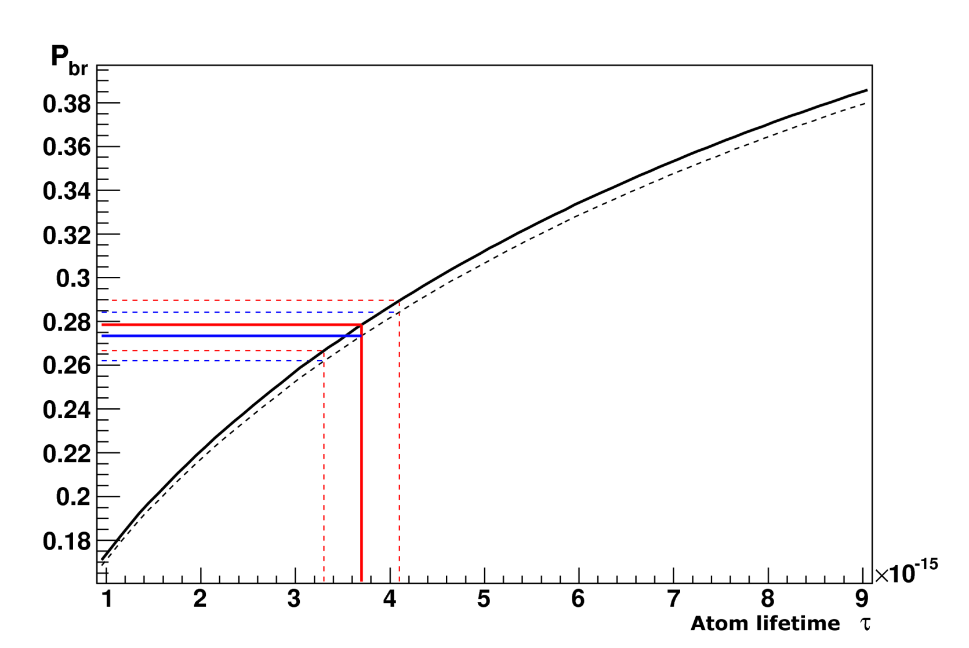
Break-up dependencies P_{br} from atom lifetime for K⁺π– and π⁺K– atom
P_{br} values corresponding to τ_{1S}^{th}
Atom | s, μm | P_{br} | P_{br}-σ | P_{br}+σ
A_{πΚ} | 98 | 0.274 | 0.263 | 0.285
A_{πΚ} | 108 | 0.278 | 0.267 | 0.290
A_{Κπ} | 98 | 0.269 | 0.258 | 0.280
A_{Κπ} | 108 | 0.273 | 0.262 | 0.284
Probability of break-up as a function of lifetime in the ground state for A_{πΚ} (solid line) and A_{Κπ} atoms (dashed line) in Ni target of thickness 108 μm.
Average momentum of A_{Κπ} and A_{πΚ} are 6.4 GeV/c and 6.5 GeV/c accordingly.
4/18/2016

Slide 15
DIRAC setup characteristics and experimental conditions
The angle of the secondary channel relative to proton beam | 5.7±1°
Solid angle | 1.2•10⁻³ sr
Dipole magnet | B_{max} = 1.65 T BL = 2.2 Tm
Spectrometer
Relative resolution on the particle momentum in L.S. |  | 3•10⁻³
Precision on Q-projections (experimental measurement) | σ_{QX} = σ_{QY} = 0.5 MeV/c | σ_{QL} = 0.5 MeV/c (ππ) σ_{QL} = 0.9 MeV/c (πΚ)
4/18/2016

