Slide 1
Status Report of the
DIRAC Experiment - PS 212
L. Nemenov (JINR)
SPS COMMITTEE, January 2018

Slide 2
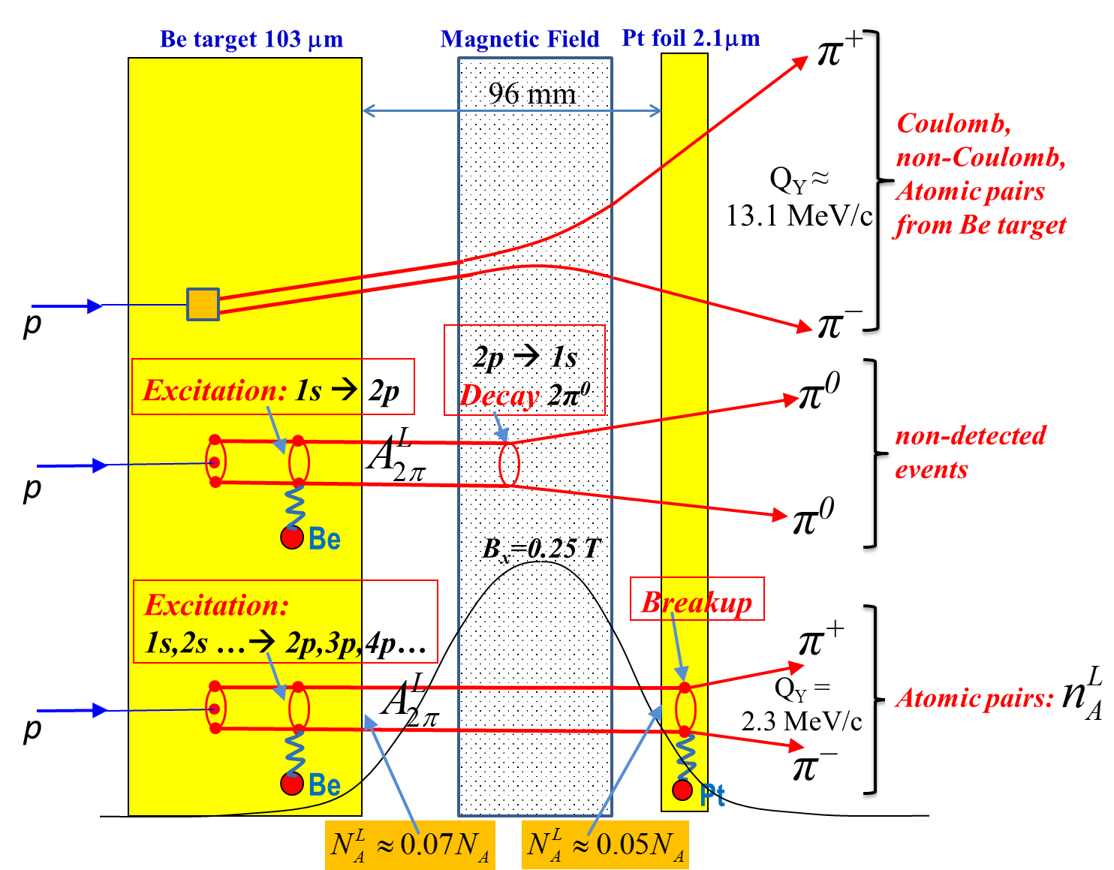
The π⁺π⁻ atoms production in Be target
Fig. 1 Method to observe long-lived A^{L}_{2π} by means of a breakup foil (Pt). The most of the produced π⁺π⁻ atoms decay (~70%) or are ionized (~6%) in the Be target. The excited (long lived) atoms (~24%) are investigated here.
1/26/2018

Slide 3
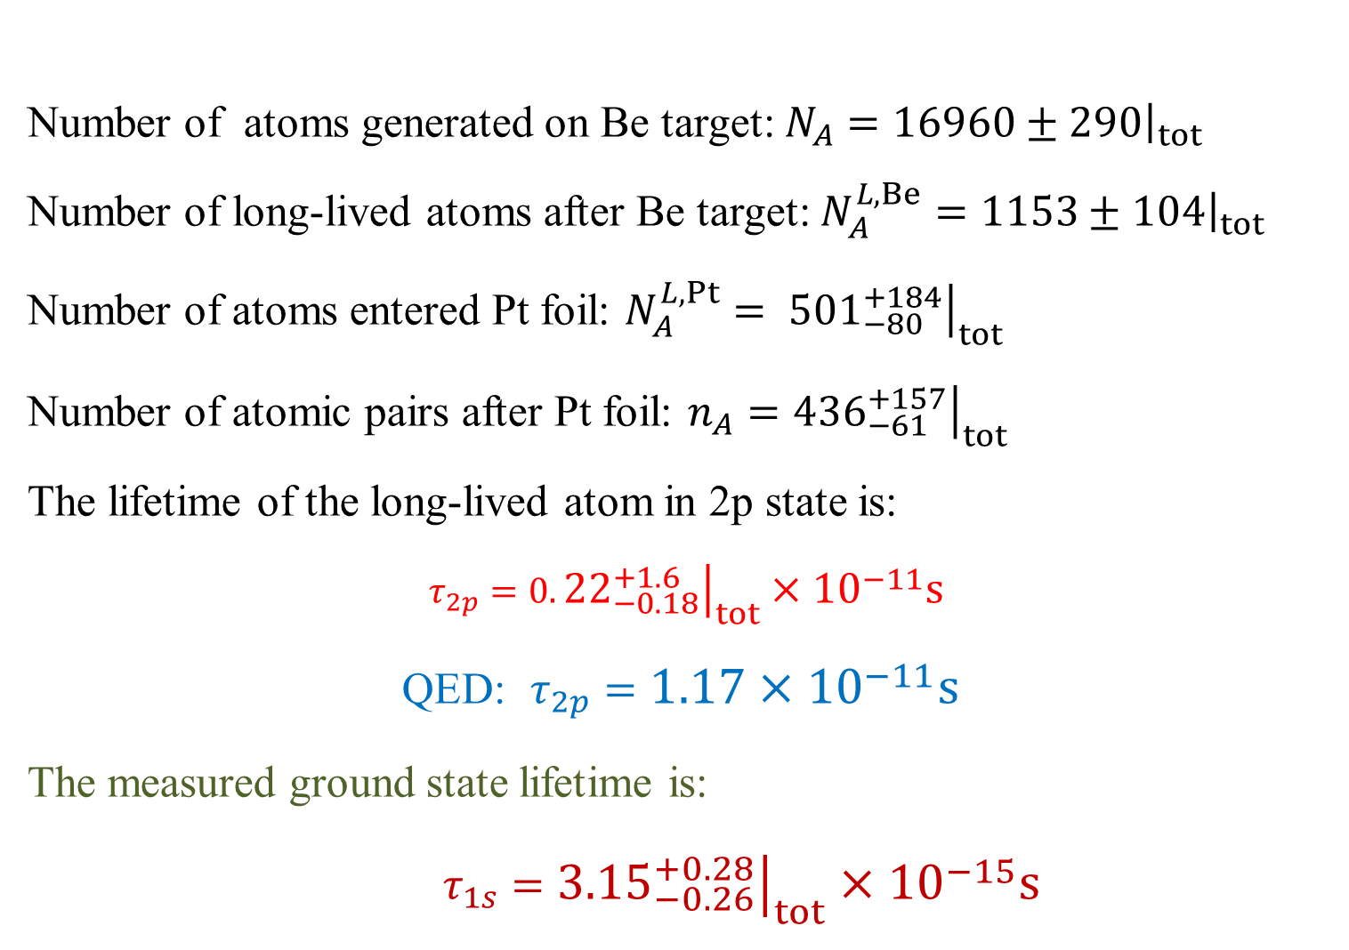
Lifetime of long-lived π⁺π⁻ atoms
Number of atoms generated on Be target: $N_{A}={\left.16960±290\right|}_{tot}$
Number of long-lived atoms after Be target: $N_{A}^{L,Be}={\left.1153±104\right|}_{tot}$
Number of atoms entered Pt foil: $N_{A}^{L,Pt}= {\left.{501}_{−80}^{+184}\right|}_{tot}$
Number of atomic pairs after Pt foil: $n_{A}={\left.{436}_{−61}^{+157}\right|}_{tot}$
The lifetime of the long-lived atom in 2p state is:
$τ_{2p}=0.{\left.{22}_{−0.18}^{+1.6}\right|}_{tot}×{10}^{−11}s$
QED: $τ_{2p}=1.17×{10}^{−11}s$
The measured ground state lifetime is:
$τ_{1s}={\left.{3.15}_{−0.26}^{+0.28}\right|}_{tot}×{10}^{−15}s$
1/26/2018

Slide 4
π⁺π⁻ atom lifetime and decay lengths
n | τ_{2π} (10⁻¹¹sec) |  | Decay length A_{2π} in L.S. (cm) for γ=16
 |  |  | (λ_{ns}=c ∙ γ ∙ τ_{nl})
 | s (l=0) | p (l=1) | s (l=0) | p (l=1)
 | τ_{ns}=τ_{1s}∙ n³
1 | 2.9 ∙10⁻⁴ | - | 1.39∙10⁻³ | -
2 | 2.32∙10⁻³ | 1.17 | 1.11∙10⁻² | 5.6
3 | 7.83∙10⁻³ | 3.94 | 3.76∙10⁻² | 19
4 | 1.86∙10⁻² | 9.05 | 8.91∙10⁻² | 43
5 | 3.63∙10⁻² | 17.5 | 1.74∙10⁻¹ | 84
6 | 6.26∙10⁻² | 29.9 | 3.01∙10⁻¹ | 144
7 | 9.95∙10⁻² | 46.8 | 4.77∙10⁻¹ | 225
8 | 1.48∙10⁻¹ | 69.3 | 7.13∙10⁻¹ | 333
1/26/2018

Slide 5
Coulomb pairs and atoms
For charged pairs from short-lived sources and with small relative momenta Q , Coulomb final state interaction has to be taken into account.
This interaction increases the production yield of the free pairs with Q decreasing and creates atoms.
Κ⁺Κ⁻
(Κ⁺Κ⁻)
Coulomb pair
Atom
There is a precise ratio between the number of produced Coulomb pairs (N_{C}) with small Q and the number of atoms (N_{A}) produced simultaneously with Coulomb pairs:
1/26/2018

Slide 6
K⁺K⁻ pair analysis
N
N
Experimental distributions of selected events. Events are fitted by the simulated distribution of K⁺K⁻ pairs (red) and experimental distribution of pure π⁺π⁻ (blue) processed with kaon masses.
N
Q_{L} [MeV/c]
2009 + 2010
K⁺K⁻ = 4534 ± 364 ; π⁺π⁻ =2635 ± 366
1/26/2018

Slide 7
Proton-antiproton pair analysis
In 2018, DIRAC will perform a search for proton-antiproton Coulomb pairs and thus proton- antiproton atoms with the same strategy as in the K⁺K⁻ case.
1/26/2018

Slide 8
Coulomb correlations
Coulomb correlations as a possible new physical method to investigate the particles production in the coordinate space.
The shape of Coulomb correlation curve for K⁺K– and proton-antiproton pairs is expected to be much sensitive to the size of particle production region compared to the case of π⁺π– pairs. Thus, detailed study of this shape could open a possibility to evaluate the size of production region for such pairs. The investigation is planned for 2018 and 2019.
1/26/2018

Slide 9
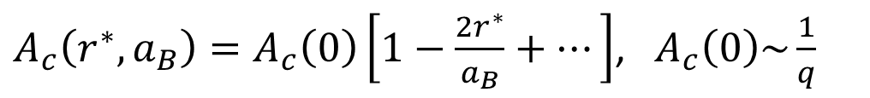
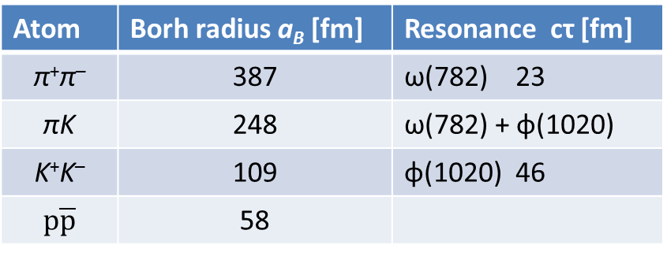
Coulomb correlations
Atom | Borh radius a_{B} [fm] | Resonance cτ [fm]
π⁺π– | 387 | ω(782) 23
πK | 248 | ω(782) + φ(1020)
K⁺K– | 109 | φ(1020) 46
$$p\overline{p}$$ | 58
 | Z | A | Nublear radius [fm]
Be | 04 | 9.012 | 2.56
Ni | 28 | 58.69 | 4.78
Pt | 78 | 195.08 | 7.13
Coulomb correlation with account of size of pair production region $r^{∗}$
$A_{c}\left(r^{∗},a_{B}\right)=A_{c}\left(0\right)\left[1−\frac{2r^{∗}}{a_{B}}+…\right]$, ${ A}_{c}\left(0\right)\sim \frac{1}{q}$
Point-like Coulomb correlation
1/26/2018

Slide 10
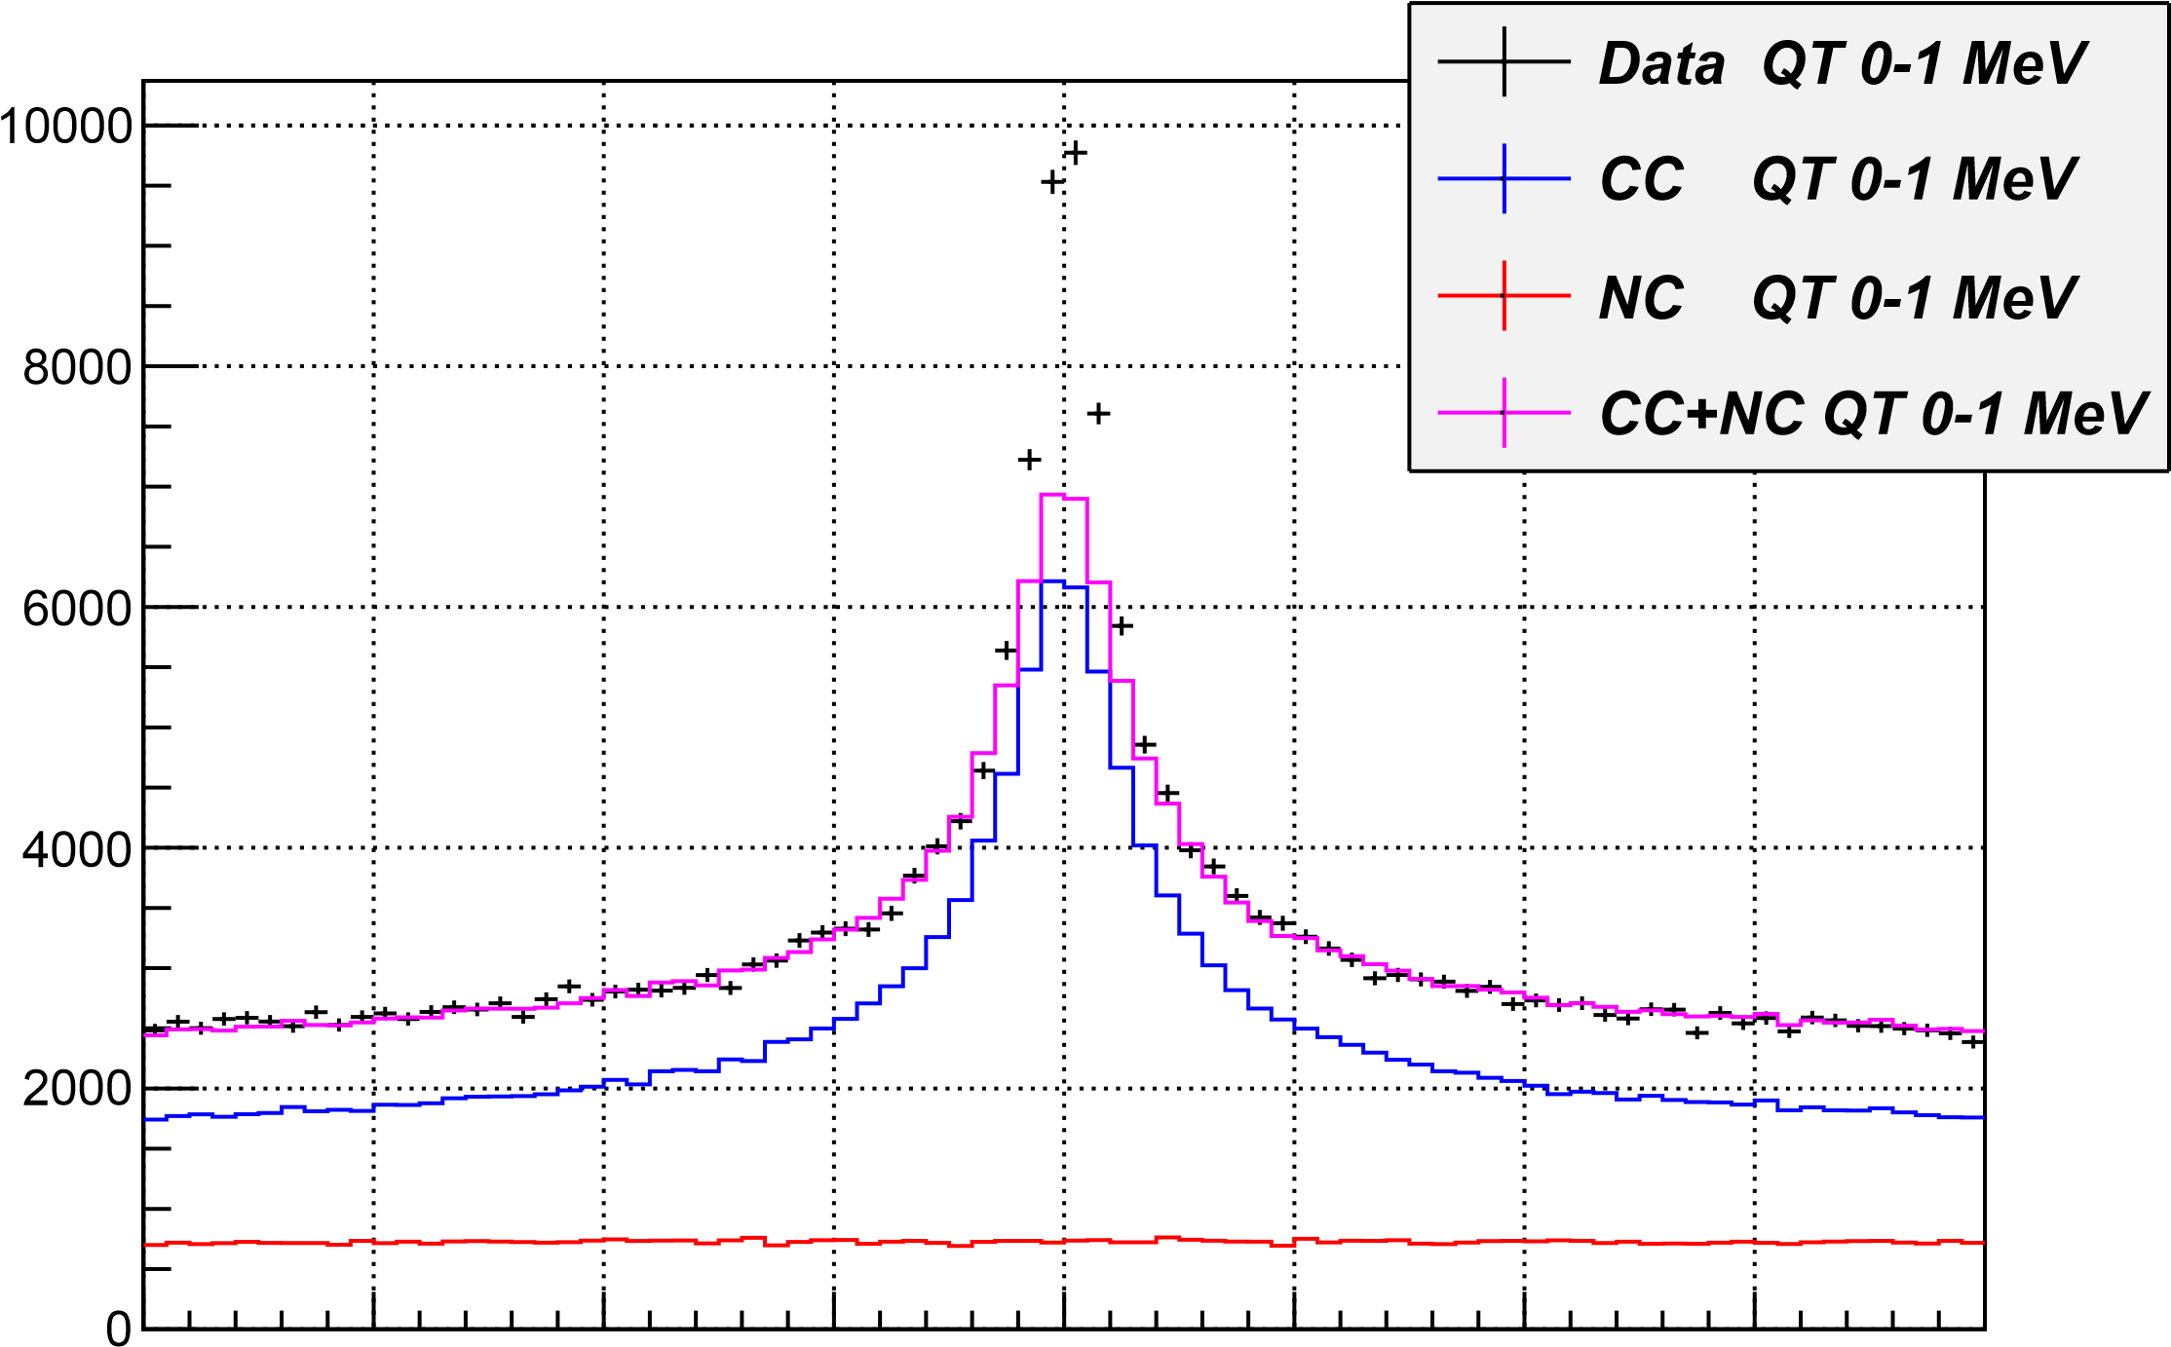
-20 -15 -10 -5 0 5 10 15 20
Q_{l} for Q_{T} between 0-1 MeV (accidentals subtracted) MeV/c

Slide 11
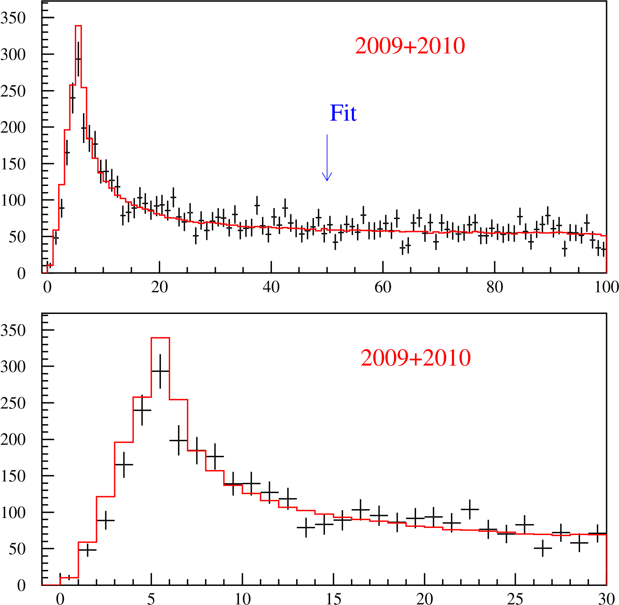
K⁺K⁻ pair analysis
N
N
Q [MeV/c]
1/26/2018

Slide 12
K⁺K⁻ pair analysis
K⁺K⁻ Coulomb pairs ratio
R
R
R
1/26/2018
Q[MeV/c]

Slide 13
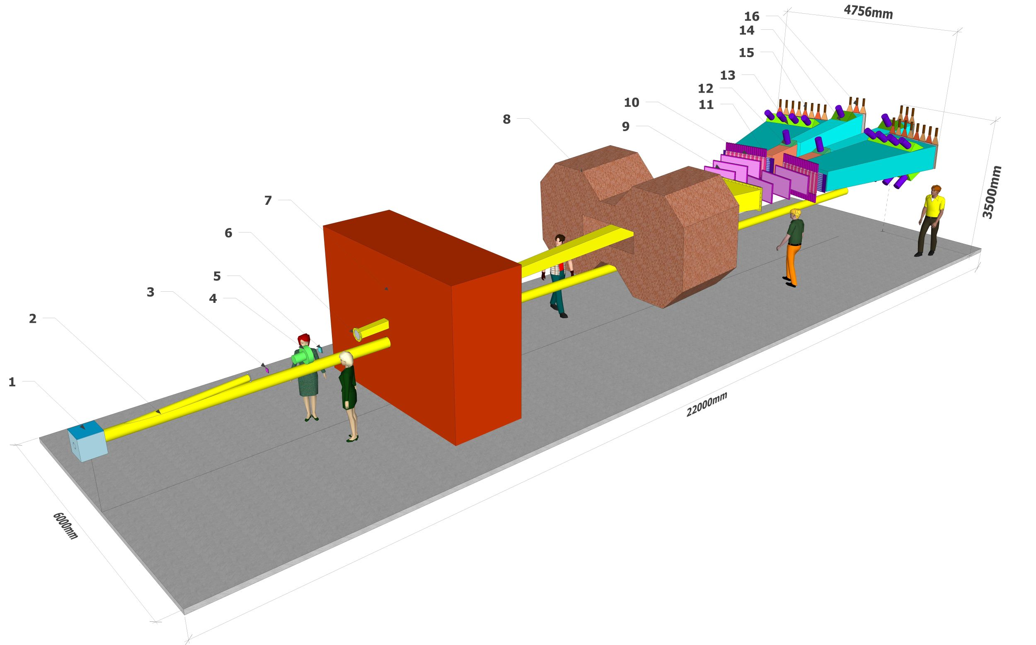
DIRAC++ (Setup Isometric view)
1/26/2018

Slide 14
Thank you
1/26/2018

Slide 15








DIRAC Collaboration
CERN
Geneva, Switzerland
Tokyo Metropolitan University
Tokyo, Japan
Czech Technical University
Prague, Czech Republic
IFIN-HH
Bucharest, Romania
Institute of Physics ASCR
Prague, Czech Republic
JINR
Dubna, Russia
Nuclear Physics Institute ASCR
Rez, Czech Republic
SINP of Moscow State University
Moscow, Russia
INFN-Laboratori Nazionali di Frascati
Frascati, Italy
IHEP
Protvino, Russia
University of Messina
Messina, Italy
Santiago de Compostela University
Santiago de Compostela, Spain
KEK
Tsukuba, Japan
Bern University
Bern, Switzerland
Kyoto University
Kyoto, Japan
Kyoto Sangyo University
Kyoto, Japan
Zurich University
Zurich, Switzerland

Slide 16
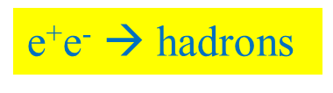
QCD Lagrangian and its prediction
The QCD Lagrangians use the SU(3)_{L}*SU(3)_{R} and SU(2)_{L}*SU(2)_{R} chiral symmetry breaking.
L(u,d,s) = L(3) = L_{sym}(3)+ L_{sym.br.}(3)
L_{sym.br.} is proportional to m_{q}
L(u,d) = L(2) = L_{sym}(2) + L_{sym.br.}(2)
QCD provides cross sections with 1% precision
Perturbation theory is working at high momentum transfer Q.
Unitarity condition.
At large Q, contribution of L_{sym.br.} to the cross section is proportional to 1/Q⁴. Therefore these experiments checked only the L_{sym} prediction precision.
  To check the total L(3) Lagrangian predictions, we must study the
  low momentum transfer Q processes.
Tools: Lattice calculations and Chiral Perturbation Theory (ChPT)
Lattice----- L(3), L(2) ChPT------Effective Lagrangians.
1/26/2018

Slide 17
Measurement of the πK and ππ scattering length on SPS CERN
The number of produced A_{2π} , A_{π}⁺_{K}⁻ and A_{π}⁻_{K}⁺ per time unit at SPS CERN at p_{p} = 450Gev/c, will be 12±2, 53±11 and 24±5 times higher than in the DIRAC experiment [J.Phys. G: Nucl. Phys. 43 (2016)]
For the setup with the same parameters as in the DIRAC experiment and running time 5 months the expected statistical (sysematic) precision for πK scattering length |a_{1/2}-a_{3/2}| is ~5% (2%). (The DIRAC error is 34%). It allows to check with the same accuracy predictions of the total L(3) QCD Lagrangian based on the chiral SU(3)_{L}*SU(3)_{R} symmetry breaking.
Simultaneously the expected number of π⁺π⁻ atomic pairs n_{A}=400000 . The statistical (systematic) precision of the π⁺π⁻ scattering length
|a₀-a₂| will be: 0.7% (2%).
1/26/2018

Slide 18
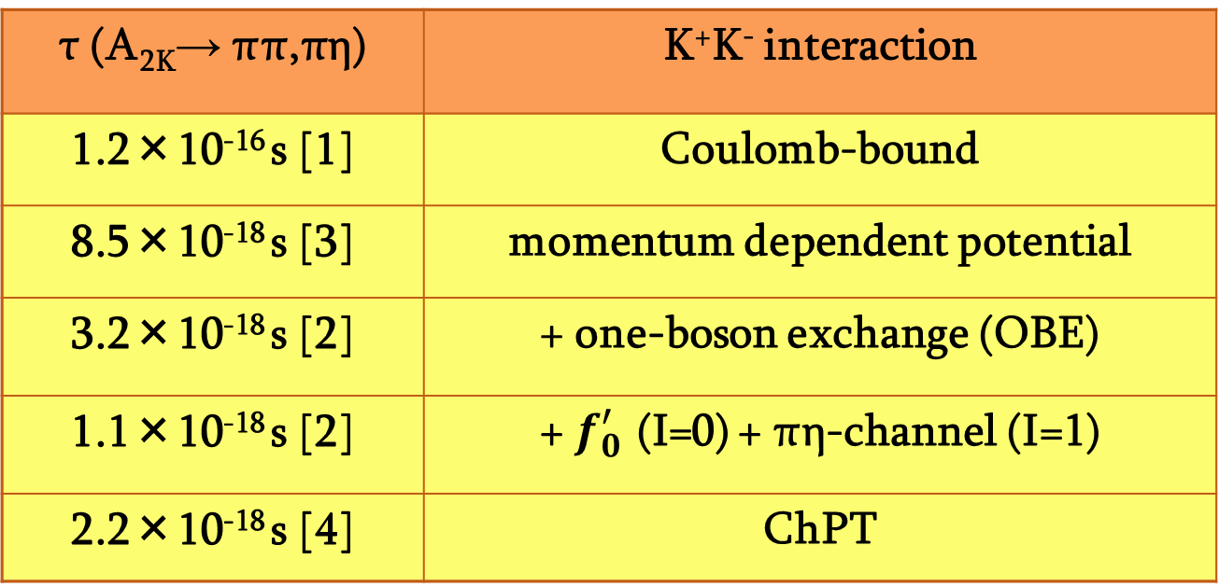
K⁺K– atom and its lifetime
The A_{2Κ} lifetime is strongly reduced by strong interaction (OBE, scalar meson f₀ and a₀) as compared to the annihilation of a purely Coulomb-bound system (K⁺K⁻).
τ (A_{2K}→ ππ,πη) | K⁺K⁻ interaction
1.2×10⁻¹⁶ s [1] | Coulomb-bound
8.5×10⁻¹⁸ s [3] | momentum dependent potential
3.2×10⁻¹⁸ s [2] | + one-boson exchange (OBE)
1.1×10⁻¹⁸ s [2] | + $f_{0}^{′}$ (I=0) + πη-channel (I=1)
2.2×10⁻¹⁸ s [4] | ChPT
K⁺K⁻ interaction
complexity
References:
[1] S. Wycech, A.M. Green, Nucl. Phys. A562 (1993), 446;
[2] S. Krewald, R. Lemmer, F.P. Sasson, Phys. Rev. D69 (2004), 016003;
[3] Y-J Zhang, H-C Chiang, P-N Shen, B-S Zou, PRD74 (2006) 014013;
[4] S.P. Klevansky, R.H. Lemmer, PLB702 (2011) 235.
1/26/2018

Slide 19
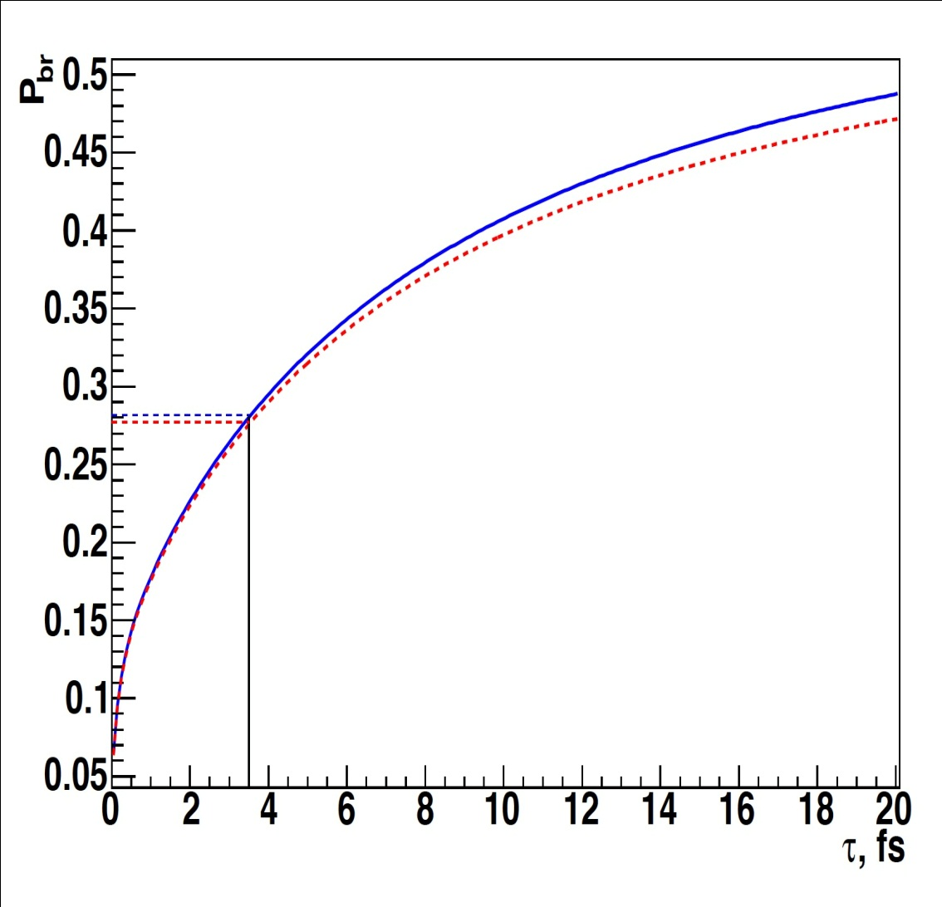
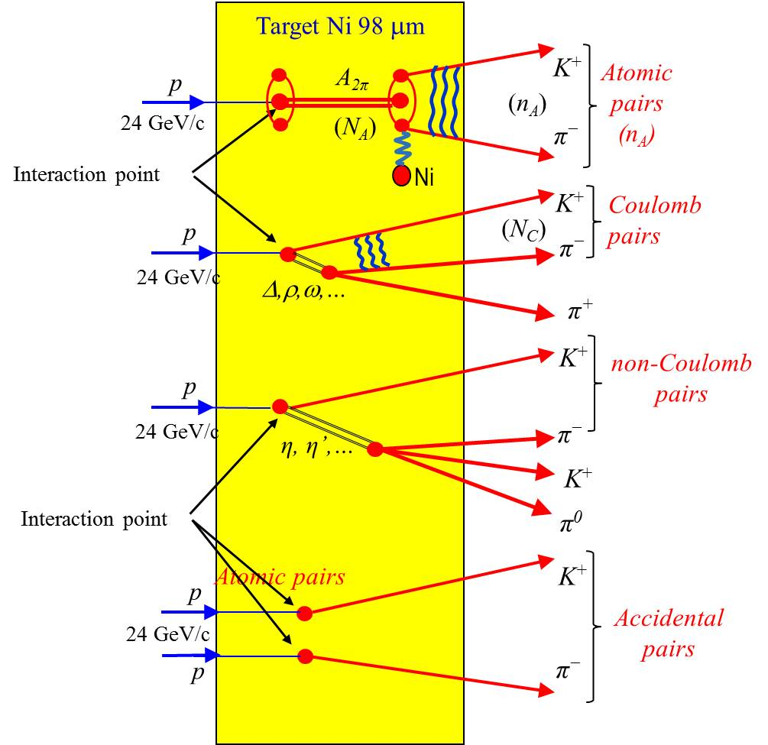
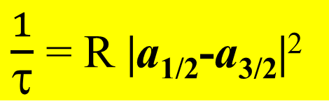
The πK atom lifetime and πK scattering length
$\frac{1}{τ}$ = R |a_{1/2}-a_{3/2}|²
τ_{th} =(3.5±0.4)×10⁻¹⁵ s. The evaluation error from this relation for |a_{1/2}-a_{3/2}| is 1%
1/26/2018

Slide 20
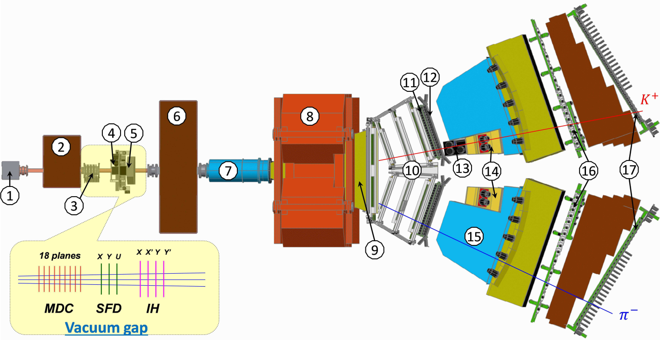
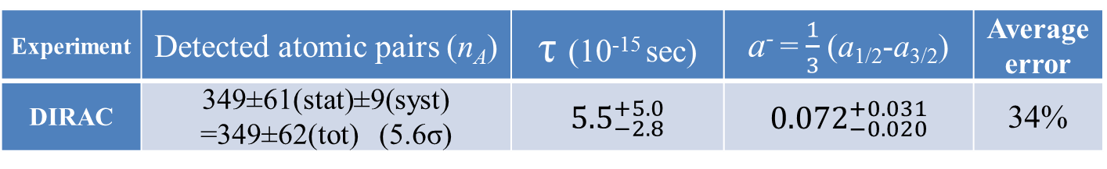
DIRAC setup, experimental and theoretical data
27 September to 19 November.
27 September to 19 November.
Experiment | Detected atomic pairs (n_{A}) | τ (10⁻¹⁵ sec) | a⁻ = $\frac{1}{3}$(a_{1/2}-a_{3/2}) | Average error
DIRAC | 349±61(stat)±9(syst) =349±62(tot) (5.6σ) | ${5.5}_{−2.8}^{+5.0}$ | ${0.072}_{−0.020}^{+0.031}$ | 34%
Theory | P.Buttiker et al., Eur.Phys.J. (2004) | K.Sasaki et al., Phys.Rev. (2014) | Z.Fu, Phys.Rev. (2013) | S.R.Beame et al. Phys.Rev (2008) | C.Lang et al.,Phys.Rev. (2012) | J.Bijnens et al., J. High Energy Phys. (2004)
a⁻ | 0.090±0.005 | 0.081 | 0.077 | 0.077 | 0.10 | 0.089
Method | Roy-Steiner equations | Lattice calculations | Lattice calculations | Lattice calculations | Lattice calculations | ChPT, two loops
1/26/2018

Slide 21
QCD and Chiral Lagrangian predictions check with long-lived π⁺π⁻ atoms
The DIRAC collaboration Phys.Lett.(2015) observed 436±61 pion pairs from the long-lived (τ ≥ 1×10⁻¹¹ sec) π⁺π⁻ atom breakup in Pt foil(Phys.Lett.(2015).
The short-lived atoms lifetime measurement allowed to evaluate ππ scattering length combination a₀ - a_{2.}
The study of the long-lived atoms will allow to measure the Lamb shift depending on another ππ scattering length combination: 2a₀+a₂ and to evaluate the a₀, a₂ separately.
1/26/2018

Slide 22
I. Long-lived states of π⁺π⁻ atoms
Fig. 8. |Q_{L}| experimental distribution after subtraction of background obtained with 3 parameter fit (black points with statistical error) and after subtraction of background obtained with 2 parameter fit (blue dashed line), comparing to the simulated distribution of atomic pairs (red dotted-dashed line).
The fit procedures have been applied to the 1-dimensional |Q_{L}| distribution.
The atomic pairs number in the region |Q_{L}| < 2, Q_{T} < 4 MeV/c obtained with 3 parameter fit is n_{A}^{L} = 435±03 and with 2 parameter fit is n_{A}^{L} = 579±64.
1/26/2018

Slide 23
K⁺K⁻ pair analysis
K⁺K⁻ Coulomb pairs signal
N
2009 + 2010
Distribution of K⁺K⁻ pairs in the RUN 2009 + 2010 over the full pair momentum in laboratory system.
1/26/2018
P[MeV/c]

Slide 24
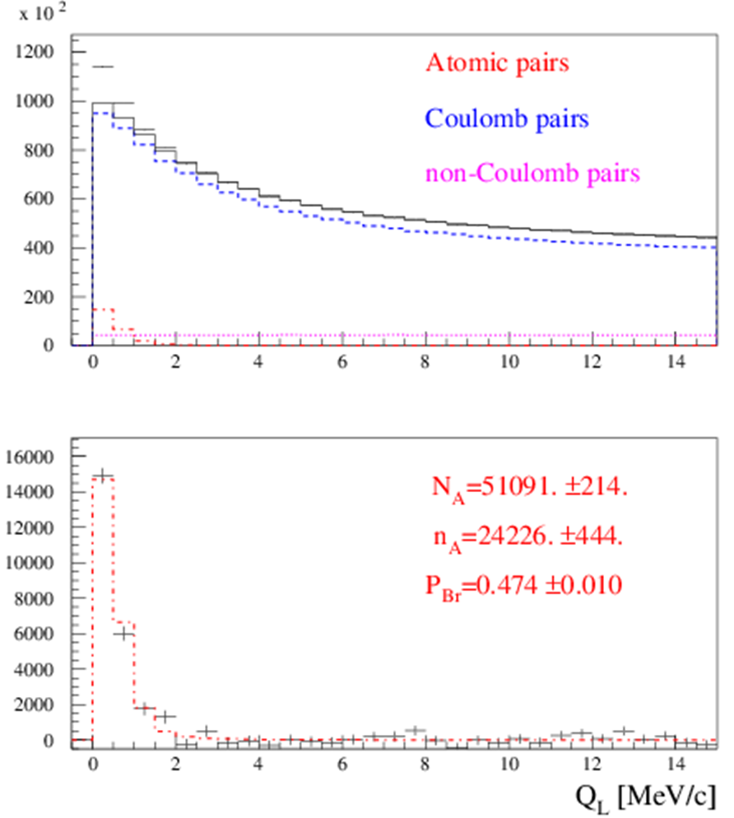
III. The short-lived π⁺π⁻ atom lifetime measurement
Preliminary results on the short-lived atom lifetime measurement based on all available 2008-2010 data are presented in Fig. 1 and 2.
Fig.1. Distribution over |Q_{L}| for events, selected with criterion
Q_{T} < 4 MeV/c. Fractions of atomic, Coulomb and non-Coulomb pairs were obtained by fitting the distri-bution over (|Q_{L}|,Q_{T}) with criteria: |Q_{L}|<15 MeV/c, Q_{T} < 4 MeV/c.
N_{A}, n_{A} and P_{br}. are the number of produced atoms, detected atomic pairs and probability of the atoms breaking in the target respectively.
1/26/2018

Slide 25
III. The short-lived π⁺π⁻ atom lifetime measurement
Preliminary results on the short-lived atom lifetime measurement based on all available 2008-2010 data are presented in Fig. 1 and 2.
Fig.1. Distribution over |Q_{L}| for events, selected with criterion
Q_{T} < 4 MeV/c. Fractions of atomic, Coulomb and non-Coulomb pairs were obtained by fitting the distri-bution over (|Q_{L}|,Q_{T}) with criteria: |Q_{L}|<15 MeV/c, Q_{T} < 4 MeV/c.
N_{A}, n_{A} and P_{br}. are the number of produced atoms, detected atomic pairs and probability of the atoms breaking in the target respectively.
1/26/2018

Slide 26
III. The short-lived π⁺π⁻ atom lifetime measurement
1. The average probability of π⁺π⁻ atom breakup for the Ni targets of 98 µm thickness (RUN 2008) and 109 µm (RUNS 2009-2010) was evaluated as P_{br}= 0.474 ± 0.01. It is in agreement with the value P_{br}= 0.46 ± 0.013 obtained for the 98 µm target and published in 2011.
In the final data analysis, the new measurements of multiple scattering will be included. The dedicated paper will be ready before June of 2018.
2. The current value of systematical error in the π⁺π⁻ atom lifetime measurement is equal to the statistical uncertainty. The main part of the systematical error arises due to an uncertainty in the multiple scattering in the Ni target.
To reduce this error, we did an experimental study of the multiple scattering in the targets: Be: 100 and 2000 μm; Ti: 250 μm ; Ni: 50, 109 and 150 μm and Pt: 2 and 30 μm.
For Be (2000 μm), Ni (109 μm) the difference between theoretical and experimental r.m.s. is 0.4% and 0.8% accordingly. The r.m.s. values were calculated in the interval of ±2σ.
The achieved precision of multiple scattering investigation is better by one order of magnitude than in the previous experiments.
1/26/2018

Slide 27
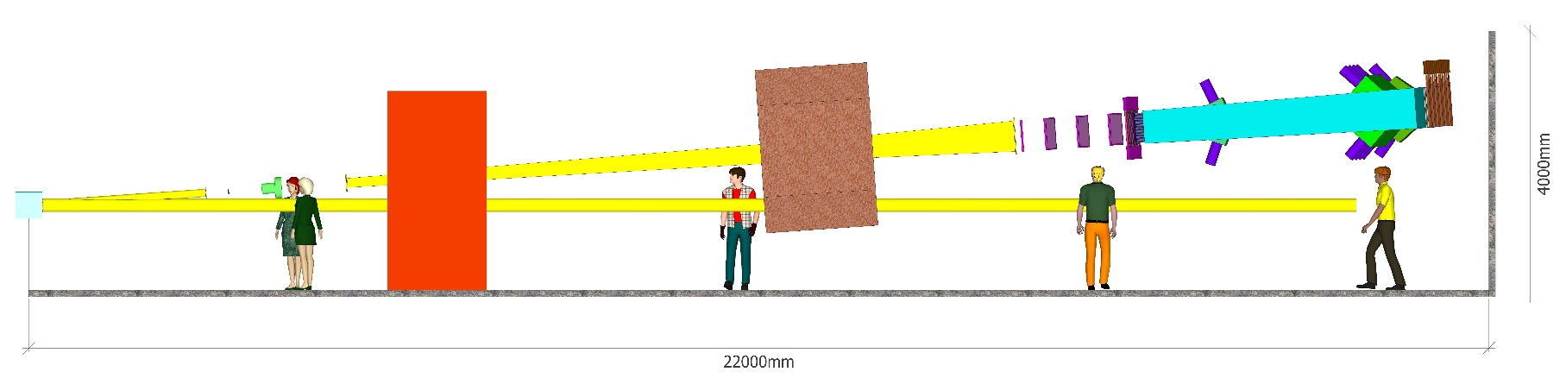
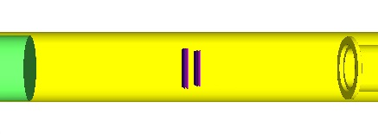
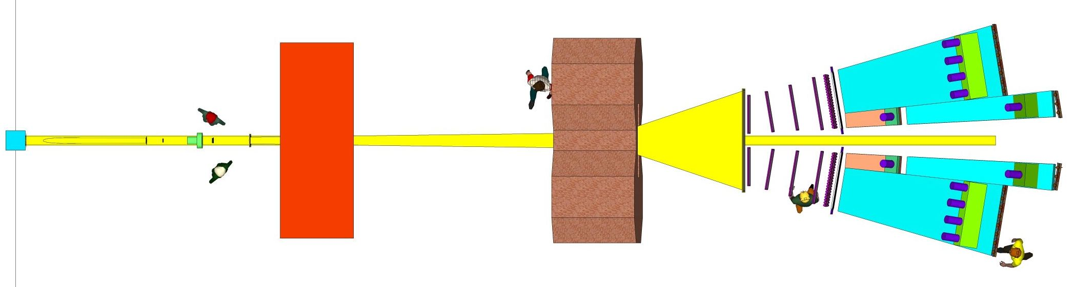
DIRAC++ Setup (top view)
π⁺
K⁺
K –
π–
1/26/2018

Slide 28
DIRAC++ (Detectors)
Setup element (number planes) | Aperture (cm) | Occupancy (s⁻¹ · cm⁻²) | X₀ % | Resolution
 |  |  |  | Coordinate (µm) | Time (ns)
1. Target Station (*) 2. Vacuum system (*) 3. Vertex detector (2 ÷ 4 planes) | 7.6 × 7.6 | (5 ÷ 20) · 10⁵ | 0.7 ÷ 1.5 | 50 | 0.2
4. RICH? | 9.0 × 9.0 | (4 ÷ 16) · 10⁵ | < 5 |  | < 1
5. SFD (3 planes) (*) | 10. × 10. | (3 ÷ 12) · 10⁵ | 2.7 | 60 | 0.3
6. Vacuum system (*) 7. Iron shielding wall (*) 8. Spectrometer magnet (*) | 155 × 50
9. Downstream Tracker (2 × 8) | 75 ÷ 110×44 | (1 ÷ 10) · 10⁴ | 4 ÷ 8 | < 80
10. Vertical Hodoscope (2 × 1 ÷ 2) (*) | 112 × 44 | (1 ÷ 8) · 10⁴ |  |  | < 0.7
11. Horizontal Hodoscope (2) (*) | 115 × 44 | (1 ÷ 8) · 10⁴ |  |  | < 0.5
12. Heavy Gas Cherenkov detector (2) (*) | 30 × 49 | (1 ÷ 8) · 10⁴ |  |  | < 1.0
13. Nitrogen Cherenkov detector (2) | 90 × 50 | (1 ÷ 10) · 10³ |  |  | < 1.0
14. Nitrogen Cherenkov detector (2) | 37 × 53 | (1 ÷ 8) · 10⁴ |  |  | < 1.0
15. PreShower detector (2) | 148 × 60 | (1 ÷ 8) · 10³ |  |  | < 1.0
16. PreShower detector (2) | 56 × 60 | (5 ÷ 40) · 10³ |  |  | < 1.0
--. Ionisation Hodoscope (4 planes) | 10. × 10. | (4 ÷ 16) · 10⁵ | 3
* - Existing parts of the Setup
? - Micro-Pattern Gas Detectors (MPGD)
1/26/2018

Slide 29
SPS beam time for πK scattering length measurement
The data at p_{p} = 24GeV/c and 450Gev/c were simulated, processed and analysed (V.Yazkov, DIRAC note, 2016 05).
Experimental conditions on SPS with Ni target
Thin Ni target, nuclear efficiency ~ 6x10⁻⁴.
The proton beam can be used for other experiments.
Proton beam intensity: 3x10¹¹ protons/s
(DIRAC worked at 2.7x10¹¹ protons/s)
Number of spills: 4.5x10⁵ with spill duration 4.5 s
Data taking: 3000 spills per 24 hours.
Running time: 5 months
The expected number of πK atomic pairs: n_{A}=13000
(In the DIRAC experiment was n_{A}=349±62)
The statistical precision in these conditions for πK scattering length will be: ~5%
The expected systematic error will be at the level of 2%
The expected number of π⁺π⁻ atomic pairs n_{A}=400000
The statistical precision of the π⁺π⁻ scattering length will be: 0.7%
The expected systematic error will be at the level of 2%
1/26/2018

Slide 30
L(2) and Chiral Lagrangian predictions check with short-lived π⁺π⁻ atoms
The QCD Lagrangian L(2) and Chiral Lagrangian describe processes with u and d quarks, using SU(2)_{L}*SU(2)_{R} chiral symmetry breaking.
From the ChPT prediction for a₀ and a₂, the π⁺π⁻ atom lifetime in the ground state, given by 1/τ = R|a₀-a₂|², is τ_{th}=(2.9±0.1)*10⁻¹⁵ s.
The evaluation error for |a₀-a₂| from this relation is 0.6%.
These Lagrangians predict the S-wave π⁺π⁻ scattering lengths a₀ and a₂.
1/26/2018

Slide 31
L(2) and Chiral Lagrangian predictions check with short-lived π⁺π⁻ atoms
ChPT | a₀ and a₂ a₀-a₂ | 2.3% precision 1.5% precision | Colangelo et al. Nucl.Phys.(2001)
Lattice calculations | a₀ a₂ | 4-10% precision ~1% precision | K.Sasaki et al., Phys.Rev. 2014, Z.Fu, Phys.Rev.(2013), C.Lang et al.,Phys.Rev.(2012), Feng et al., Phys. Lett.(2010), T.Yagy at al., arXiv:1108.2970, S.Beame et al. Phys.Rev(2008)
Experimental values | a₀-a₂ | ~ 4% precision | J.R.Bateley at al., Eur. Phys. J. (2009), J.R.Bateley at al., Eur. Phys. (2010), Adeva et al., Phys. Lett. (2011)
 | a₀ a₂ | ~ 6% precision ~22% precision | J.R.Bateley at al., Eur. Phys. J. (2009), J.R.Bateley at al., Eur. Phys. (2010)
on SPS | a₀-a₂ | ~2% precision | DIRAC estimation
1/26/2018

