Slide 1
DIRAC Report
SPSC – June 2019
L. Nemenov on behalf of the DIRAC Collaboration

Slide 2
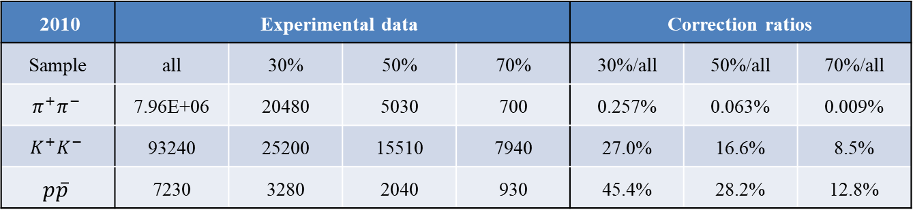
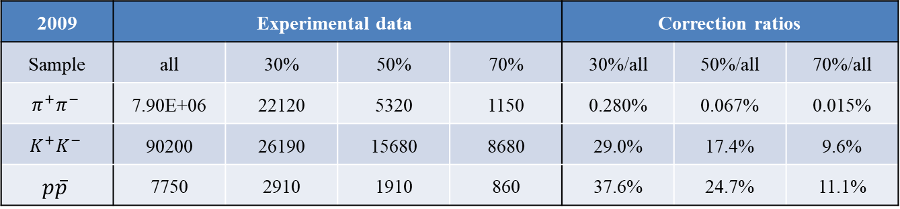
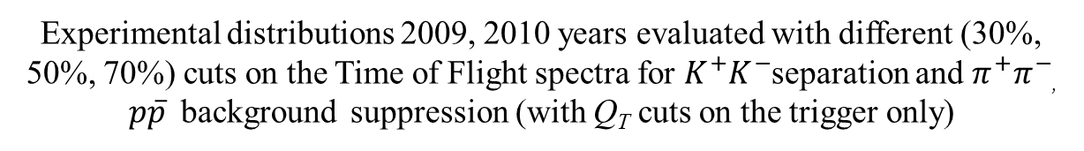
Experimental data
Experimental distributions 2009, 2010 years evaluated with different (30%, 50%, 70%) cuts on the Time of Flight spectra for $K^{+}K^{−}$separation and $π^{+}π^{−}$, $p\overline{p}$ background suppression (with Q_{T} cuts on the trigger only)
2009 | Experimental data |  |  |  | Correction ratios
Sample | all | 30% | 50% | 70% | 30%/all | 50%/all | 70%/all
$$π^{+}π^{−}$$ | 7.90E+06 | 22120 | 5320 | 1150 | 0.280% | 0.067% | 0.015%
$$K^{+}K^{−}$$ | 90200 | 26190 | 15680 | 8680 | 29.0% | 17.4% | 9.6%
$$p\overline{p}$$ | 7750 | 2910 | 1910 | 860 | 37.6% | 24.7% | 11.1%
2010 | Experimental data |  |  |  | Correction ratios
Sample | all | 30% | 50% | 70% | 30%/all | 50%/all | 70%/all
$$π^{+}π^{−}$$ | 7.96E+06 | 20480 | 5030 | 700 | 0.257% | 0.063% | 0.009%
$$K^{+}K^{−}$$ | 93240 | 25200 | 15510 | 7940 | 27.0% | 16.6% | 8.5%
$$p\overline{p}$$ | 7230 | 3280 | 2040 | 930 | 45.4% | 28.2% | 12.8%
7/3/2019

Slide 3
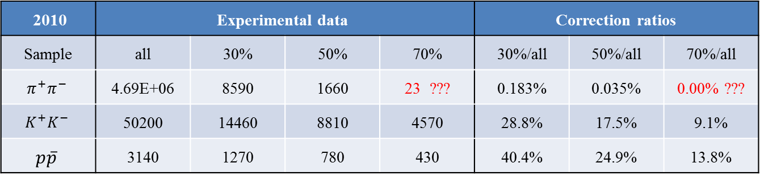
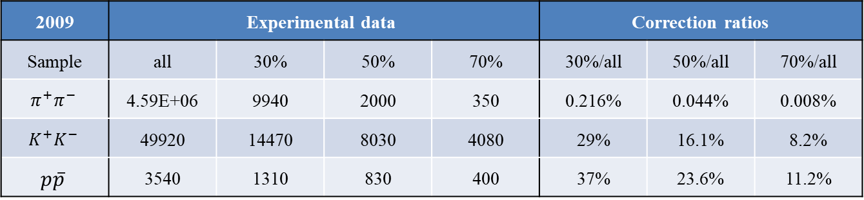
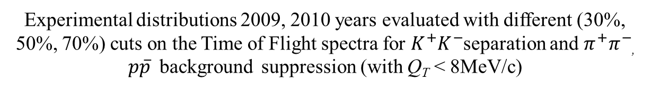
Experimental data
Experimental distributions 2009, 2010 years evaluated with different (30%, 50%, 70%) cuts on the Time of Flight spectra for $K^{+}K^{−}$separation and $π^{+}π^{−}$, $p\overline{p}$ background suppression (with Q_{T} < 8MeV/c)
2009 | Experimental data |  |  |  | Correction ratios
Sample | all | 30% | 50% | 70% | 30%/all | 50%/all | 70%/all
$$π^{+}π^{−}$$ | 4.59E+06 | 9940 | 2000 | 350 | 0.216% | 0.044% | 0.008%
$$K^{+}K^{−}$$ | 49920 | 14470 | 8030 | 4080 | 29% | 16.1% | 8.2%
$$p\overline{p}$$ | 3540 | 1310 | 830 | 400 | 37% | 23.6% | 11.2%
2010 | Experimental data |  |  |  | Correction ratios
Sample | all | 30% | 50% | 70% | 30%/all | 50%/all | 70%/all
$$π^{+}π^{−}$$ | 4.69E+06 | 8590 | 1660 | 23 ??? | 0.183% | 0.035% | 0.00% ???
$$K^{+}K^{−}$$ | 50200 | 14460 | 8810 | 4570 | 28.8% | 17.5% | 9.1%
$$p\overline{p}$$ | 3140 | 1270 | 780 | 430 | 40.4% | 24.9% | 13.8%
7/3/2019

Slide 4
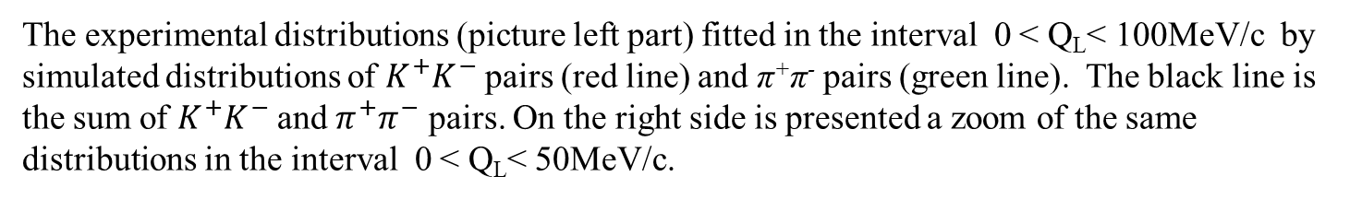
Experimental distributions 2009 and 2010 on Q_{L} (Q_{T}<6MeV/c)
The experimental distributions (picture left part) fitted in the interval 0 < Q_{L}< 100MeV/c by simulated distributions of $K^{+}K^{−}$ pairs (red line) and π⁺π⁻ pairs (green line). The black line is the sum of $K^{+}K^{−}$and $π^{+}π^{−}$ pairs. On the right side is presented a zoom of the same distributions in the interval 0 < Q_{L}< 50MeV/c.
7/3/2019
4

Slide 5
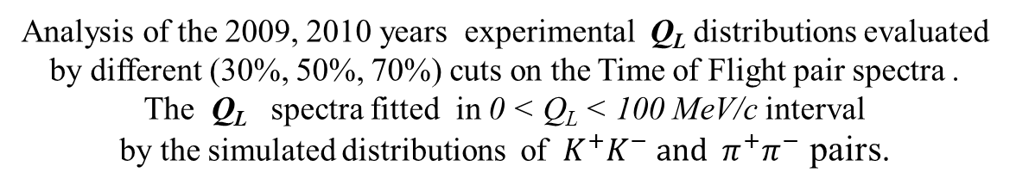
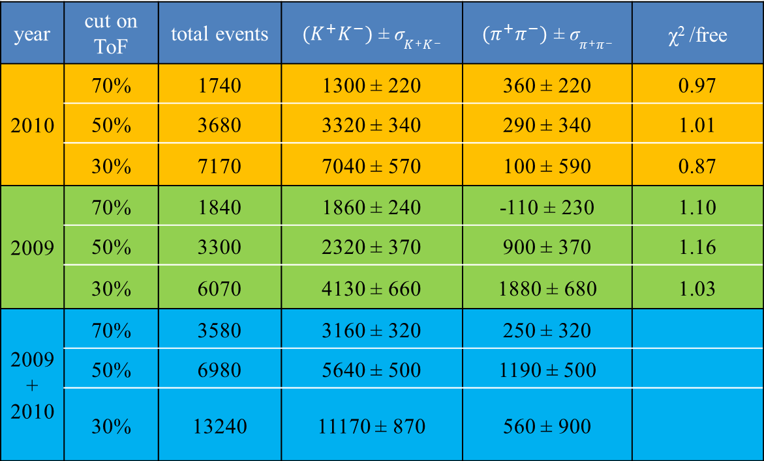
K⁺K⁻ experimental data evaluated with Q_{T} ≤ 6 MeV/c
Analysis of the 2009, 2010 years experimental Q_{L} distributions evaluated by different (30%, 50%, 70%) cuts on the Time of Flight pair spectra .
The Q_{L} spectra fitted in 0 < Q_{L} < 100 MeV/c interval
by the simulated distributions of ${ K}^{+}K^{−} and { π}^{+}π^{−}$ pairs.
year | cut on ToF | total events | ${(K}^{+}K^{−})$ ± σ$K^{+}K^{−}$ | $(π^{+}π^{−})$ ± σ$π^{+}π^{−}$ | χ² /free
2010 | 70% | 1740 | 1300 ± 220 | 360 ± 220 | 0.97
 | 50% | 3680 | 3320 ± 340 | 290 ± 340 | 1.01
 | 30% | 7170 | 7040 ± 570 | 100 ± 590 | 0.87
2009 | 70% | 1840 | 1860 ± 240 | -110 ± 230 | 1.10
 | 50% | 3300 | 2320 ± 370 | 900 ± 370 | 1.16
 | 30% | 6070 | 4130 ± 660 | 1880 ± 680 | 1.03
2009 + 2010 | 70% | 3580 | 3160 ± 320 | 250 ± 320
 | 50% | 6980 | 5640 ± 500 | 1190 ± 500
 | 30% | 13240 | 11170 ± 870 | 560 ± 900
7/3/2019

Slide 6
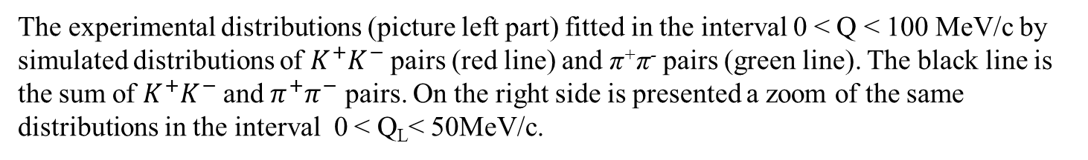
Experimental distributions 2009 and 2010 on Q (Q_{T}<6MeV/c)
The experimental distributions (picture left part) fitted in the interval 0 < Q < 100 MeV/c by simulated distributions of $K^{+}K^{−}$ pairs (red line) and π⁺π⁻ pairs (green line). The black line is the sum of $K^{+}K^{−}$and $π^{+}π^{−}$ pairs. On the right side is presented a zoom of the same distributions in the interval 0 < Q_{L}< 50MeV/c.
7/3/2019
6

Slide 7
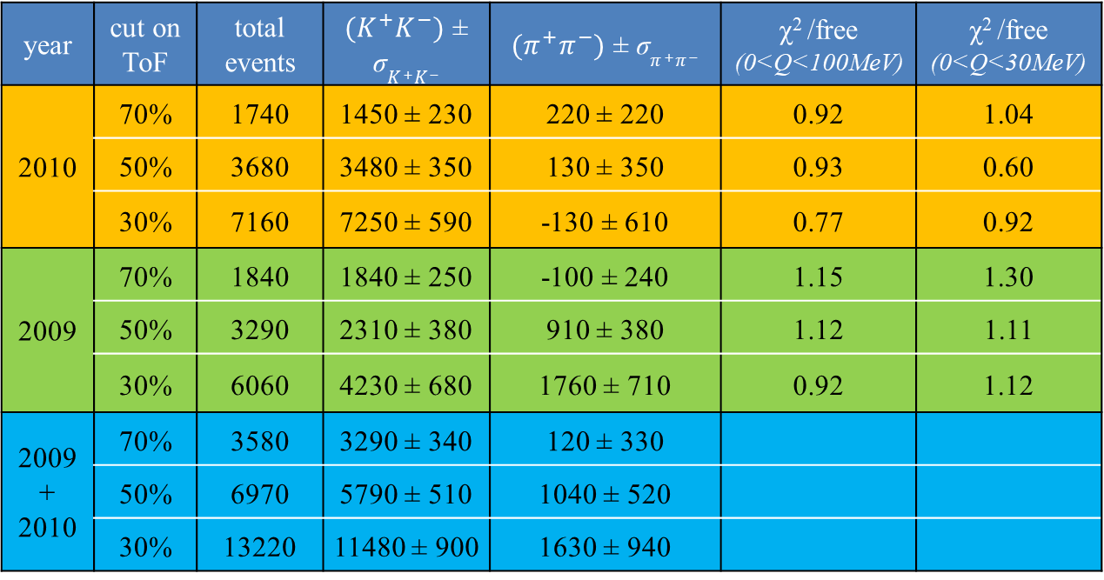
K⁺K⁻ experimental data evaluated with Q_{T} ≤ 6 MeV/c
Analysis of the 2009, 2010 years experimental Q distributions for different
(30%, 50%, 70%) cuts on the Time of Flight pairs spectra .
The sum spectra fitted in 0 < Q < 100 MeV/c and 0 < Q < 30 MeV/c interval.
year | cut on ToF | total events | ${(K}^{+}K^{−})$ ± σ$K^{+}K^{−}$ | $(π^{+}π^{−})$ ± σ$π^{+}π^{−}$ | χ² /free (0<Q<100MeV) | χ² /free (0<Q<30MeV)
2010 | 70% | 1740 | 1450 ± 230 | 220 ± 220 | 0.92 | 1.04
 | 50% | 3680 | 3480 ± 350 | 130 ± 350 | 0.93 | 0.60
 | 30% | 7160 | 7250 ± 590 | -130 ± 610 | 0.77 | 0.92
2009 | 70% | 1840 | 1840 ± 250 | -100 ± 240 | 1.15 | 1.30
 | 50% | 3290 | 2310 ± 380 | 910 ± 380 | 1.12 | 1.11
 | 30% | 6060 | 4230 ± 680 | 1760 ± 710 | 0.92 | 1.12
2009 + 2010 | 70% | 3580 | 3290 ± 340 | 120 ± 330
 | 50% | 6970 | 5790 ± 510 | 1040 ± 520
 | 30% | 13220 | 11480 ± 900 | 1630 ± 940
7/3/2019

Slide 8
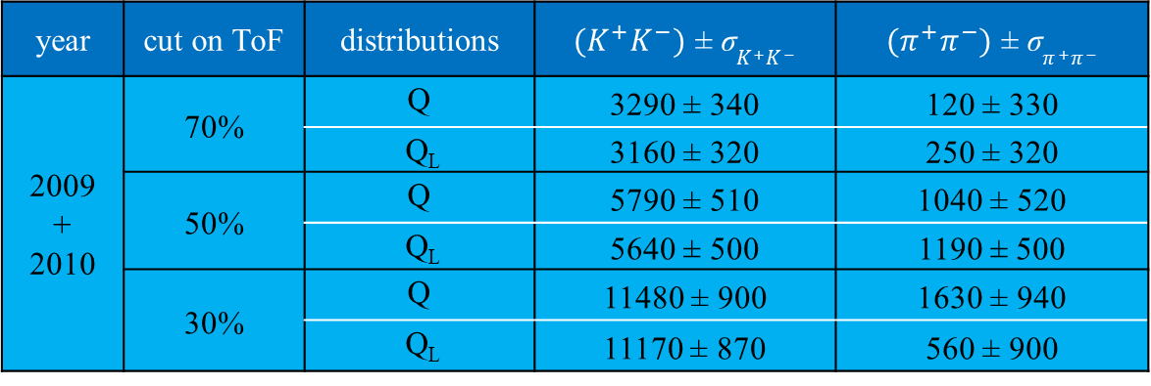
K⁺K⁻ experimental data evaluated with Q_{T} ≤ 6 MeV/c
Similarities of the Q and Q_{L} distribution analysis
year | cut on ToF | distributions | ${(K}^{+}K^{−})$ ± σ$K^{+}K^{−}$ | $(π^{+}π^{−})$ ± σ$π^{+}π^{−}$
2009 + 2010 | 70% | Q | 3290 ± 340 | 120 ± 330
 |  | Q_{L} | 3160 ± 320 | 250 ± 320
 | 50% | Q | 5790 ± 510 | 1040 ± 520
 |  | Q_{L} | 5640 ± 500 | 1190 ± 500
 | 30% | Q | 11480 ± 900 | 1630 ± 940
 |  | Q_{L} | 11170 ± 870 | 560 ± 900
7/3/2019

Slide 9
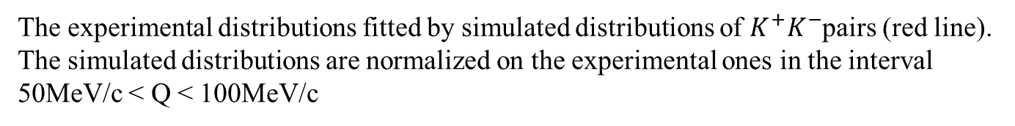
Experimental distributions on Q evaluated with Q_{T}<6MeV/c
2010
2009 + 2010
The experimental distributions fitted by simulated distributions of $K^{+}K^{−}$pairs (red line).
The simulated distributions are normalized on the experimental ones in the interval 50MeV/c < Q < 100MeV/c
7/3/2019
9

Slide 10
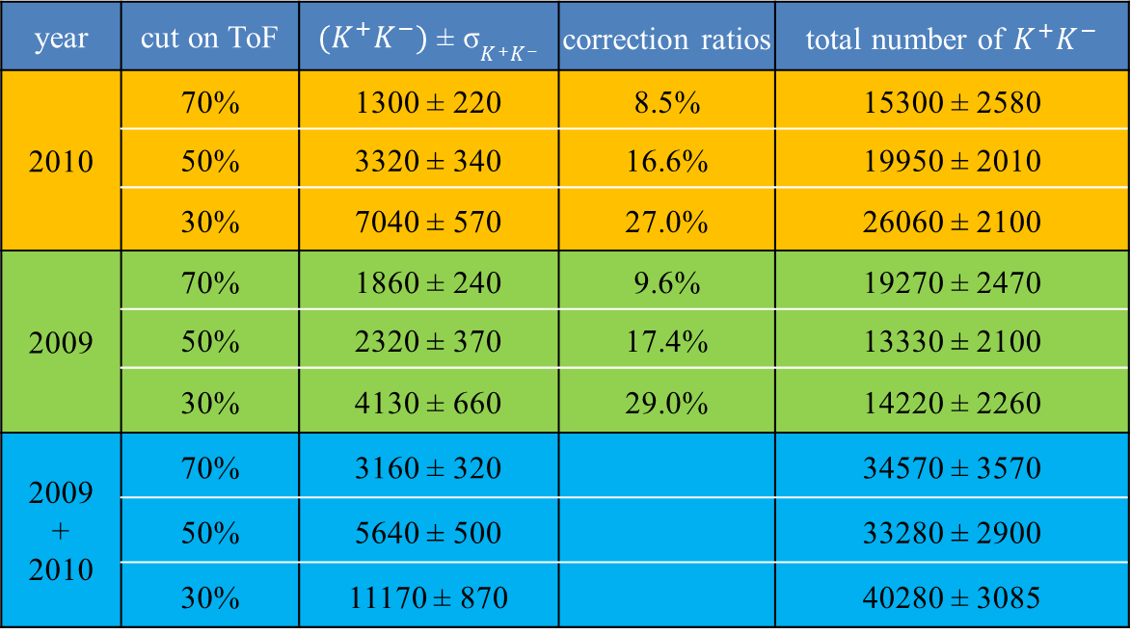
Total number of K⁺K⁻ pairs with Q_{T} ≤ 6 MeV/c
The numbers of 𝐾⁺𝐾⁻ were evaluated in the Q_{L} analysis using the coefficients from table 2.
year | cut on ToF | $(K^{+}K^{−})$ ± σ$K^{+}K^{−}$ | correction ratios | total number of $K^{+}K^{−}$
2010 | 70% | 1300 ± 220 | 8.5% | 15300 ± 2580
 | 50% | 3320 ± 340 | 16.6% | 19950 ± 2010
 | 30% | 7040 ± 570 | 27.0% | 26060 ± 2100
2009 | 70% | 1860 ± 240 | 9.6% | 19270 ± 2470
 | 50% | 2320 ± 370 | 17.4% | 13330 ± 2100
 | 30% | 4130 ± 660 | 29.0% | 14220 ± 2260
2009 + 2010 | 70% | 3160 ± 320 |  | 34570 ± 3570
 | 50% | 5640 ± 500 |  | 33280 ± 2900
 | 30% | 11170 ± 870 |  | 40280 ± 3085
7/3/2019

Slide 11
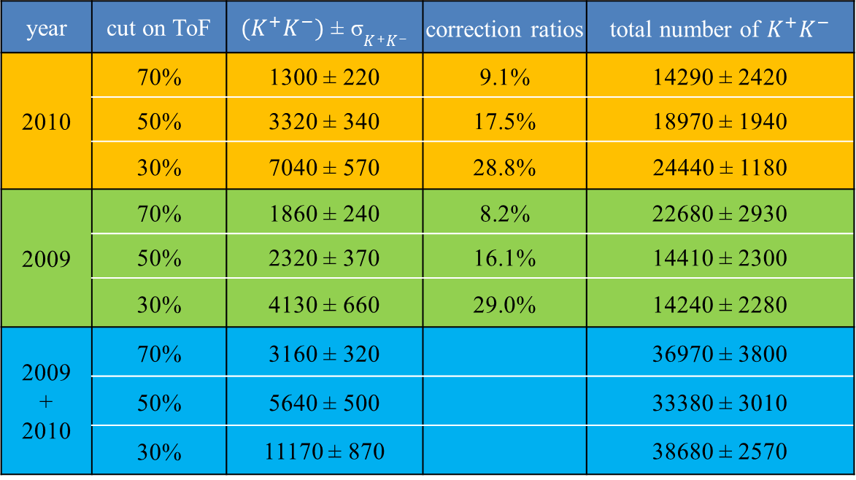
Total number of K⁺K⁻ pairs with Q_{T} ≤ 6 MeV/c
The numbers of 𝐾⁺𝐾⁻ were evaluated in the Q_{L} analysis using the coefficients from table 3.
year | cut on ToF | $(K^{+}K^{−})$ ± σ$K^{+}K^{−}$ | correction ratios | total number of $K^{+}K^{−}$
2010 | 70% | 1300 ± 220 | 9.1% | 14290 ± 2420
 | 50% | 3320 ± 340 | 17.5% | 18970 ± 1940
 | 30% | 7040 ± 570 | 28.8% | 24440 ± 1180
2009 | 70% | 1860 ± 240 | 8.2% | 22680 ± 2930
 | 50% | 2320 ± 370 | 16.1% | 14410 ± 2300
 | 30% | 4130 ± 660 | 29.0% | 14240 ± 2280
2009 + 2010 | 70% | 3160 ± 320 |  | 36970 ± 3800
 | 50% | 5640 ± 500 |  | 33380 ± 3010
 | 30% | 11170 ± 870 |  | 38680 ± 2570
7/3/2019

Slide 12
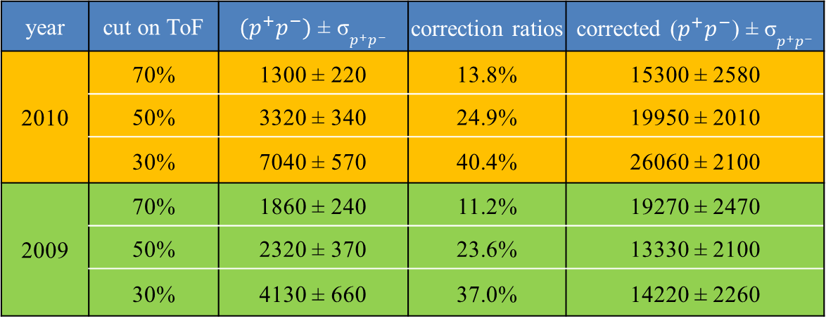
Total numbers of $p\overline{p}$ pairs with Q_{T} ≤ 6 MeV/c
The numbers of $p\overline{p}$ pairs were evaluated in Q_{L} analysis using coefficients from the table 2.
year | cut on ToF | $(p^{+}p^{−})$ ± σ$p^{+}p^{−}$ | correction ratios | corrected ($p^{+}p^{−}$) ± σ$p^{+}p^{−}$
2010 | 70% | 1300 ± 220 | 13.8% | 15300 ± 2580
 | 50% | 3320 ± 340 | 24.9% | 19950 ± 2010
 | 30% | 7040 ± 570 | 40.4% | 26060 ± 2100
2009 | 70% | 1860 ± 240 | 11.2% | 19270 ± 2470
 | 50% | 2320 ± 370 | 23.6% | 13330 ± 2100
 | 30% | 4130 ± 660 | 37.0% | 14220 ± 2260
7/3/2019

Slide 13
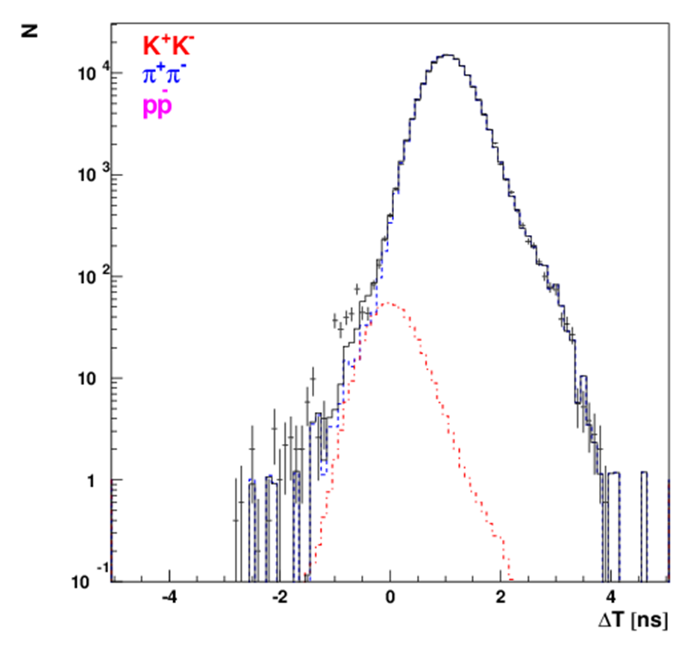
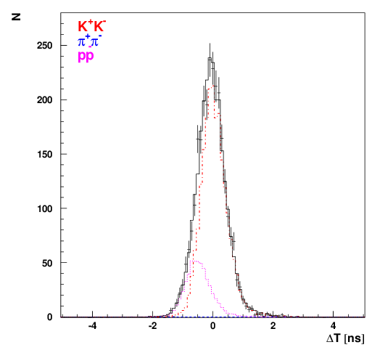
K⁺K⁻ pair analysis
The time-of-flight distribution for the low momentum interval
The time-of-flight distribution for the high momentum interval
7/3/2019

Slide 14
K⁺K⁻ pair analysis
K⁺K⁻ Coulomb pairs signal
N
2009 + 2010
Distribution of K⁺K⁻ pairs in the RUN 2009 + 2010 over the full pair momentum in laboratory system.
7/3/2019
P[MeV/c]

Slide 15
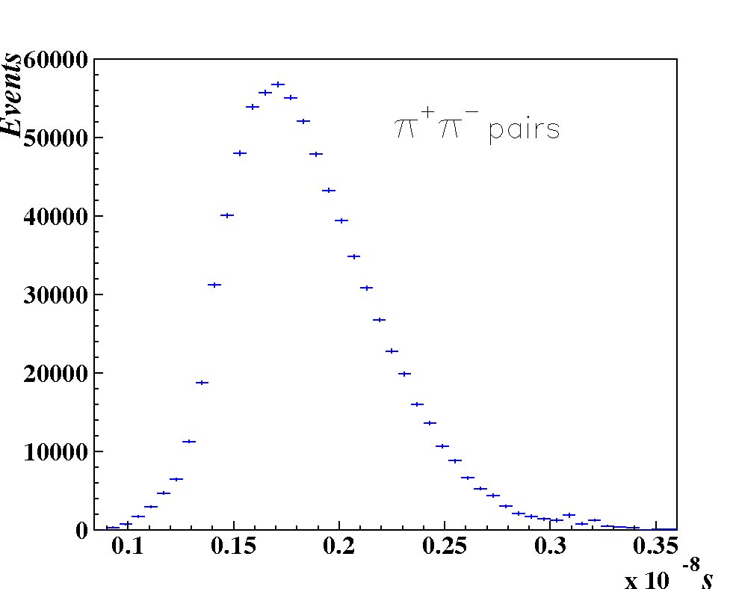
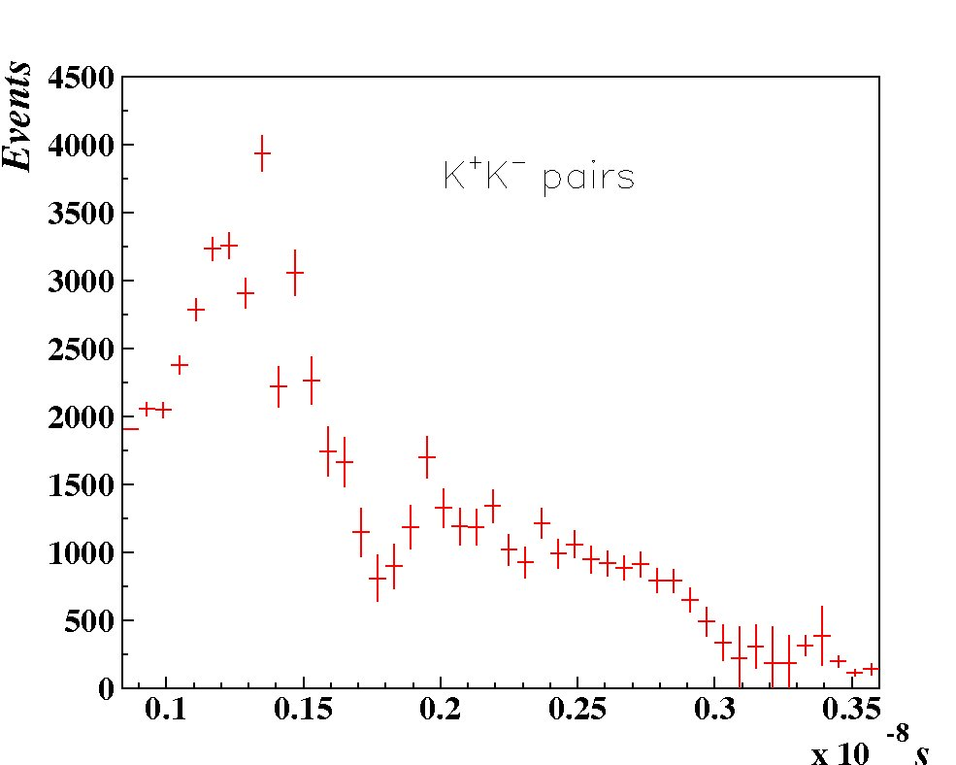
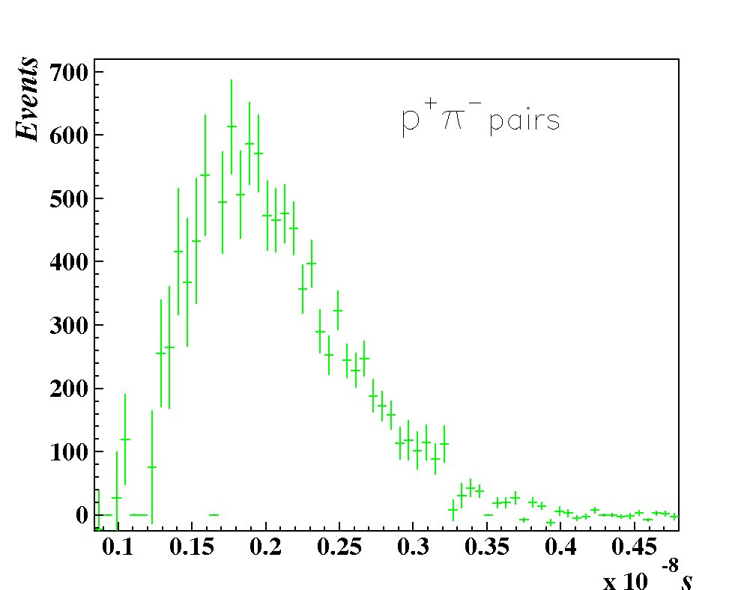
Number of atomic pairs
7/3/2019

Slide 16
K⁺K⁻ pair analysis
K⁺K⁻ Coulomb pairs ratio
R
R
R
7/3/2019
Q[MeV/c]

Slide 17
Thank you
7/3/2019

Slide 18
Additional slides
Simulation of K⁺ and K– production cross section
M. Gugiu

Slide 19
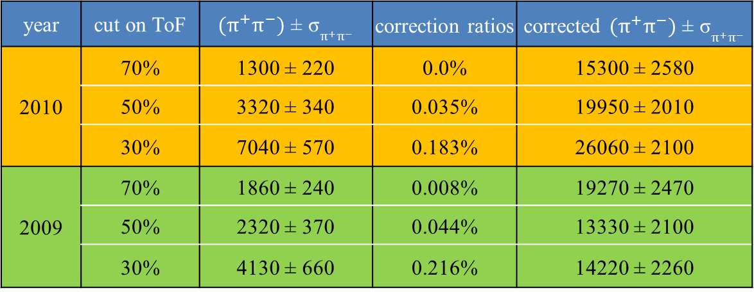
π⁺π⁻ corrected experimental data with Q_{T} ≤ 8 MeV/c
year | cut on ToF | $(π^{+}π^{−})$ ± σ$π^{+}π^{−}$ | correction ratios | corrected $(π^{+}π^{−})$ ± σ$π^{+}π^{−}$
2010 | 70% | 1300 ± 220 | 0.0% | 15300 ± 2580
 | 50% | 3320 ± 340 | 0.035% | 19950 ± 2010
 | 30% | 7040 ± 570 | 0.183% | 26060 ± 2100
2009 | 70% | 1860 ± 240 | 0.008% | 19270 ± 2470
 | 50% | 2320 ± 370 | 0.044% | 13330 ± 2100
 | 30% | 4130 ± 660 | 0.216% | 14220 ± 2260
7/3/2019

