Slide 1
DIRAC status
21. October 2011
Leonid Nemenov
π⁺K‒- and π‒K⁺-atoms
π⁺π‒-atoms (Α_{2π})
Run 2011
Future magnet
Α_{2π} level scheme, Stark effect and
energy splitting measurement

Slide 2
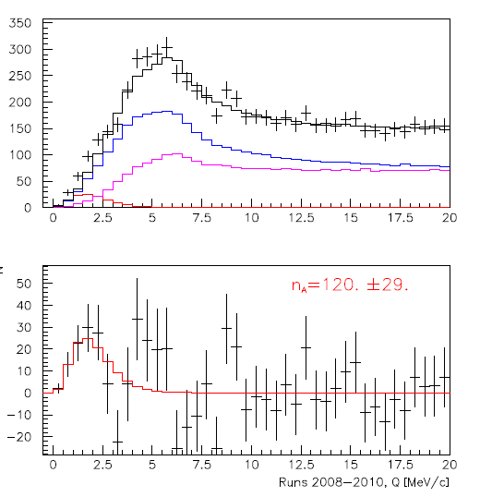
I Status of π⁺K‒ -atoms
A. Benelli, V. Yazkov
Coulomb pairs
Run 2008-2010, statistics with low and medium background (⅔ of all statistics). Point-like production of all particles. The e⁺e‒ background was not subtracted.
non-Coulomb pairs
Atomic pairs
Q
Q – relative momentum in the πK c.m.s.

Slide 3
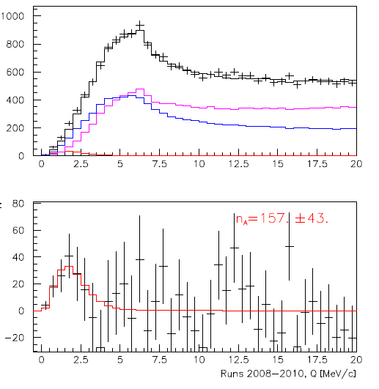
II Status of π⁻K⁺ -atoms
A. Benelli, V. Yazkov
Coulomb pairs
Run 2008-2010, statistics with low and medium background (⅔ of all statistics). Point-like production of all particles. The e⁺e‒ background was not subtracted.
non-Coulomb pairs
Atomic pairs
Q – relative momentum in the πK c.m.s.

Slide 4
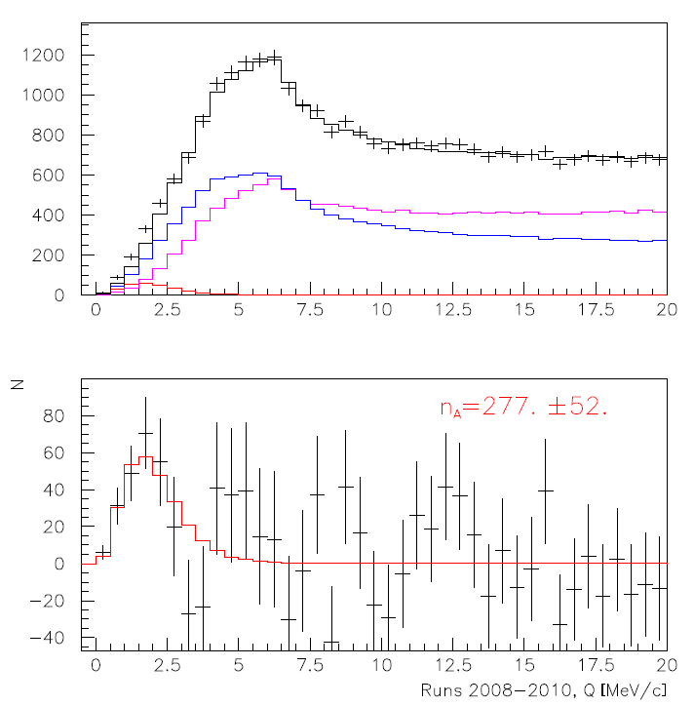
III. The status of π⁻K⁺ and π⁺K‒atoms
A. Benelli, V. Yazkov
Run 2008-2010, statistics with low and medium background (⅔ of all statistics). Point-like production of all particles. The e⁺e‒ background was not subtracted.
Coulomb pairs
non-Coulomb pairs
Atomic pairs
Q – relative momentum in the πK c.m.s.

Slide 5
IV Status π⁺π‒ -atoms
A. Benelli, V. Yazkov
Coulomb pairs
Coulomb pairs
non-Coulomb pairs
non-Coulomb pairs
Atomic pairs
Atomic pairs
Run 2008-2010, statistics with low and medium background (⅔ of all statistics). Point-like production of all particles. The e⁺e‒ background was not subtracted.

Slide 6
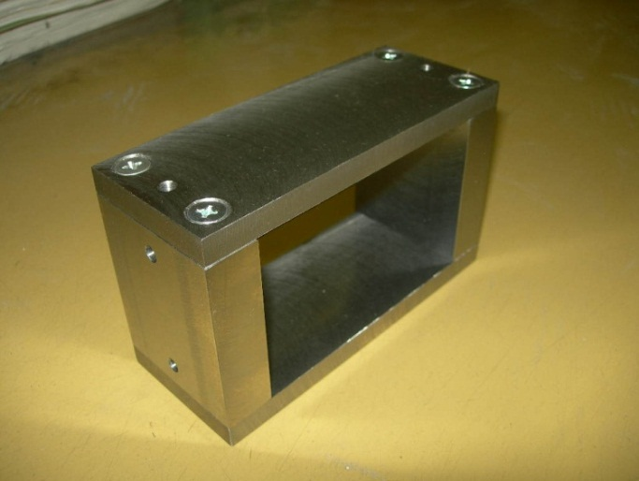
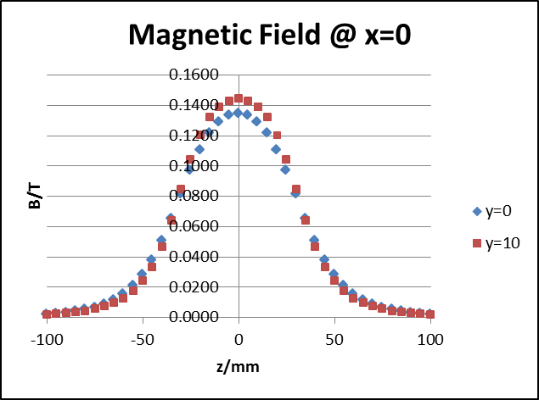
V Status of 2011 run
Tokyo Metropolitan University & Kyoto University
y
z
90mm
x
60mm
150mm
Neodymium magnetic piece=70x60x5mm³: Gap=60mm; BL=0.01Tm Time of delivery to CERN: before 4 May 2011

Slide 7
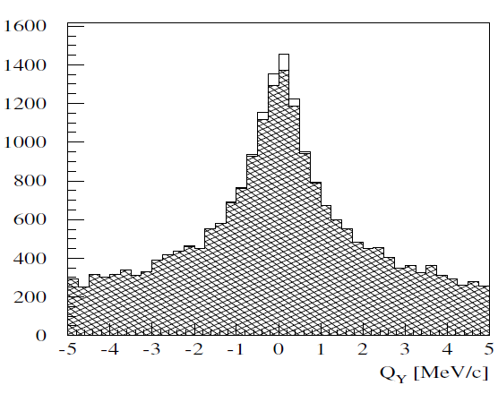
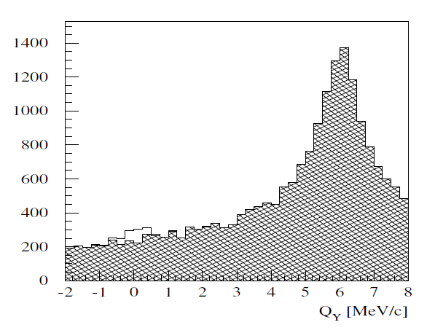
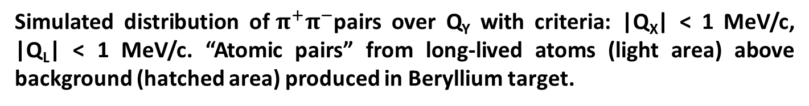
Simulation of long-lived A_{2π} observation
V. Yazkov
Without magnet
With magnet after Be target
Simulated distribution of${ π}^{+}π^{−}$pairs over Q_{Y} with criteria: |Q_{X}| < 1 MeV/c, |Q_{L}| < 1 MeV/c. “Atomic pairs” from long-lived atoms (light area) above background (hatched area) produced in Beryllium target.

Slide 8
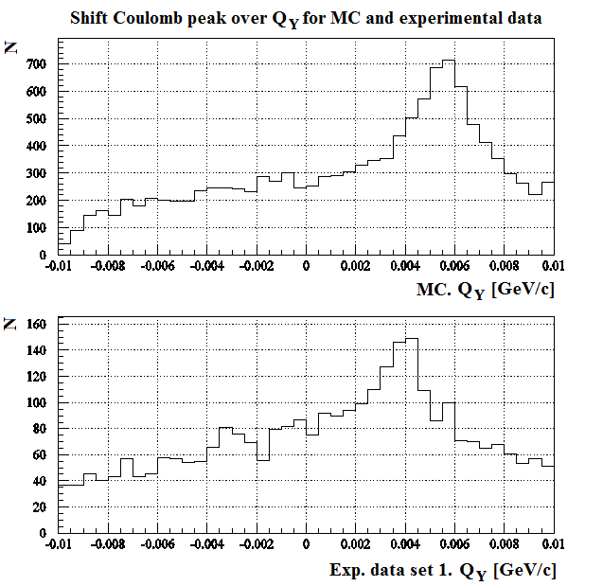
Coulomb peak of π⁺π‒
Shift because of magnet degradation !

Slide 9
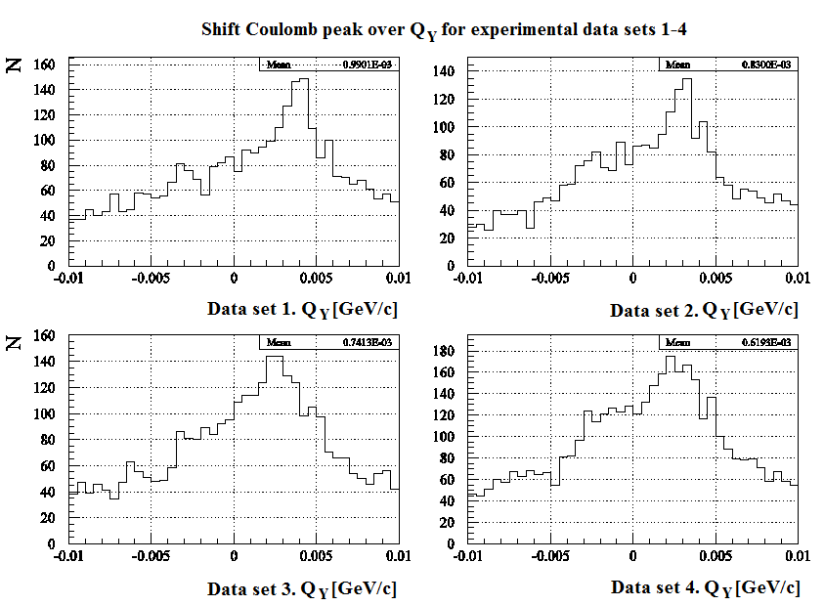
Shift of Q_{y} (June-August) π⁺π‒ data

Slide 10
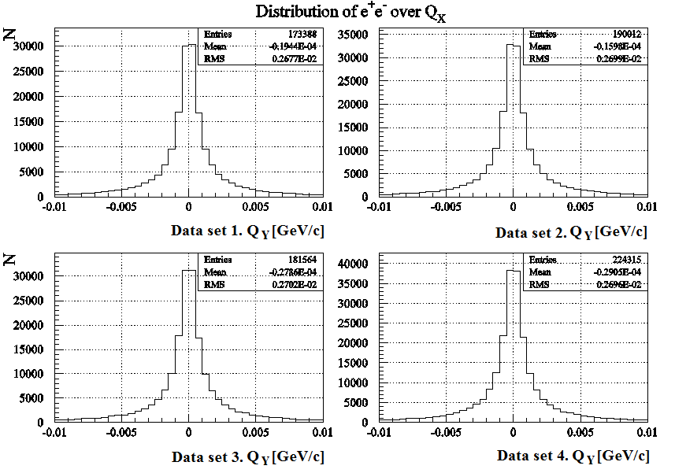
Q_{x} distribution (B_{x}=0)
F. Takeutchi, V. Yazkov

Slide 11
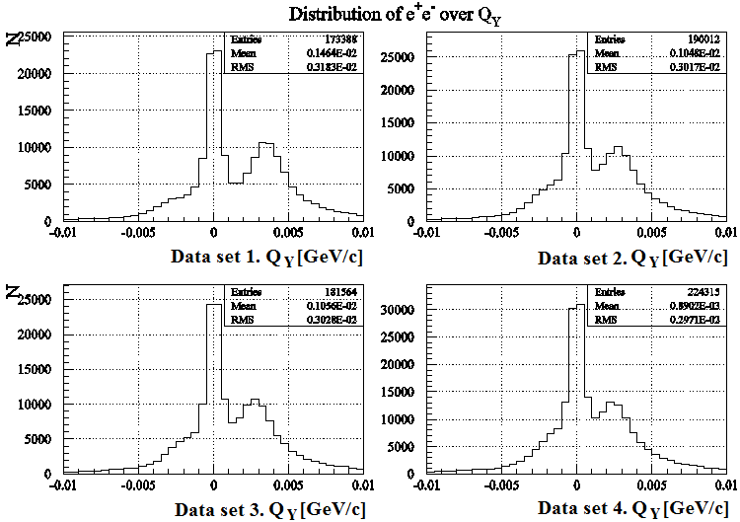
Shift of Q_{y} (June-August) e⁺e‒ data
F. Takeutchi, V. Yazkov
1
2
1
Pairs generated after magnet
2
Pairs generated on Be target before magnet

Slide 12
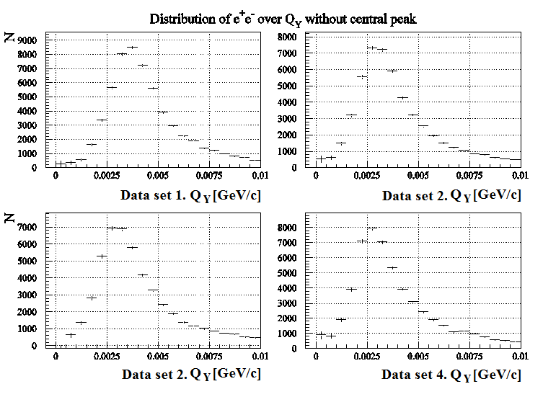
Shift of Q_{y} (June-August) e⁺e‒ data without central peak
F. Takeutchi, V. Yazkov
e⁺e‒ generated on Be target before magnet

Slide 13
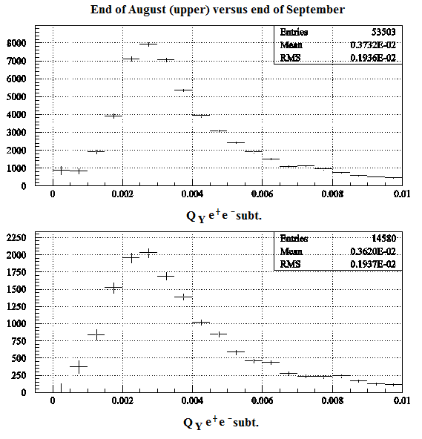
Shift of Q_{y} (August-September) e⁺e‒ data without central peak
F. Takeutchi, V. Yazkov

Slide 14
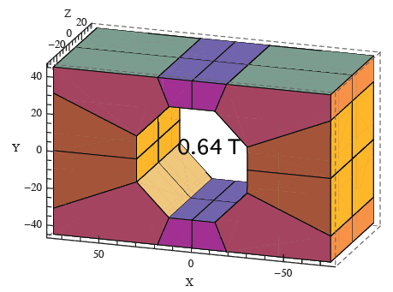
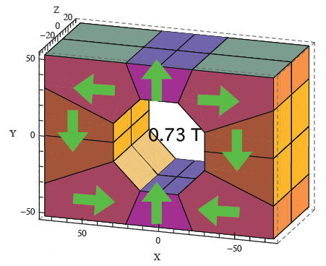
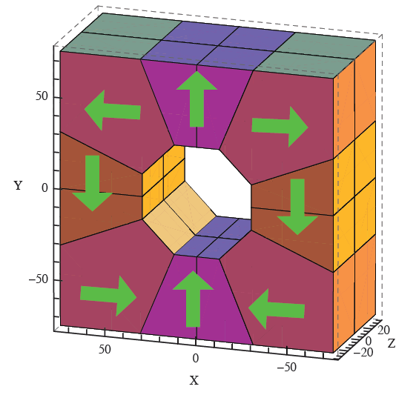
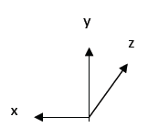




VI STATUS OF THE FUTURE MAGNET
Y. Iwashita
Halbach configuration
NdBFe
or
SmCo
60 x 60 bore
flat
$150x90x70; \sim$7.4 Kg.
$150x105x70;\sim 8$.7 Kg.
B = 0.89 T
$ρ \sim$ 7.7 g/cm³
$150x150x70; \sim$13.0 Kg.
The magnets cost about 17000 $. The fabrication time is about 65 days.

Slide 15
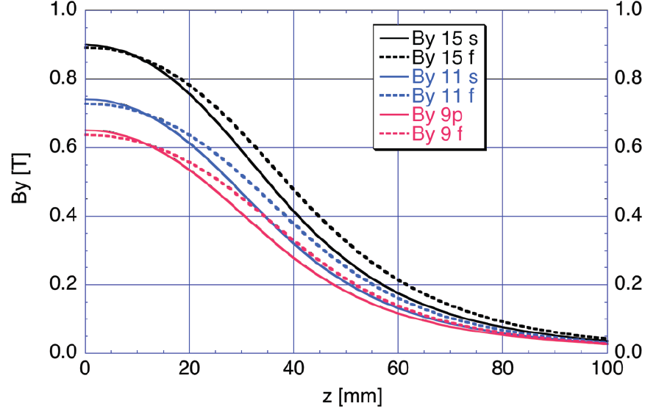
By along z-axis
Y. Iwashita

Slide 16
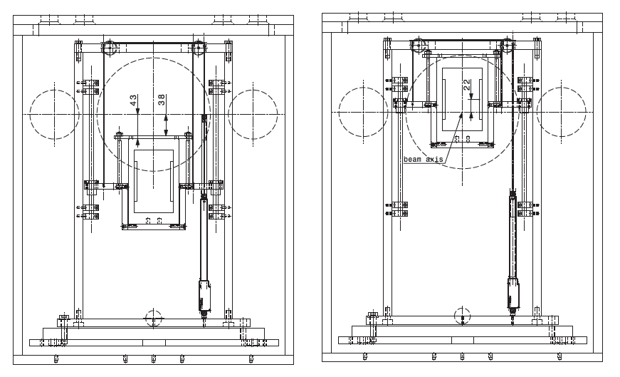


Current Magnet Holder
V. Brekhovskikh
$$lower position$$
operating$position$

Slide 17
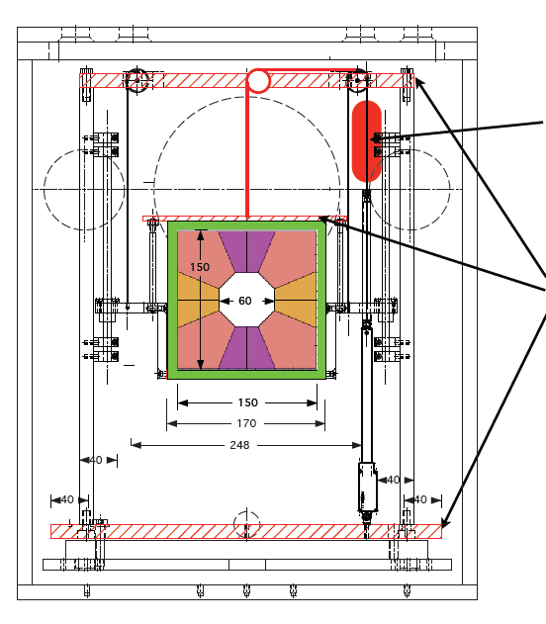



The New Magnet Holder
Y. Iwashita
$$lower position$$
$$Counter balance$$
$$New parts$$

Slide 18
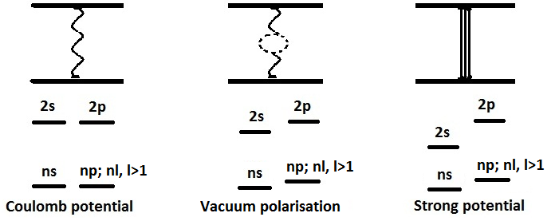



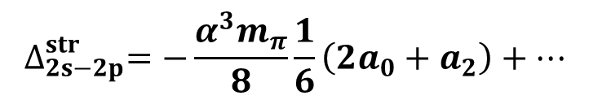


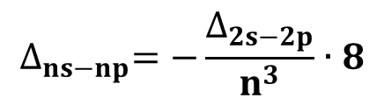
VII ENERGY SPLITTING MEASUREMENT
A_{2π} Energy Levels
J. Schweizer (P. L. 2oo4)
For Coulomb potential E depends on n only.
$$∆_{2s−2p}^{str}=−0.47 eV$$
$$∆_{2s−2p}^{vac+str}=−0.58 eV$$
$$∆_{2s−2p}^{str}=−\frac{α^{3}m_{π}}{8}\frac{1}{6}\left(2a_{0}+a_{2}\right)+…$$
$$∆_{ns−np}^{}=−\frac{∆_{2s−2p}}{n^{3}}∙8$$
CONCLUSION: one parameter (2a₀+a₂) allows to calculate all Δ_{ns-np} values.

Slide 19
Coulomb bound state and
strong & electromagnetic perturbation
DGBT ^{*)} formula & numerical values:
vacuum
polarization
em shift
strong shift
A) Energy shift contributions:
with
B) Decay width:
Remark
S-wave scattering lengths are amplitudes at threshold:
and
______
*) Deser, Goldberger, Baumann, Thirring, PR 96 (1954) 774.

Slide 20
A_{2π} level scheme and 2s – 2p energy splitting
E_{n} (keV)
J. Schacher
-0.21
n=3
-0.47
n=2
ε_{2s}
Γ_{2s}
ΔE_{2s-2p}
Stark mixing
-1.86
n=1
ε_{1s}
Γ_{1s}

Slide 21
Values for energy shifts and lifetimes of π⁺π⁻ atom
J. Schacher
[J. Schweizer, PL B587 (2004) 33]
*)

Slide 22
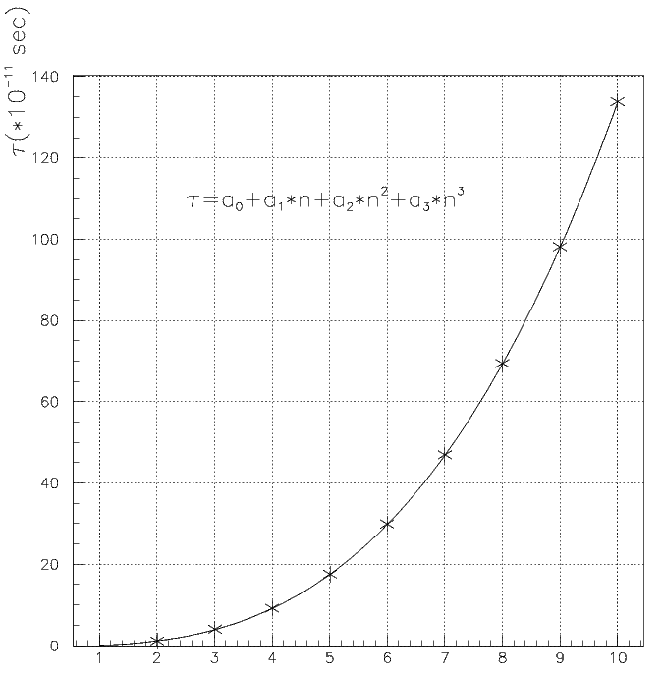
A_{2π} lifetime, τ, in np states
M. Pentia
n_{H} | τ_{H} •10⁸ s | τ_{2π} •10¹¹ s | Decay length A_{2π} in L.S. cm for γ=16.1
2p | 0.16 | 1.17 | 5.7
3p | 0.54 | 3.94 | 19
4p | 1.24 | 9.05 | 44
5p | 2.40 | 17.5 | 84.5
6p | 4.1 | 29.9 | 144
7p |  | 46.8* | 226
8p |  | 69.3* | 335
* - extrapolated values
CERN, Geneva - Monday 26, September, 2011

Slide 23
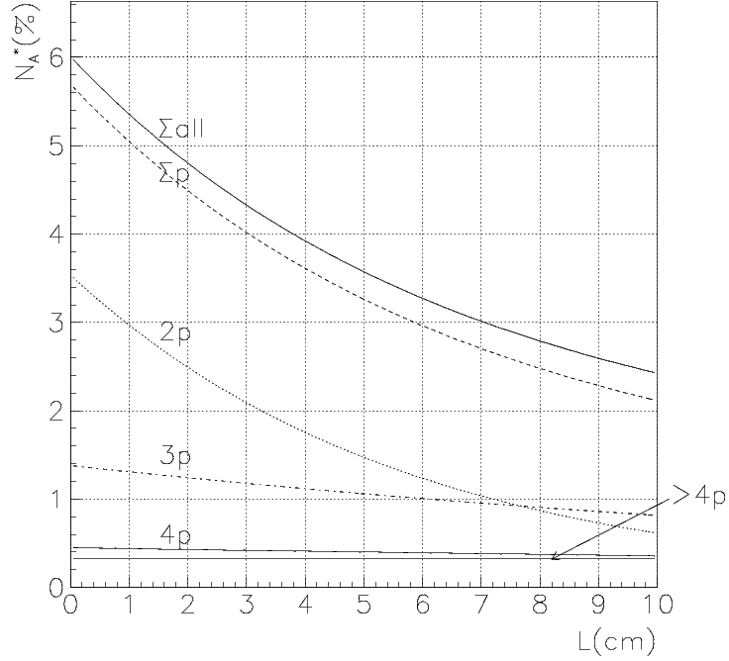
Long-lived A_{2π} yield and quantum numbers
L. Afanasev; O. Gorchakov (DIPGEN)
Atomic pairs from A_{2π} long-lived states breakup in 2μm Pt.

Slide 24

Lamb shift measurement with external magnetic field
See: L. Nemenov, V. Ovsiannikov, Physics Letters B 514 (2001) 247.
Impact on atomic beam by
external magnetic field B_{lab} and Lorentz factor γ
…. relative distance between
π⁺ and π⁻ in A_{2π} system
π⁻
…. laboratory magnetic field
π⁺
…electric field in A_{2π} system

Slide 25
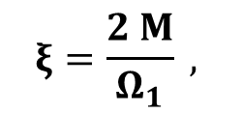
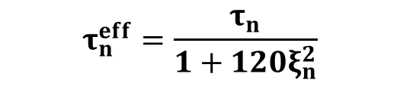

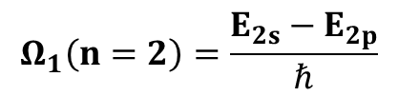
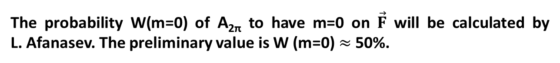

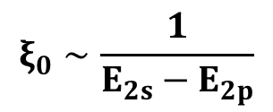
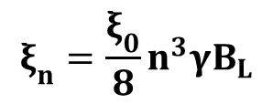
The lifetime of A_{2π} in electric field
L. Nemenov, V. Ovsiannikov [PL B514 (2oo1) 247]
F … strength of electric field in A_{2π} c.m.s.
$${F=βγB}_{L},$$
B_{L} ≡ B_{lab} in lab system
→ m must be 0
$$Ω_{1}\left(n=2\right)=\frac{E_{2s}−E_{2p}}{ℏ}$$
$$ξ_{0}∼\frac{1}{E_{2s}−E_{2p}}$$
$$ξ_{n}=\frac{ξ_{0}}{8}n^{3}γB_{L}$$
$$ξ\left(2s−2p\right)=ξ_{0}γB_{L}$$
CONCLUSION: the lifetimes for long-lived states can be calculated using only one parameter → E_{2s}-E_{2p}.
The probability W(m=0) of A_{2π} to have m=0 on $\vec{F}$ will be calculated by L. Afanasev. The preliminary value is W (m=0)$≈$ 50%.

Slide 26
A_{2π}* (2p-state) lifetime versus electric field
J. Schacher
Atom-field interaction:
with
…will change =>
[weak-field limit]

Slide 27
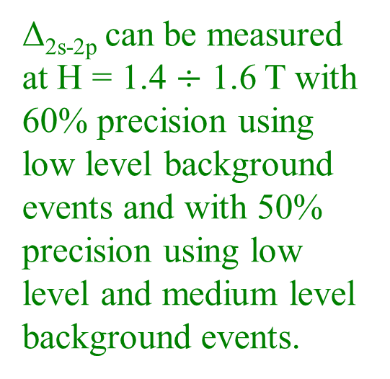
H=0.0 T ξ=1 N_{A}=330 ± 40
H=0.1 T ξ=1 N_{A}=330 (1-0.7%)
V. Brekhovskikh
ξ | 0.4 |  | 1 |  | 1.6
H=0.4 T | 328 |  | 317 |  | 302
 |  | 11 |  | 15 |  | 13
H=0.6 T | 325 |  | 304 |  | 279
 |  | 21 |  | 25 |  | 23
H=0.8 T | 322 |  | 290 |  | 258
 |  | 32 |  | 32 |  | 32
H=1.0 T | 317 |  | 276 |  | 241
 |  | 41 |  | 35 |  | 38
H=1.2 T | 312 |  | 263 |  | 227
 |  | 49 |  | 36 |  | 46
H=1.4 T | 307 |  | 251 |  | 215
 |  | 56 |  | 36 |  | 46
H=1.6 T | 302 |  | 241 |  | 206
 |  | 61 |  | 35 |  | 48
Δ_{2s-2p} can be measured at H = 1.4 $÷$ 1.6 T with 60% precision using low level background events and with 50% precision using low level and medium level background events.

Slide 28
Magnetic Field - 1.0 T
V. Brekhovskikh
Magnetic Field 1.0 T ξ = 40% 317.273
 | 2p | 3p | 4p | 5p | 6p | 7p | 8p | ∑
n,% | 0.42 | 0.27 | 0.15 | 0.079 | 0.046 | 0.025 | 0.012 | 1.002
τ∙10⁻¹¹,s | 1.17 | 3.94 | 9.05 | 17.5 | 29.9 | 46.8 | 69.3 | 177.66
L,cm | 5.64 | 19.02 | 43.68 | 84.47 | 144.32 | 225.89 | 334.49 | 857.50
ξ_{n} | 0.0075 | 0.0254 | 0.0603 | 0.1177 | 0.2034 | 0.3231 | 0.4822 | 1.2197
τ_{eff}∙10⁻¹¹,s | 1.162 | 3.656 | 6.302 | 6.571 | 5.011 | 3.461 | 2.397 | 28.561
L_{eff},cm | 5.609 | 17.647 | 30.418 | 31.715 | 24.188 | 16.703 | 11.572 | 137.85
N_{a} | 0.0714 | 0.1595 | 0.1193 | 0.0701 | 0.0429 | 0.0239 | 0.0116 | 0.499
N_{a}^{eff} | 0.0710 | 0.1557 | 0.1124 | 0.0624 | 0.0349 | 0.0171 | 0.0070 | 0.4605
Magnetic Field 1.0 T ξ = 100% 276.147
 | 2p | 3p | 4p | 5p | 6p | 7p | 8p | ∑
n,% | 0.42 | 0.27 | 0.15 | 0.079 | 0.046 | 0.025 | 0.012 | 1.002
τ∙10⁻¹¹,s | 1.17 | 3.94 | 9.05 | 17.5 | 29.9 | 46.8 | 69.3 | 177.66
L,cm | 5.64 | 19.02 | 43.68 | 84.47 | 144.32 | 225.89 | 334.49 | 857.50
ξ_{n} | 0.0188 | 0.0636 | 0.1507 | 0.2943 | 0.5086 | 0.8076 | 1.2056 | 3.0492
τ_{eff}∙10⁻¹¹,s | 1.122 | 2.653 | 2.429 | 1.535 | 0.933 | 0.590 | 0.395 | 9.659
L_{eff},cm | 5.416 | 12.806 | 11.726 | 7.412 | 4.504 | 2.849 | 1.907 | 46.622
N_{a} | 0.0714 | 0.1595 | 0.1193 | 0.0701 | 0.0429 | 0.0239 | 0.0116 | 0.499
N_{a}^{eff} | 0.0683 | 0.1369 | 0.0821 | 0.0335 | 0.0118 | 0.0030 | 0.0005 | 0.3362
Magnetic Field 1.0 T ξ = 160% 240.908
 | 2p | 3p | 4p | 5p | 6p | 7p | 8p | ∑
n,% | 0.42 | 0.27 | 0.15 | 0.079 | 0.046 | 0.025 | 0.012 | 1.002
τ∙10⁻¹¹,s | 1.17 | 3.94 | 9.05 | 17.5 | 29.9 | 46.8 | 69.3 | 177.66
L,cm | 5.64 | 19.02 | 43.68 | 84.47 | 144.32 | 225.89 | 334.49 | 857.50
ξ_{n} | 0.0301 | 0.1017 | 0.2411 | 0.4709 | 0.8137 | 1.2922 | 1.9289 | 4.8788
τ_{eff}∙10⁻¹¹,s | 1.055 | 1.757 | 1.135 | 0.634 | 0.372 | 0.233 | 0.155 | 5.339
L_{eff},cm | 5.092 | 8.483 | 5.476 | 3.059 | 1.793 | 1.122 | 0.747 | 25.774
N_{a} | 0.0714 | 0.1595 | 0.1193 | 0.0701 | 0.0429 | 0.0239 | 0.0116 | 0.499
N_{a}^{eff} | 0.0637 | 0.1079 | 0.0458 | 0.0106 | 0.0016 | 0.0001 | 3.87∙10⁻⁶ | 0.2296
CERN, Geneva - Monday 26, September, 2011

Slide 30
Reserve:

Slide 31
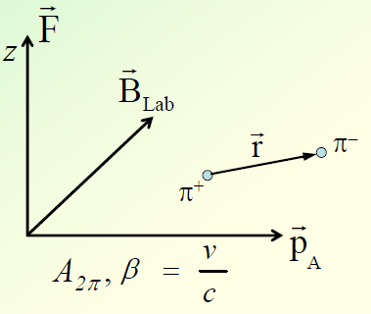
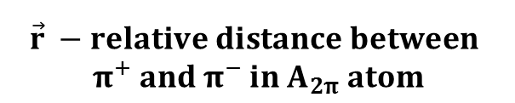

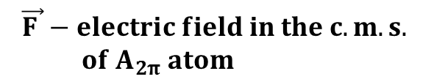

External magnetic and electric fields
Atoms in a beam are influenced by external magnetic field and the relativistic Lorentz factor.
$$\vec{r} −relative distance between$$
${ π}^{+} and π^{−} in A_{2π} atom$
$$\vec{B}−laboratory magnetic field$$
$$\vec{F }−electric field in the c.m. s.$$
$of A_{2π} atom$
$$F=βγB_{L }≈γB_{L}$$

Slide 32
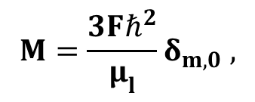
The lifetime of A_{2π} in electric field
L. Nemenov, V. Ovsiannikov (P. L. 2oo1)
mmmmmmmmmmm
F – strength of electric field in A_{2π} c.m.s.
$${F=βγB}_{L},$$
B_{L} in lab. syst.
→ m must be 0
$$Ω_{1}\left(n=2\right)=\frac{E_{2s}−E_{2p}}{ℏ}$$
$$ξ_{0}∼\frac{1}{E_{2s}−E_{2p}}$$
$$ξ_{n}=\frac{ξ_{0}}{8}n^{3}γB_{L}$$
$$ξ\left(2s−2p\right)=ξ_{0}γB_{L}$$
CONCLUSION: the lifetimes for long-lived states can be calculated using only one parameter → E_{2s}-E_{2p}.
The probability W(m=0) of A_{2π} to have m=0 on $\vec{F}$ will be calculated by L. Afanasev. The preliminary value is W (m=0)$≈$ 50%.

