Slide 1
DIRAC Report
SPSC – October 2021
L. Nemenov on behalf of the DIRAC Collaboration

Slide 2
Outline
Investigation of π⁺π⁻ , K⁺π⁻ and K⁻π⁺ atoms.
K⁺K⁻ pairs analysis in the effective mass region near 2m_{K.}
Proton-antiproton pairs analysis preliminary results.
The first evaluation of the K⁺K⁻ atom numbers.
The short-lived π⁺π⁻ atom lifetime measurement.

Slide 3
Outline
Investigation of π⁺π⁻, K⁺π⁻ and K⁻π⁺ atoms.
1.The first short-lived π⁺π⁻ atom lifetime measurement and ππ scattering length evaluation.
2. The first long-lived π⁺π⁻ atom observation and its lifetime measurement.
3. The first K⁺π⁻ and K⁻π⁺ atom observation, its lifetime measurement and the Kπ scattering length evaluation.
4. The investigation of Coulomb final state interaction in ππ and πK pairs.
The π⁺π⁻ and Kπ scattering length are calculating in QCD.
K⁺K⁻ atom.
The first step is investigation of K⁺K⁻ pairs production in the effective mass region near 2m_{K}

Slide 4
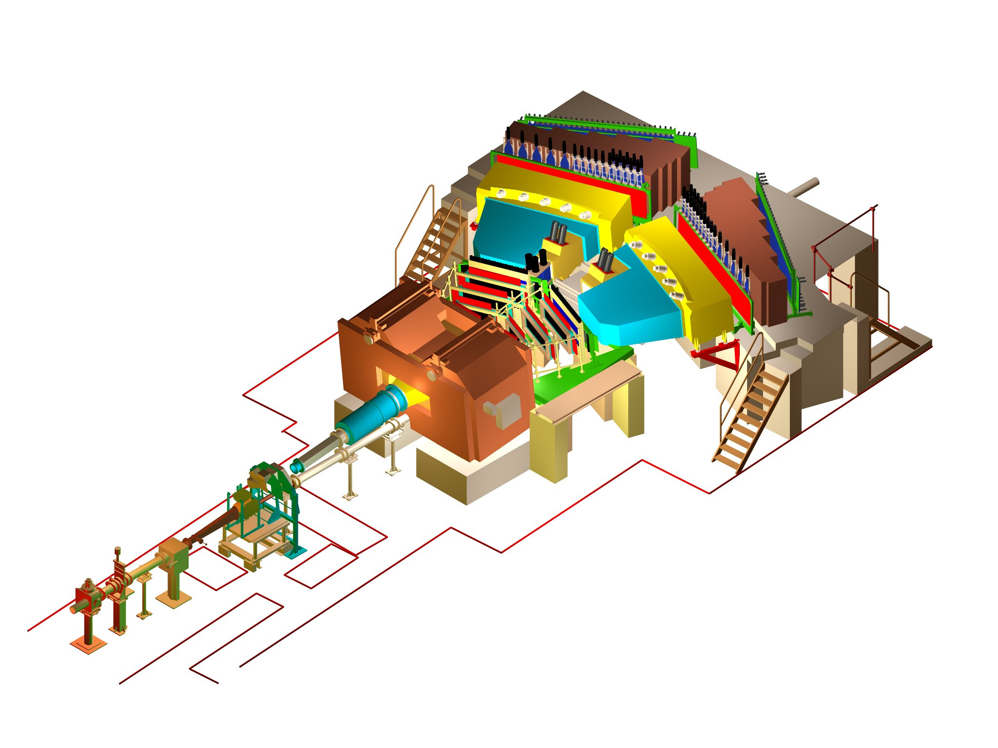
DIRAC set-up
Notes:
4

Slide 5
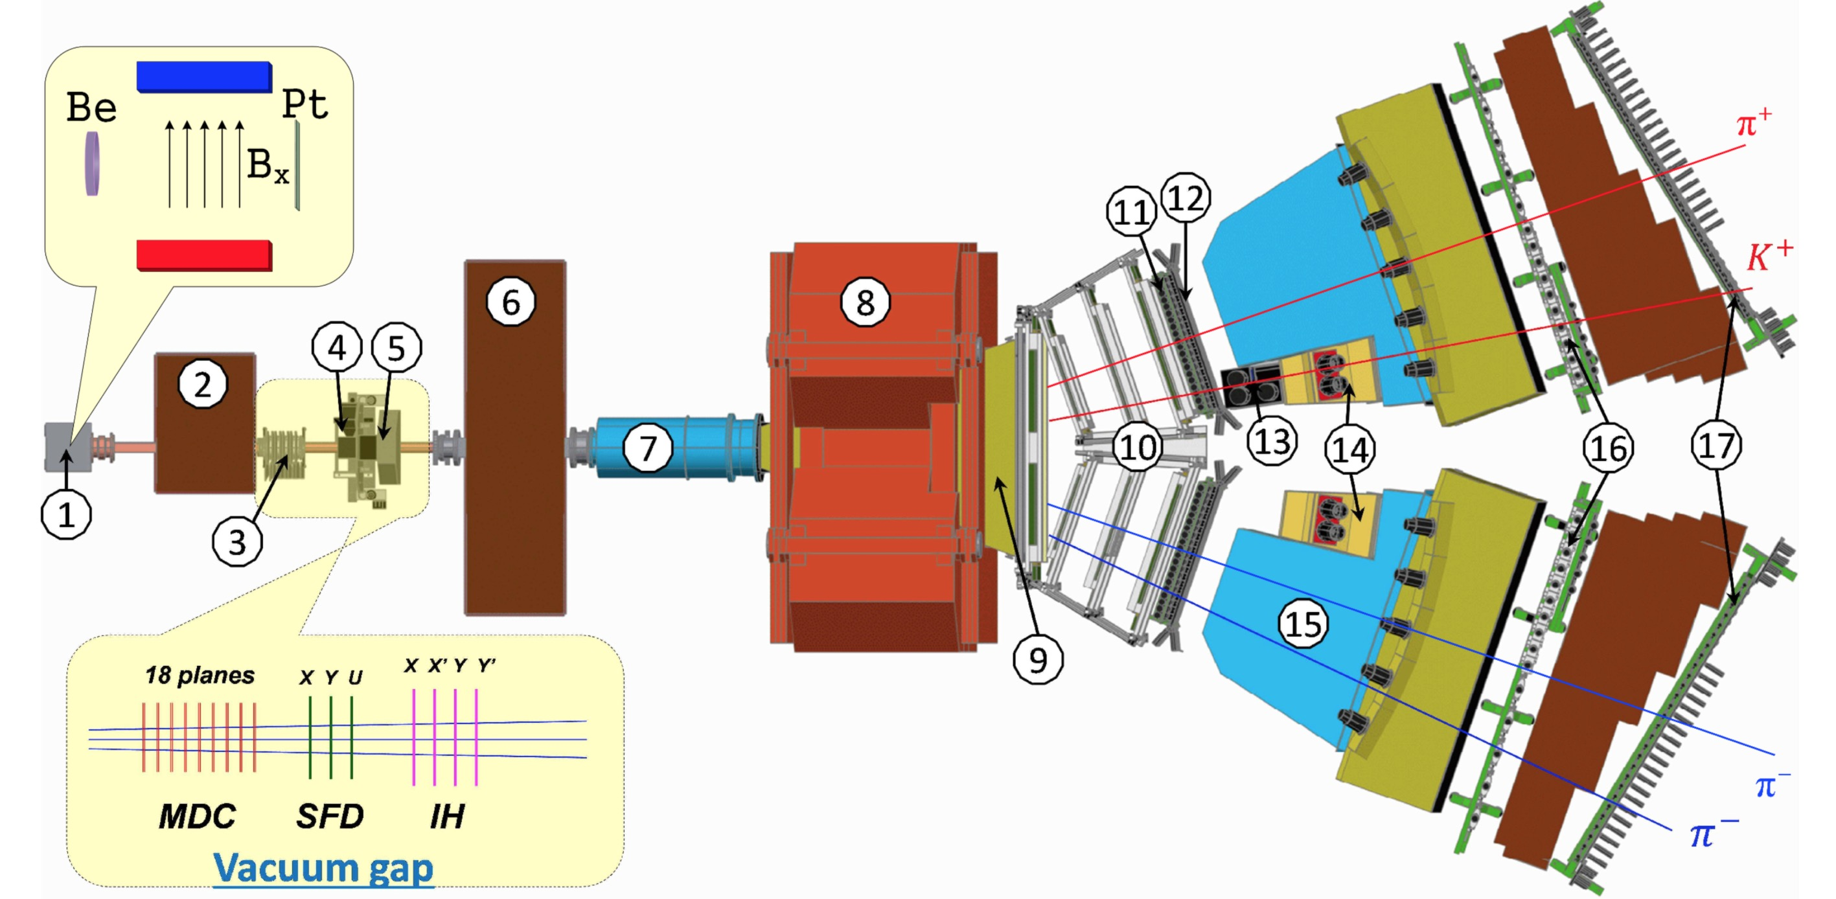
DIRAC set-up
Fig. 2. General view of the DIRAC setup:
1 -- target station with insertion, showing the Be target, magnetic field and Pt breakup foil; 2 -- first shielding;
3 -- microdrift chambers (MDC); 4 -- scintillating fiber detector (SFD); 5 -- ionisation hodoscope (IH);
6 -- second shielding; 7 -- vacuum tube; 8 -- spectrometer magnet; 9 -- vacuum chamber; 10 -- drift chambers (DC);
11 -- vertical hodoscope (VH); 12 -- horizontal hodoscope (HH); 13 -- aerogel Cherenkov; 14 -- heavy gas Cherenkov;
15 -- nitrogen Cherenkov; 16 -- preshower (PSh); 17 -- muon detector.
(The plotted symmetric and asymmetric events are a π⁺π⁻ and K⁺π⁻ pair, respectively.)

Slide 6
Schematic description of K⁺K⁻ production processes
a) | b)
Fig. 1
The black point presents the pair point-like production; the wavy lines describe the Coulomb interaction in the final state.
The circle and square present the pair non point-like production and strong interaction in the final state respectively.

Slide 7
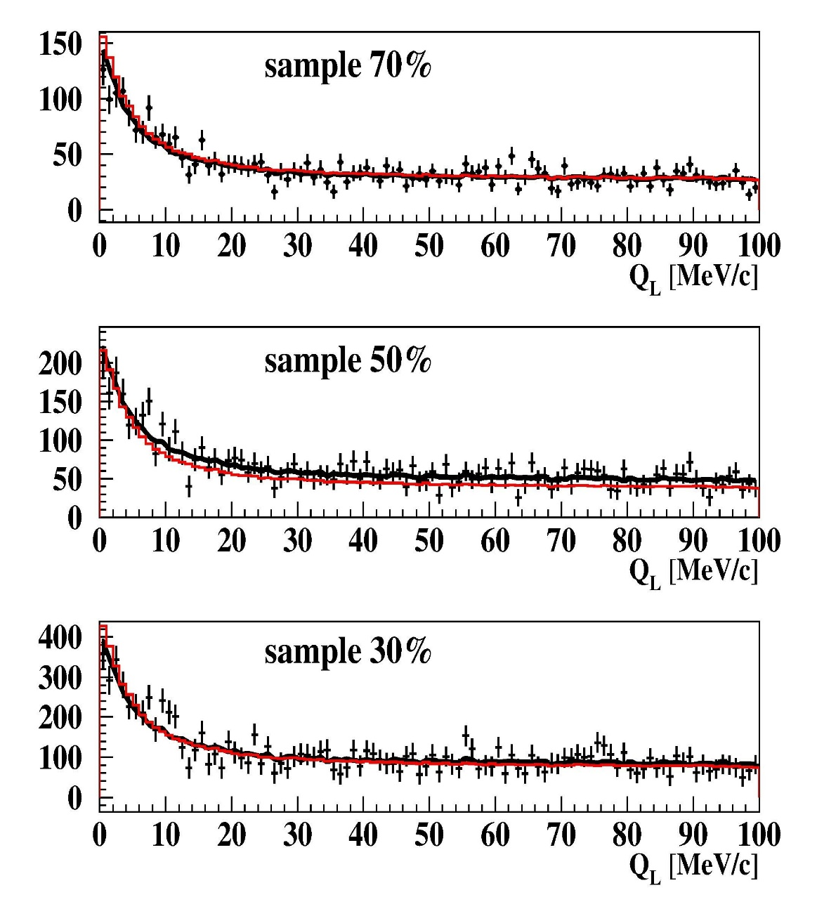
Q_{L} distributions of the subsamples 30%, 50% and 70% for DATA3/ DATA2
Fig. 2: The experimental spectra in the interval 0 < Q_{L} < 100 MeV/c are fitted by simulated K⁺K⁻ (point-like, Coulomb FSI) and residual π⁺π⁻ and p-anti-p background distributions. The red curve is the K⁺K⁻ distribution, the black one is the sum of K⁺K⁻ and residual background distributions. In the subsamples 70% and 30% the residual background is small and these curves practically coincide. For K⁺K⁻ pairs in the region of Q_{L} < 10 MeV/c the Coulomb enhancement is clearly visible, whereas the residual background is small and practically uniform.

Slide 8
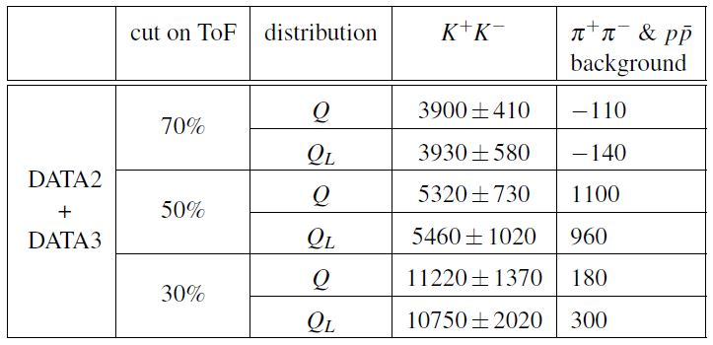
Matching pair numbers for Q and Q_{L} distribution analyses
The errors of K⁺K⁻ and background values are the same.
It is seen from Table that the K⁺K⁻ pairs number defined on Q and Q_{L} distributions do not differ significantly.

Slide 9
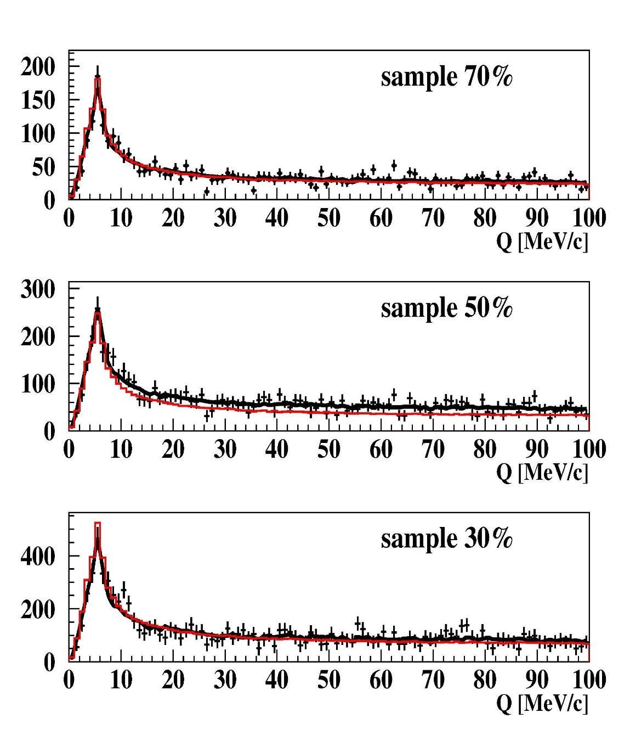
Q distributions of the subsamples 30%, 50% and 70% for DATA2 and DATA3
Fig. 3: Simulated distributions of K⁺K⁻ (ALICE parame-trization) and residual back-ground of π⁺π⁻, accidental and p-anti-p pairs are fitting the experimental spectrum in the interval 0<Q<100MeV/c. The red line is the K⁺K⁻ distribution, the black line is the sum of K⁺K⁻ and residual background. In the subsamples 70% and 30% the residual background is small and these lines practically coincide.

Slide 10
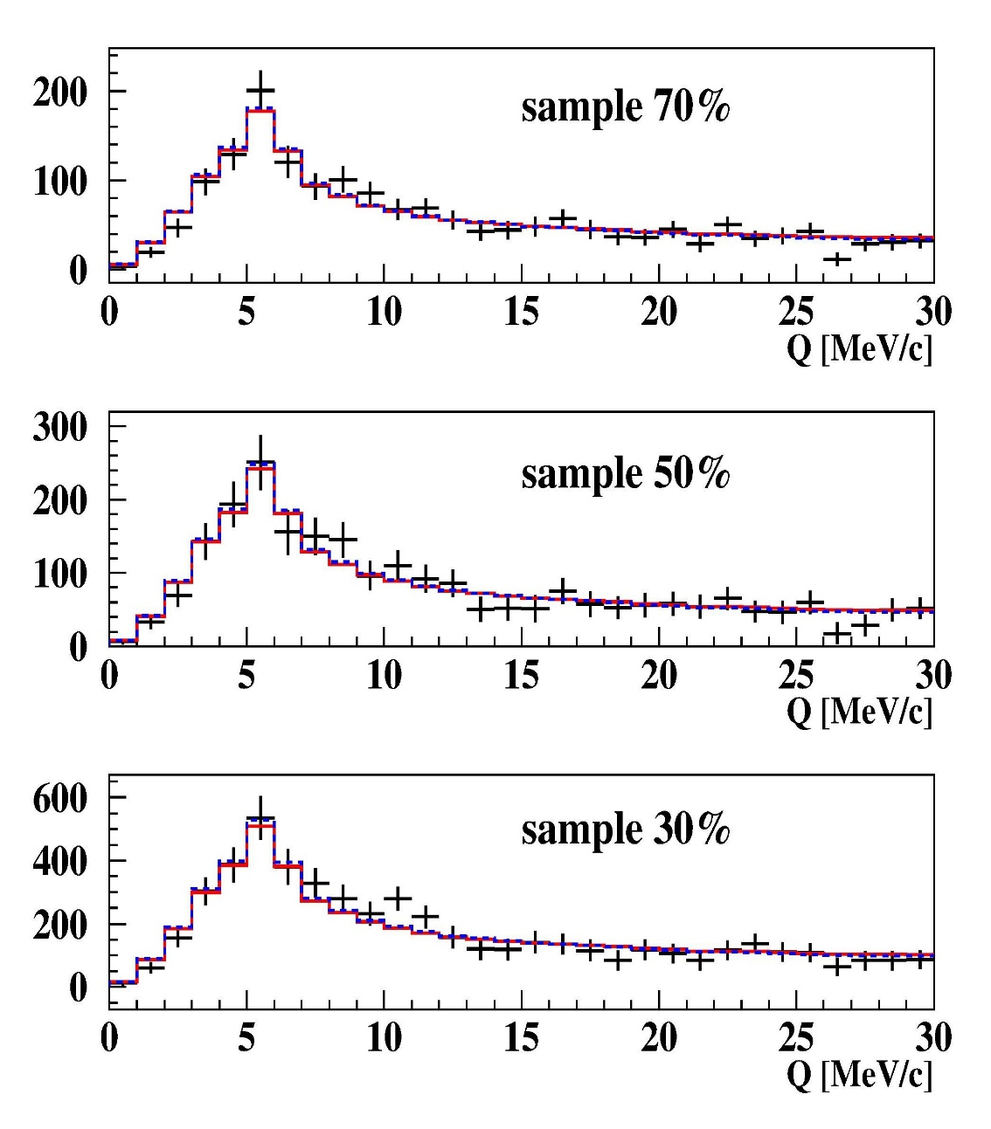
Q distributions in the interval 0-30 MeV/c of K⁺K⁻
Fig.5 Q distributions in the interval
0-30 MeV/c of K⁺K⁻ (ALICE parametrization) of the subsamples 30%, 50% and 70% for the DATA3/ DATA2 after residual background subtraction. The red and the blue fitting histograms were evaluated from the analysis of experimental distributions with residual background in Coulomb and Martin parametrizations respectively. It is seen that in this interval of Q the difference between these histograms is absent and they describe ”pure” experimental K⁺K⁻ distributions well.

Slide 11
The first evaluation of the K⁺K⁻ atoms number
The K⁺K⁻ pairs analysis at Q_{L} < 30 MeV/c shows the Coulomb parametrization at small Q_{L}, describes well the experimental data, and confirm the Coulomb interaction as the main contribution to the final state interaction at small Q.
In this case, there is a direct connection between the detected number of K⁺K⁻ pairs with small Q and the number of K⁺K⁻ atoms generated in the experiment.
Based on experimental data, it allows, by a model independent way, to evaluate, in the first time, the number of produced K⁺K⁻ atoms.
This work will begin in 2022.

Slide 12
KK Coulomb pairs and KK atoms
For charged pairs from short-lived sources and with small relative momenta Q, Coulomb final state interaction has to be taken into account.
This interaction increases the production yield of the free pairs with Q decreasing and creates atoms.
K⁺K⁻
Coulomb pair
Atom
There is a precise ratio between the number of produced Coulomb pairs (N_{C}) with small Q and the number of atoms (N_{A}) produced simultaneously with Coulomb pairs:
N_{A} = K(Q₀)N_{C}(Q ≤ Q₀), $\frac{δK(Q0)}{K(Q0)}$≤ 10⁻²
n_{A} – atomic pairs number, P_{br}= $\frac{nA}{NA}$

Slide 13
The atom yields for DIRAC at 24 GeV/c and 450 GeV/c
p_{p} at θ_{lab} | π⁺π⁻ atom | K⁻π⁺ atom | K⁺π⁻ atom
p_{p}=24 GeV/c at θ_{lab}=5.7º | 190∙10⁻¹¹ | 22∙10⁻¹¹ | 52∙10⁻¹¹
p_{p}=450 GeV/c at θ_{lab}=4.0º | 3400∙10⁻¹¹ | 810∙10⁻¹¹ | 850∙10⁻¹¹
p_{p}=24 GeV/c at θ_{lab}=5.7º (DIRAC acceptance) | 120∙10⁻¹¹ | 1.3∙10⁻¹¹ | 3.1∙10⁻¹¹
p_{p}=450 GeV/c at θ_{lab}=4.0º (DIRAC acceptance) | 1900∙10⁻¹¹ | 88∙10⁻¹¹ | 97∙10⁻¹¹
yield ratio (DIRAC acceptance) | 16 | 68 | 31

Slide 14
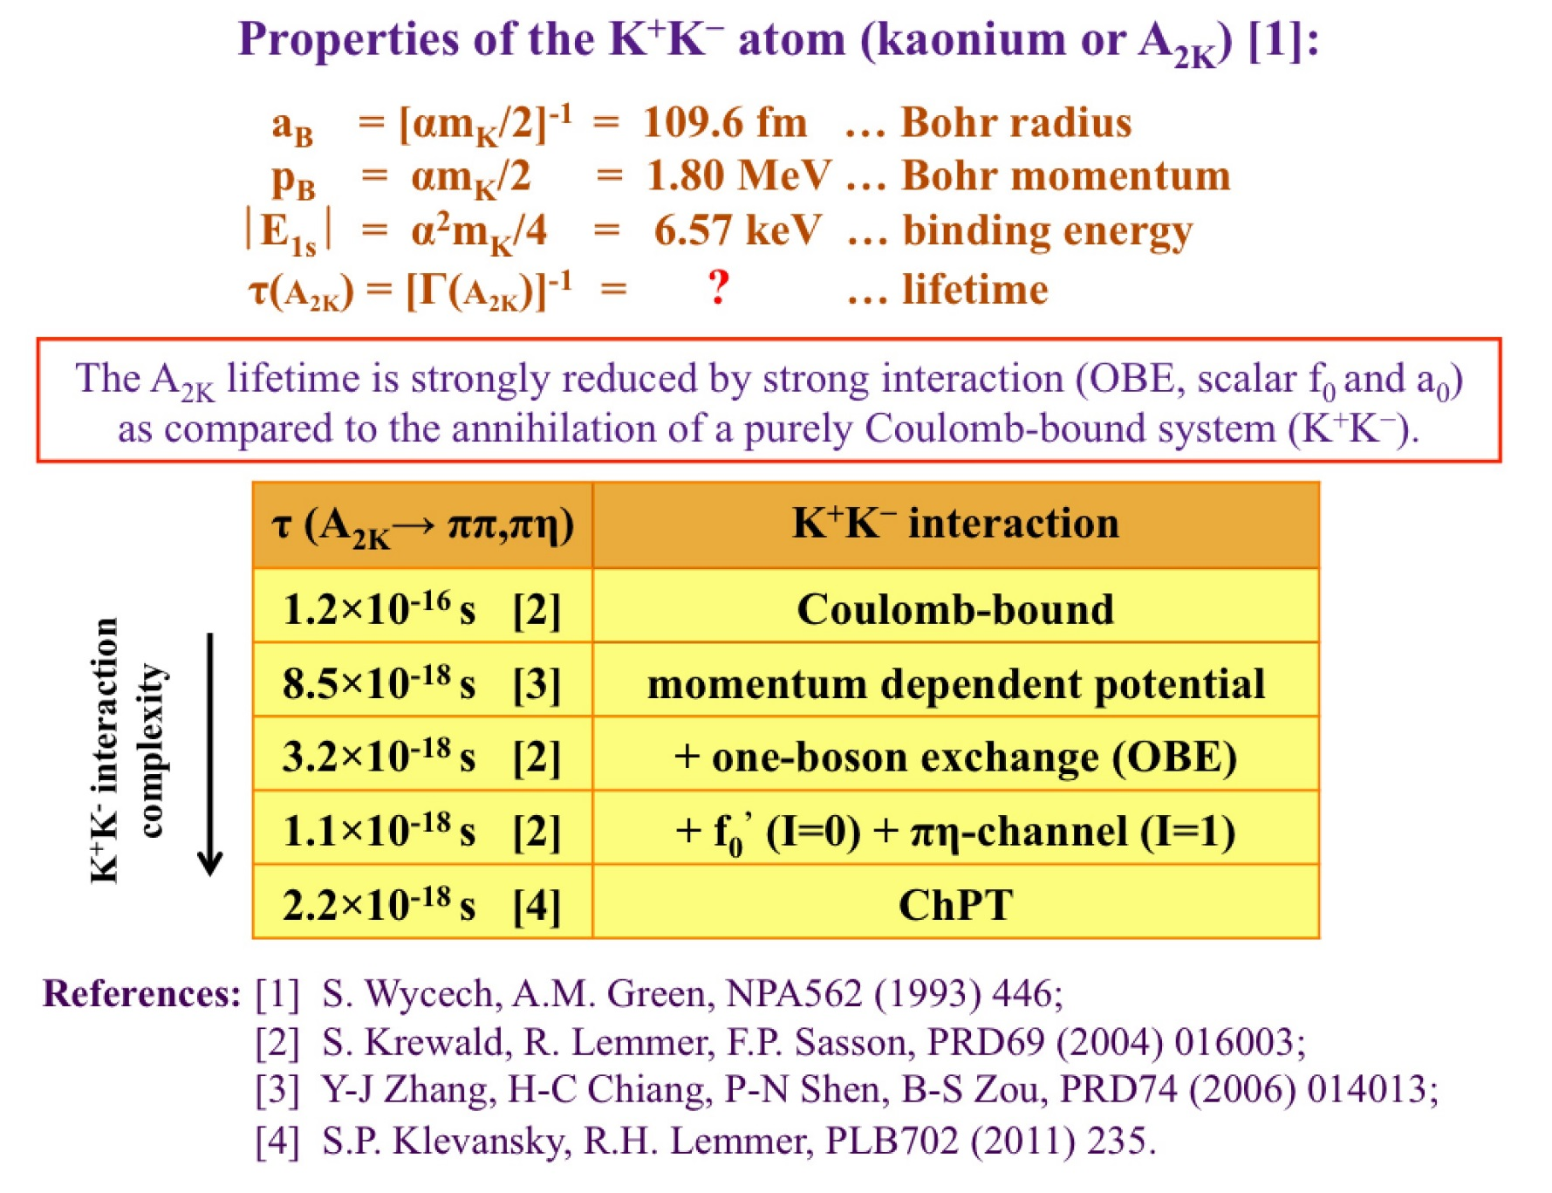
K⁺K⁻ atom and its lifetime

Slide 15
Proton-antiproton pairs analysis
Fig. 6: Q_{L} distribution of pp‾ pairs (black points). The blue histogram shows the K⁺K⁻ pairs simulated spectrum calculated in the Coulomb parametrization and fitting experimental K⁺K⁻ pairs distribution. This histogram fits the pp‾ pairs distribution in Q_{L} interval 50MeV/c-100MeV/c. It is seen that for low Q_{L} values the Coulomb final state interaction enlarges the pp‾ pairs yield significantly more than K⁺K⁻ pairs.

Slide 16
Thank you
10/10/2021

Slide 17
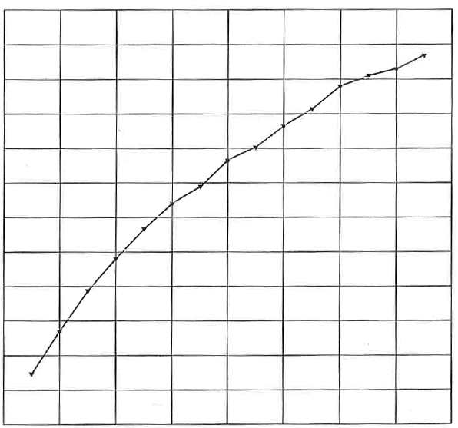
K⁺K⁻ atoms ionization probability
x 10⁻²
3.9
3.5
3.1
2.7
2.3
1.9
1.5
28 μm Pt
Ionization Probability
0 1 2 3 4
Life time τ in 10^{–18} s
Κ⁺Κ⁻ atoms Lorentz factor is γ = 18
Notes:
17

