Slide 1
Experimental check of precise
predictions of QCD using
π⁺K⁻ , K⁺π⁻ and π⁺π⁻ atoms
L. Nemenov (JINR) on behalf of the DIRAC Collaboration
“Physics Beyond Colliders” workshop - CERN, September 2016

Slide 2
QCD Lagrangian and its prediction
The QCD Lagrangians use the SU(3)_{L}*SU(3)_{R} and SU(2)_{L}*SU(2)_{R} chiral symmetry breaking.
L(u,d,s) = L(3) = L_{sym}(3)+ L_{sym.br.}(3)
L_{sym.br.} is proportional to m_{q}
L(u,d) = L(2) = L_{sym}(2) + L_{sym.br.}(2)
QCD provides cross sections with 1% precision.
Perturbation theory is working at high momentum transfer Q.
Unitarity condition
At large Q, contribution of L_{sym.br.} to the cross section is proportional to 1/Q⁴. Therefore, these experiments checked only the L_{sym} prediction.
To check the total L(3) Lagrangian predictions, we should study
low momentum transfer processes.
Tools: Lattice calculations and Chiral Perturbation Theory (ChPT)
{Lattice --- L(3), L(2); ChPT --- effective Lagrangians}
20.09.16

Slide 3
Measurement of πK scattering lengths
The S-wave πK scattering lengths a_{1/2} & a_{3/2} disappear in the chirally symmetic world. Therefore, the scattering lengths a_{1/2} and a_{3/2} are very sensitive to L_{sym.br.}(3).
For Lattice QCD (LQCD), the πK interaction at threshold is a rela-tively simple process. LQCD provides πK scattering lengths with an average precision of 5%.
This precision will be improved in the near future.
There is only one experimental study: DIRAC collaboration observed 349±62 πK atomic pairs [PRL (2016)] and measured |a_{1/2}-a_{3/2}| with
an average precision of 34% (ICHEP 2016, Chicago).
20.09.16

Slide 4
Measurement of πK scattering lengths
DIRAC collaboration proposes:
to measure πK scattering lengths with precision of better than 5% ,
to check lattice calculations of the total QCD Lagrangian L(3) at the same precision.
The measurement should be performed with the 450 GeV/c CERN SPS proton beam.
20.09.16

Slide 5
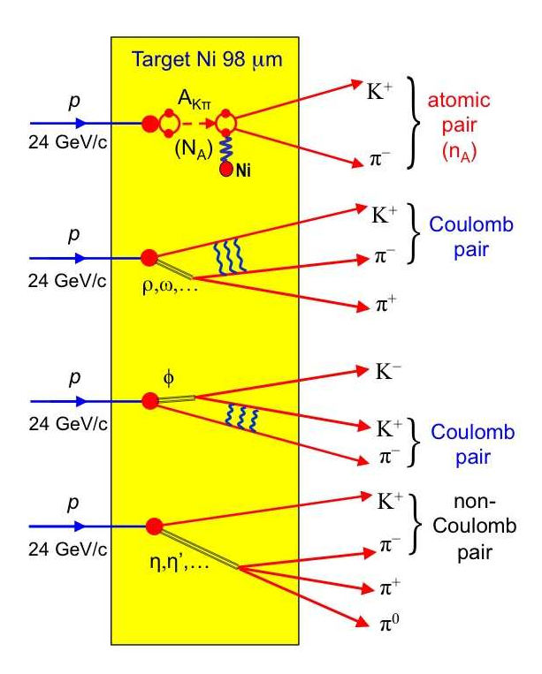
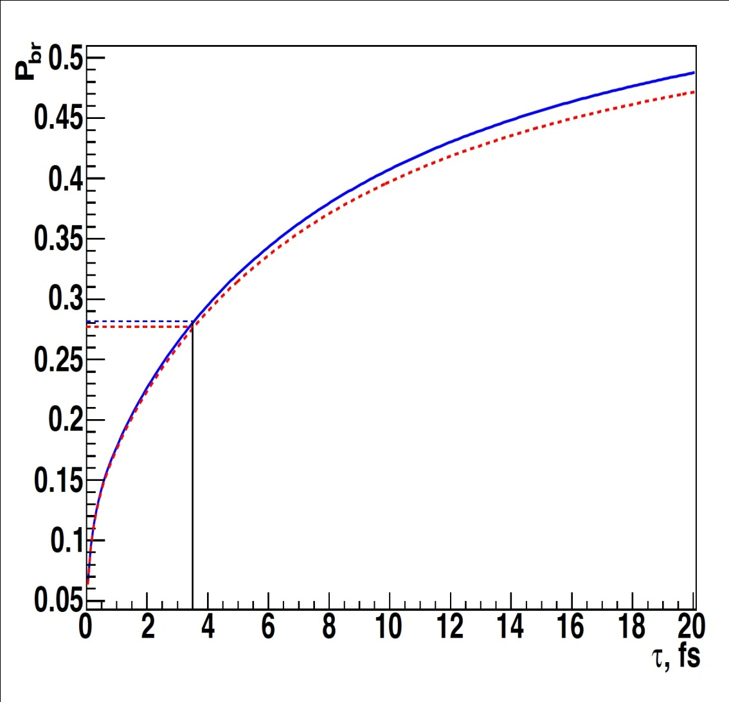
πK atom lifetime and πK scattering length
= R |a_{1/2}-a_{3/2}|²
1/τ
τ_{th} =(3.5±0.4)×10⁻¹⁵ s. The evaluation error for |a_{1/2}-a_{3/2}| from this relation is 1% .
20.09.16

Slide 6
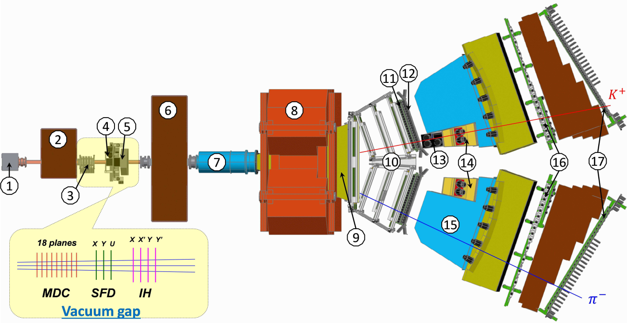
DIRAC setup & experimental and theoretical data
Experiment | Detected atomic pairs (n_{A}) | τ (10⁻¹⁵ s) | a₀⁻ = (a_{1/2}-a_{3/2})/3 | Average error
DIRAC | 349±61(stat)±9(syst) =349±62(tot) (5.6σ) | 5.5± | 0 .072± | 34%
5.0
2.8
0.031
0.020
Theory | Buttiker et al. EPJ (2004) | Sasaki et al. PRD (2014) | Fu PRD (2012) | Beane et al. PRD (2006) | Lang et al. PRD (2012) | Bijnens et al. JHEP (2004)
a₀⁻ | 0.090 ±0.005 | 0.081 ±0.013 | 0.0777 ±0.0013 | 0.077 | “0.1 – 0.2” | 0.089
Method | Roy-Steiner equation | Lattice calculation | Lattice calculation | Lattice calculation | Lattice calculation | ChPT, 2-loop
20.09.16

Slide 7
Dimeson atom production at proton momentum 450 GeV/c
The dimeson atom production in p-nucleus interaction can be enlarged by more than an order of magnitude, if the incident p momentum is increased from 24 to 450 GeV/c.
With the SPS operation conditions at 450 GeV/c (θ_{lab} = 4°) the yield, i.e. the number of produced dimeson atoms A_{2π} , A_{π+K}- and A_{π}-_{K+} per time unit, will be 12±2, 53±11 and 24±5 times higher than in the previous DIRAC experiment.
Ref.: Gorchakov and Nemenov, J. Phys. G: Nucl. Part. (2016).
This significant increase in the A_{π+K}- and A_{π}-_{K+} production allows
to measure with a new DIRAC setup in a comparable running time |a_{1/2}-a_{3/2}| with a precision better than 5% and
to check with the same accuracy predictions of the total L(3) QCD Lagrangian based on the chiral SU(3)_{L}*SU(3)_{R} symmetry breaking.
20.09.16

Slide 8
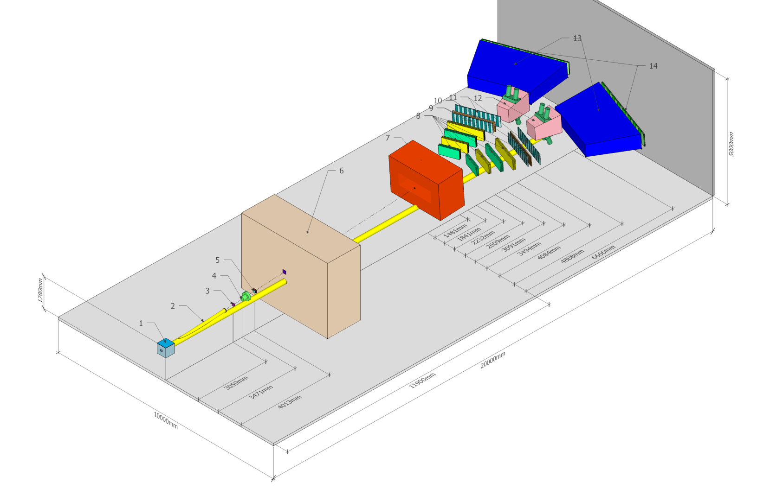
Possible scheme of the setup and detectors
20.09.16

Slide 9
SPS beam time for πK scattering length measurement
The data at p_{p} = 24GeV/c and 450GeV/c were simulated, processed and analysed (V. Yazkov, DIRAC note 2016-05).
Experimental conditions on SPS with Ni target
Thin Ni target, nuclear efficiency ~ 6x10⁻⁴.
The proton beam can be used for other experiments.
Proton beam intensity: 3x10¹¹ protons/s
(DIRAC worked at 2.7x10¹¹ protons/s)
Number of spills: 4.5x10⁵ with spill duration 4.5 s
Data taking: 3000 spills per 24 hours.
Running time: 5 months
The expected number of πK atomic pairs: n_{A}=13000
(previous DIRAC experiment: n_{A}=349±62)
Statistical precision at these conditions for πK scattering length will be: ~5% .
Expected systematic error will be at the level of 2% .
Expected number of π⁺π⁻ atomic pairs: n_{A}=400000
Statistical precision of the π⁺π⁻ scattering length will be: 0.7% .
Expected systematic error will be at the level of 2% .
20.09.16

Slide 10
L(2) and Chiral Lagrangian prediction check with short-lived π⁺π⁻ atoms
The QCD Lagrangian L(2) and Chiral Lagrangian describe processes with u and d quarks, using SU(2)_{L}*SU(2)_{R} chiral symmetry breaking.
For the ChPT prediction of a₀ and a₂ , the lifetime of the π⁺π⁻ atom in the ground state, given by 1/τ = R|a₀-a₂|², is: τ_{th}=(2.9±0.1)*10⁻¹⁵ s
The evaluation error for |a₀-a₂| from this relation is 0.6% .
These Lagrangians predict the S-wave π⁺π⁻ scattering lengths a₀ and a₂ .
20.09.16

Slide 11
L(2) and Chiral Lagrangian prediction check with short-lived π⁺π⁻ atoms
Precision
ChPT | a₀ & a₂ a₀ - a₂ | 2.3% 1.5% | Colangelo et al., NP (2001)
Lattice calculation | a₀ a₂ | 4-10% ~ 1% | Sasaki et al., PRD (2014); Fu, PRD (2013); Lang et al., PRD (2012); Feng et al., PLB (2010); Yagy at al., arXiv:1108.2970; Beane et al., PRD (2008).
Experiment | a₀ - a₂ | ~ 4% | Bateley at al., EPJ (2009); Bateley at al., EPJ (2010); Adeva et al., PLB (2011).
 | a₀ a₂ | ~ 6% ~ 22% | Bateley at al., EPJ (2009); Bateley at al., EPJ (2010).
SPS | a₀-a₂ | ~ 2% | DIRAC estimation
20.09.16

Slide 12
QCD and Chiral Lagrangian predictions check with long-lived π⁺π⁻ atoms
The DIRAC collaboration [Adeva et al., PLB (2015)] observed 436±61 pion pairs from the long-lived
(τ ≥ 10⁻¹¹ s) π⁺π⁻ atom breakup (ionisation).
The study of these excited atoms allows to measure the Lamb shift, depending on another ππ scattering length combination: 2a₀+a₂
The SPS proton beam and new experimental arrangements make this measurement possible!
20.09.16

Slide 13
Thank you
20.09.16

Slide 14
Additional slides
Simulation of K⁺ and K– production cross section
M. Gugiu

Slide 15
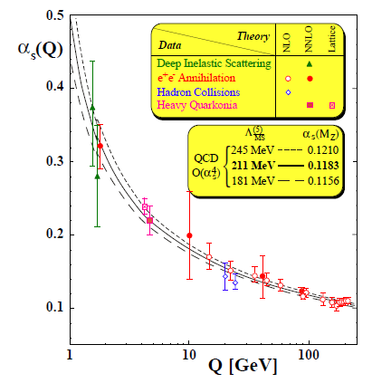
DIRAC search for strong interaction dynamics - Quark confinement
S. Bethke, J.Phys.G26:R27, 2000
α_{S} large – small Q²
“quark confinement”
perturbative QCD not suitable.
Lattice QCD solve field equations
on a space-time lattice by MC.
α_{S} small – large Q²
“asymptotic freedom”
and perturbative QCD
π⁺
π⁺
π⁰
π⁺
u
d
u
d
u
d
u
u
u
d
Small Δx distance;
quark degrees
of freedom
Energy fed
into the system
The released energy gets
out a quark-antiquark pair
from the Vacuum
Large Δx distance;
pion degrees of freedom
string breaks generate qq
pair to reduce field energy
“quark confinement”
DIRAC
“asymptotic freedom”
20.09.16
Mircea Pentia IFIN-HH Bucharest

Slide 16
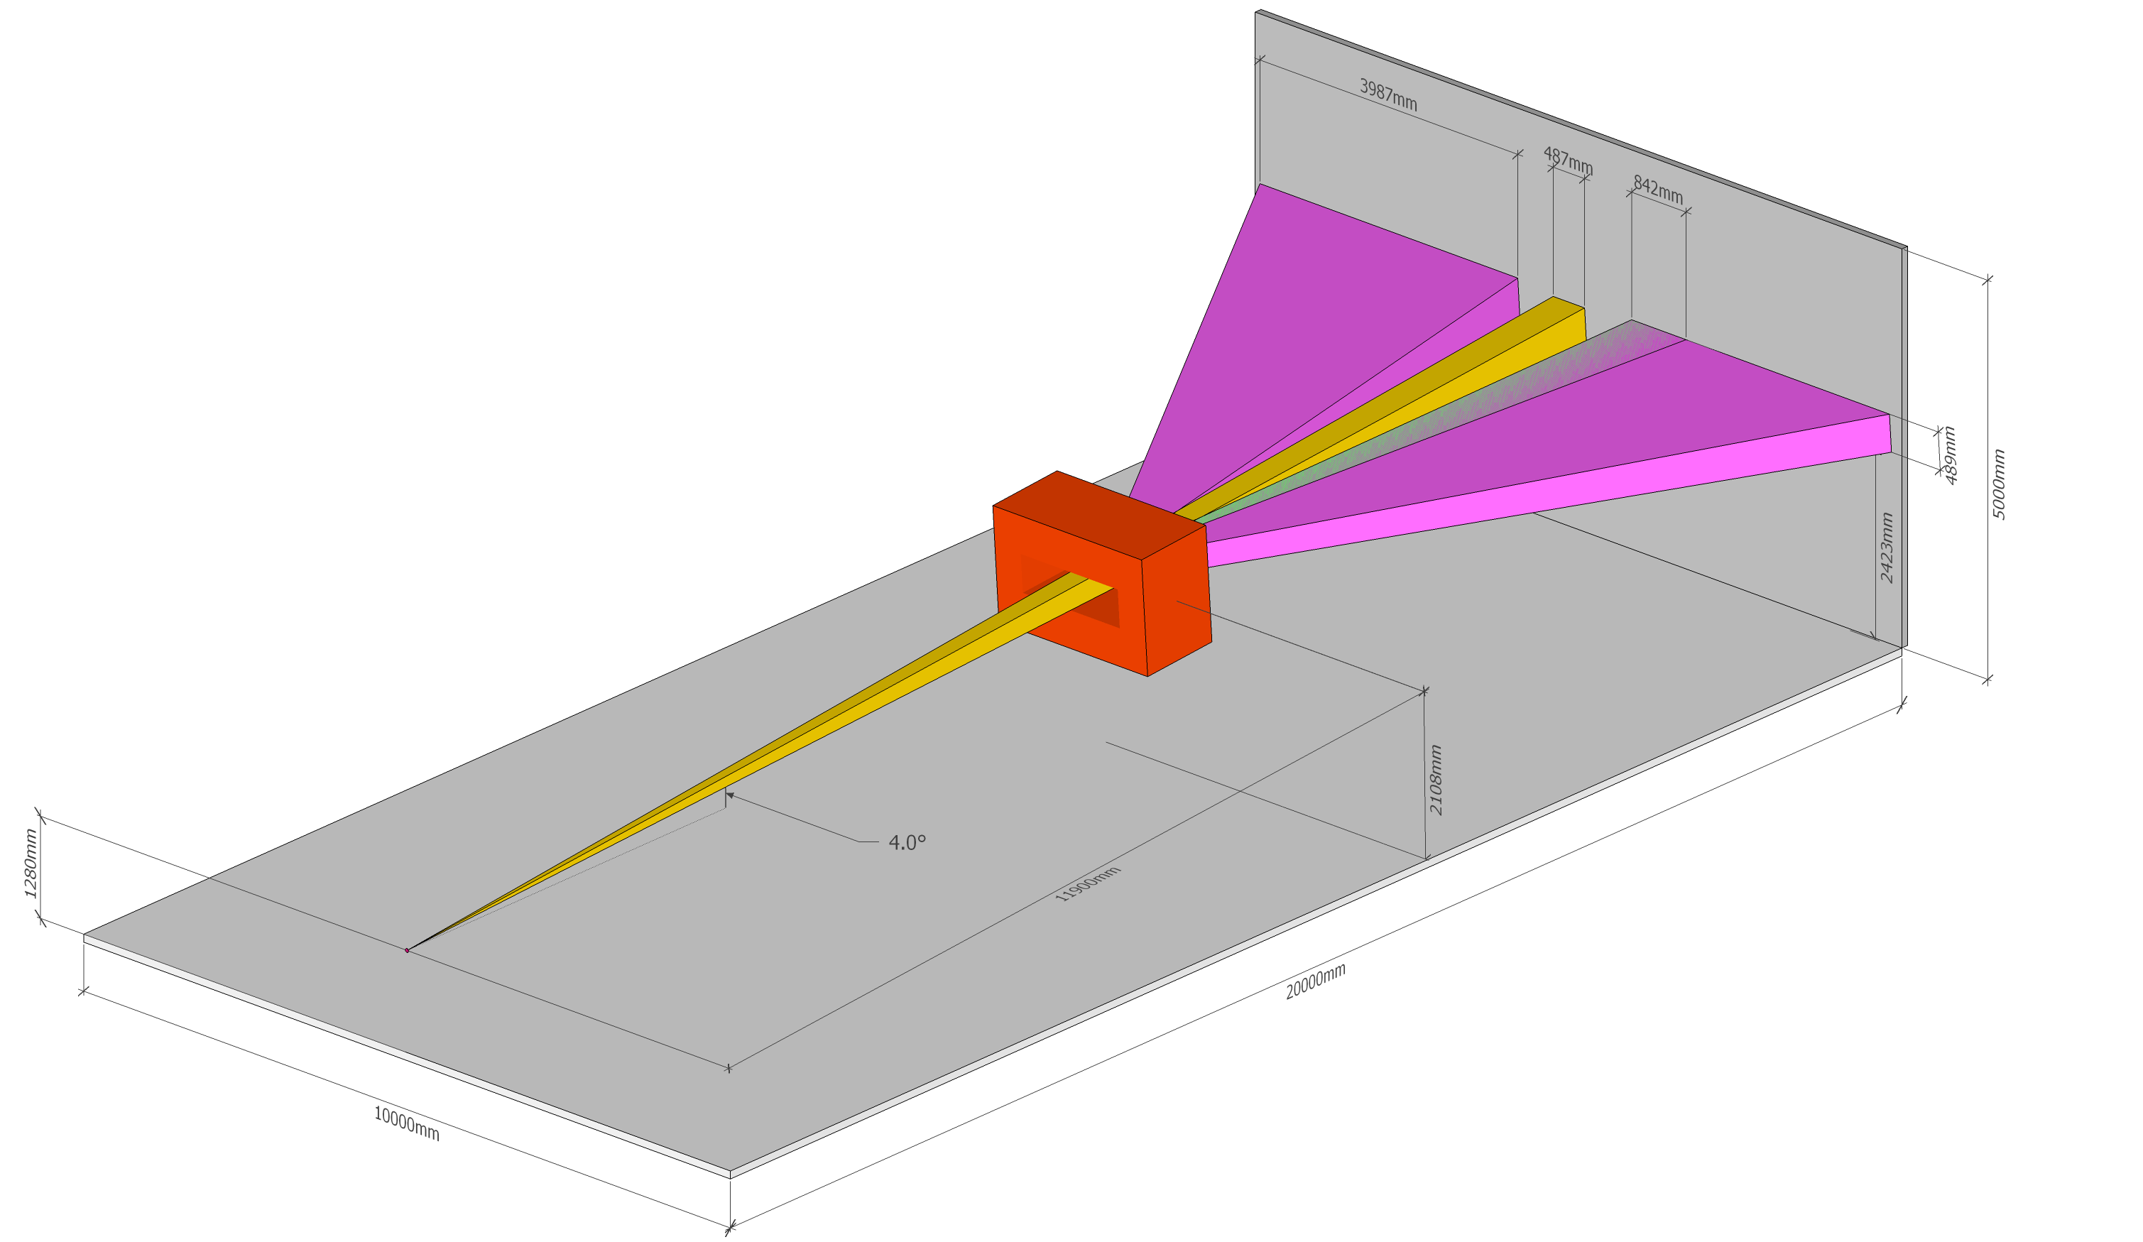
The possible scheme of the setup and detectors
20.09.16

Slide 17
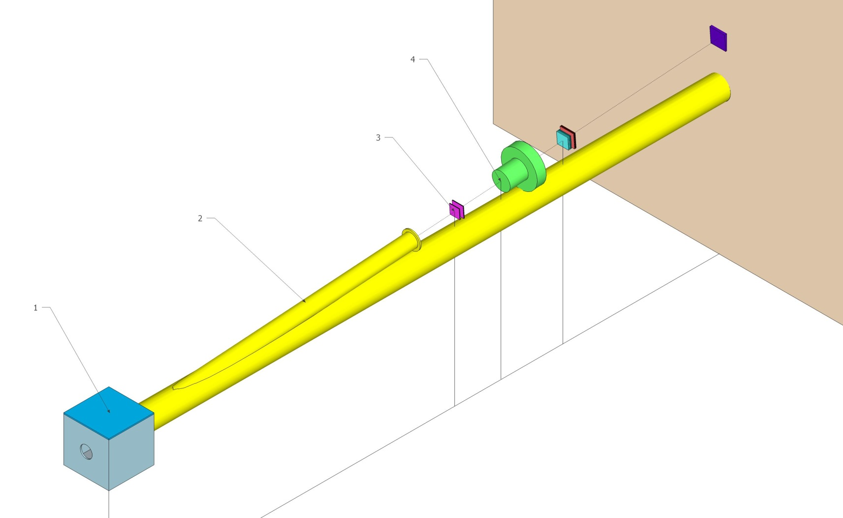
The possible scheme of the detectors before the magnet
20.09.16

